Slide 1
Target-oriented Semi-supervised Domain Adaptation for WiFi-based HAR
Zhipeng Zhouª, Feng Wang^{b}, Jihong Yu^{c}, Ju Ren^{d}, Zhi Wang^{e}, Wei Gong*ª
ªUniversity of Science and Technology of China, ^{b}University of Mississippi
^{c}Beijing Institute of Technology, ^{d}Tsinghua University, ^{e}Xi'an Jiaotong University
May 3, Online

Slide 2
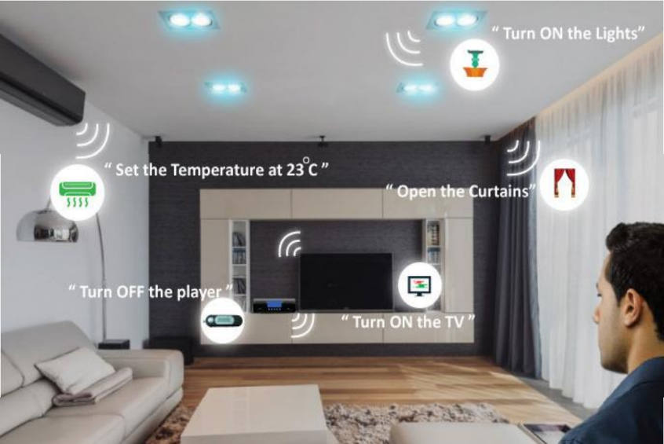
Introduction
Smart Home
Virtual Reality
Security Surveillance
WiFi-based sensing technologies have a promising vision

Slide 3
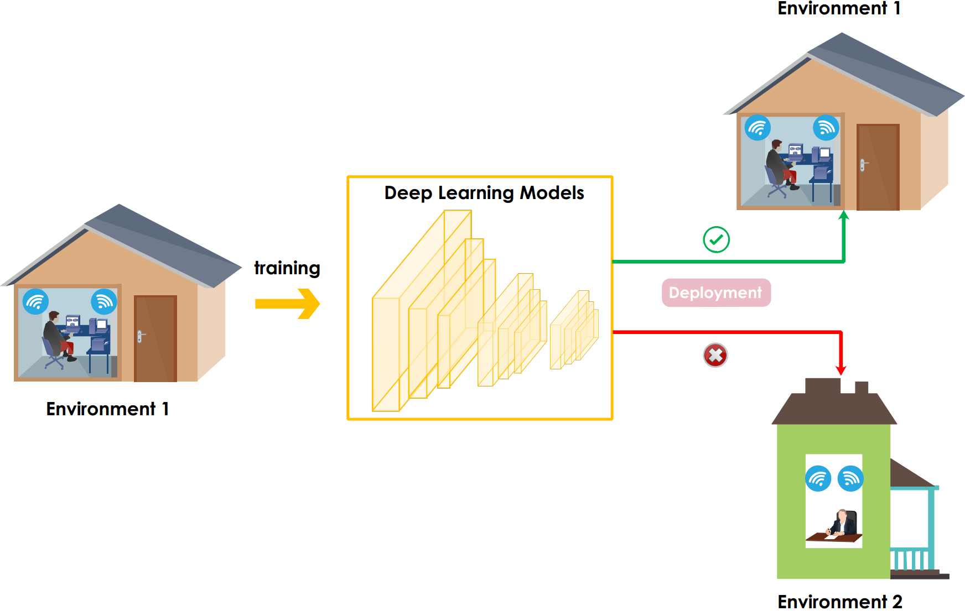
Motivation
Domain Shift
WiFi-based sensing is easily encountered by domain shift problem

Slide 4
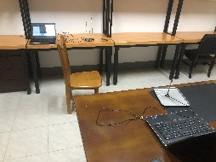
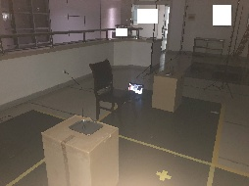
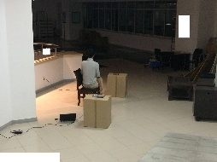
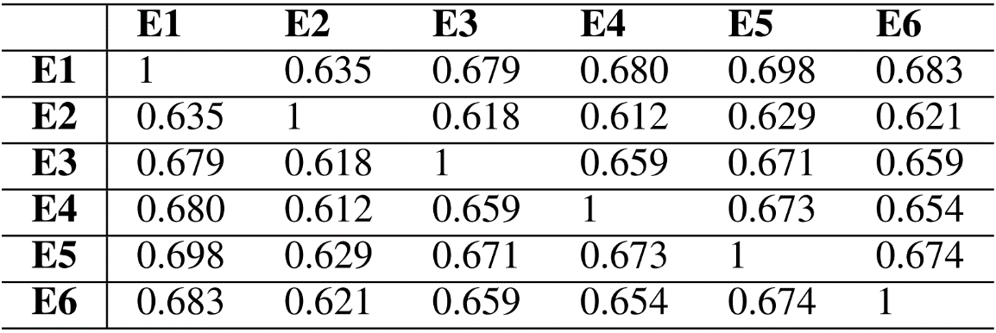
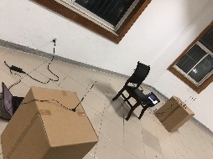
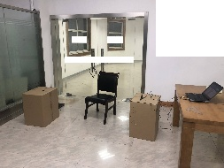
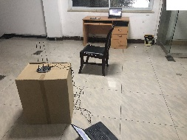
Motivation
What is the domain shift like among environments?
Domain Similarities
E1
E2
E3
E4
E5
E6
CSI is polluted by domain-specific features

Slide 5
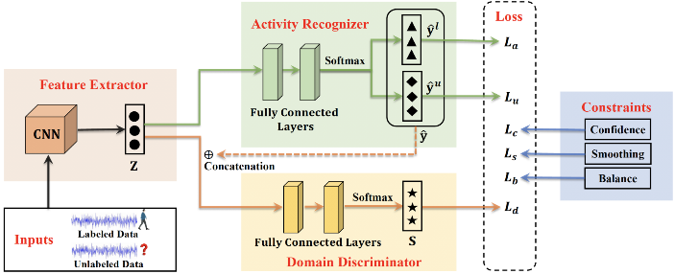
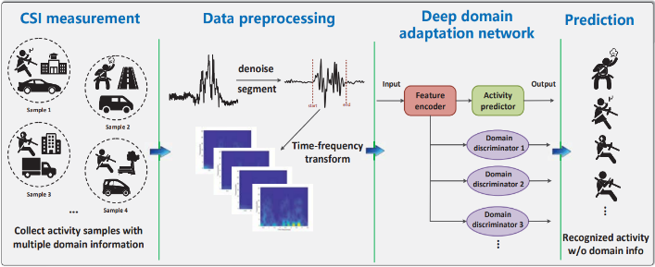
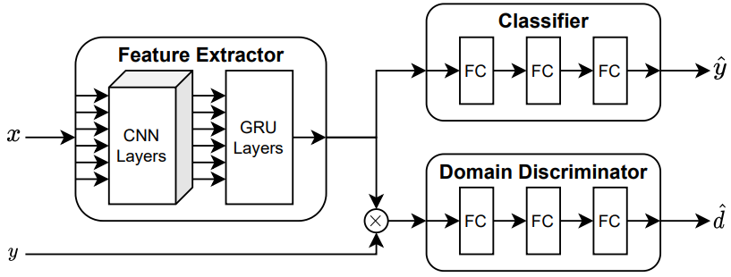
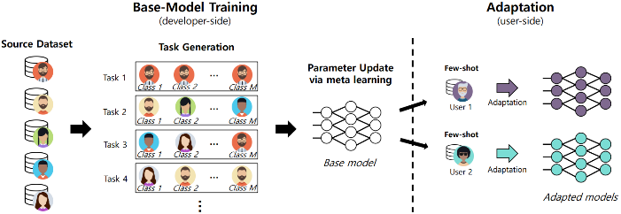
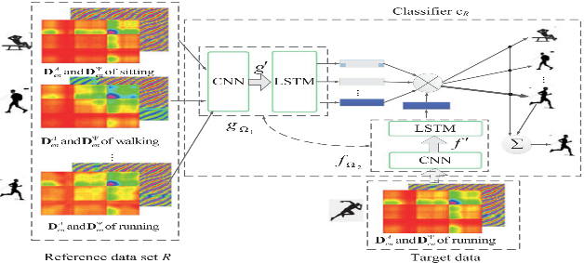
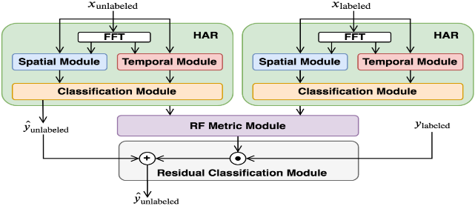
Motivation
UDA-HAR Models
Many solutions have been proposed to tackle this challenge
Few-shot Models
EI (MobiCom’18)
WiCAR (IWQoS’19)
WiHARAN (ICASSP’21)
MetaSense (SenSys’19)
MatNet (TMC’20)
RFNet (SenSys’21)

Slide 6
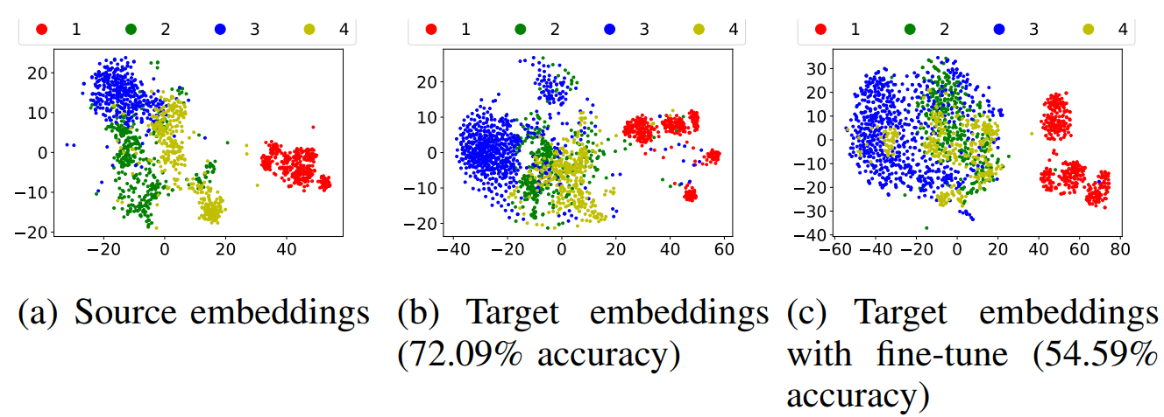
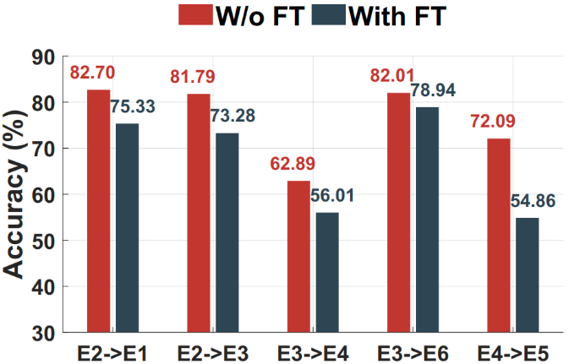
Motivation
Limitation of UDA-HAR Models
Take EI(MobiCom’18) as the baseline to conduct verification experiments.
Firstly, we visualize the source embeddings and target embeddings in (a) and (b).
Then, we finetune the model with target one-shot sample and visualize target embeddings in (c).
UDA-HAR model cannot benefit from target one-shot sample

Slide 7
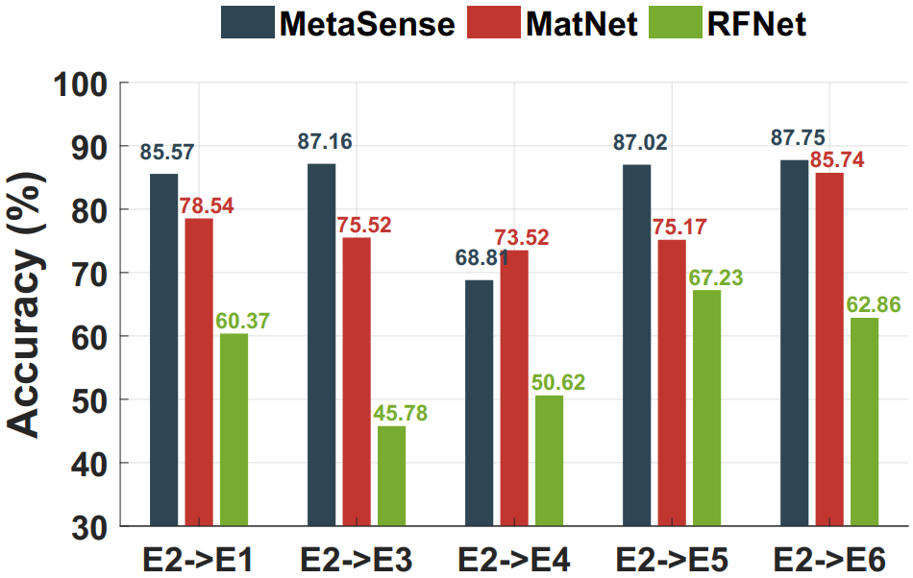
Motivation
Limitation of Few-shot Models
Take MetaSense(SenSys’19), MatNet(TMC’20), and RFNet(SenSys’21) as the baselines to conduct verification experiments.
Current few-shot learners are based on meta-learning, which is target-agnostic.
The performance of few-shot learners fluctuates greatly among different target domains

Slide 8
Motivation
We strive to develop a new semi-supervised method that can fully leverage the target samples.

Slide 9
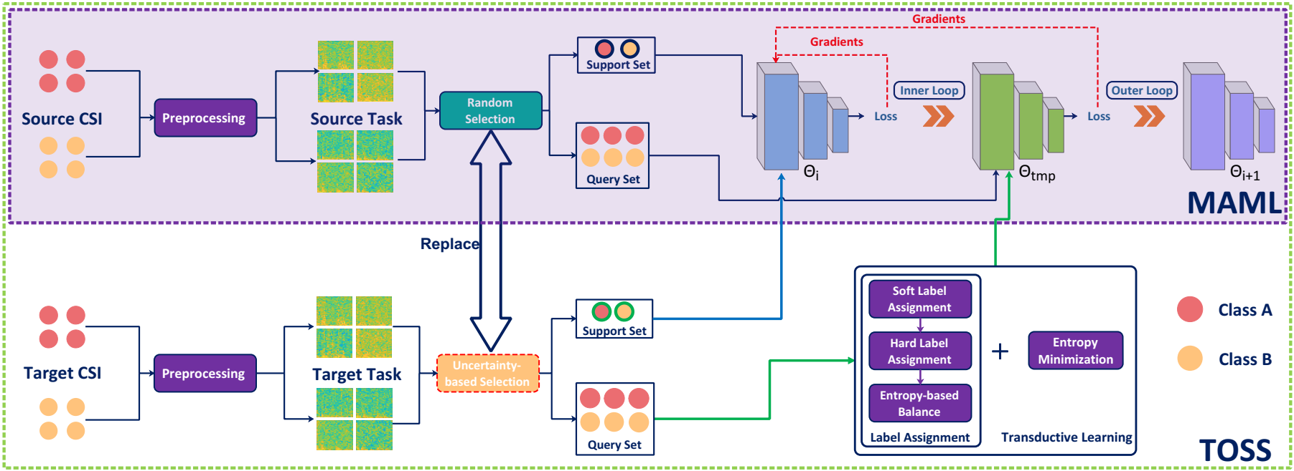
System Overview
Take MAML as the base model
We also engage the target samples in meta training

Slide 10
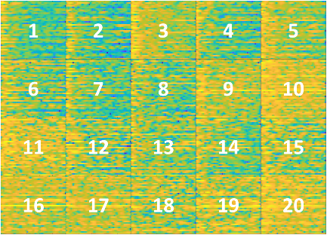
System
Pre-processing
spectrograms
(Singular vector)
Raw CSI Segment
Activity-related CSI
$$\left[\begin{matrix}\begin{matrix}r{sv}_{1}, & {rsv}_{2},\end{matrix} & \begin{matrix}…, & {rsv}_{s}\end{matrix}\end{matrix}\right]$$
STFT
PCA
(Singular value)
Low-pass Filter
$${\left[\begin{matrix}\begin{matrix}{sv}_{1}, & {sv}_{2},\end{matrix} & \begin{matrix}…, & {sv}_{s}\end{matrix}\end{matrix}\right] }^{T}$$
Case 1:
Case 2:

Slide 11
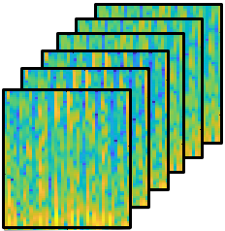
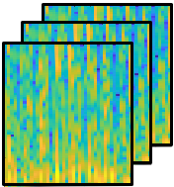
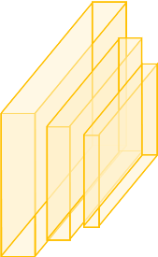
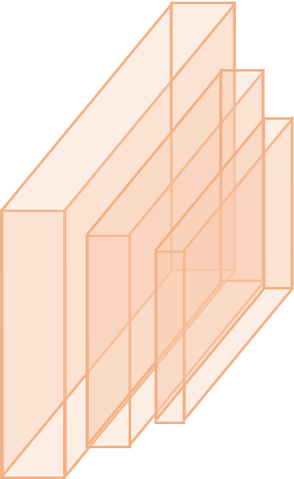
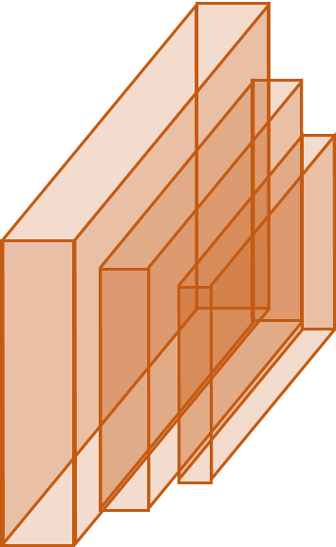
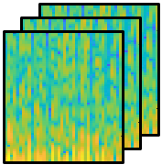
System
Meta Learning with Source Hybrid Tasks
homogeneous task
Support Set
heterogeneous task
Query Set
Inner Loop
Outer Loop

Slide 12
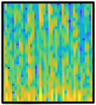
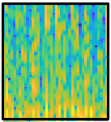
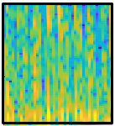
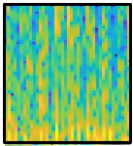
System
Target-oriented Domain Adaptation
How to generate target tasks?
Labeled Samples
Target Tasks
Target Domain
Unlabeled Sample Pool
Repeat sampling
How to get the label of the query set?

Slide 13
System
Target-oriented Domain Adaptation
Label Assignment for Query Set of Target Task
How to balance soft label and hard label
Query Set
Support Set
Intuitively, entropy represents the uncertainty of the model's prediction output for the sample, so the larger the information entropy, the more uncertain the model is about the sample, and vice versa.
MAML
When the model is uncertain about the sample prediction, we tend to choose soft labels; otherwise, we choose hard labels.
Finetune
MAML
$$BF= λ∗ e^{−Entropy}$$
$$Entropy=−o_{t}\log\left(o_{t}\right)−\left(1−o_{t}\right)log⁡(1−o_{t})$$
Soft Label
Hard Label

Slide 14
System
Target-oriented Domain Adaptation
Bi-level Optimization for Target Task
Outer Loop:
$$Loss=Loss_{KL}\left(f_{θ}\left(x_{t}\right),o_{t}\right)+BF∗Loss_{CE}\left(f_{θ}\left(x_{t}\right),h_{t}\right)+ γ∗Entropy_{reg}$$
Inner Loop:
$$Loss_{CE}=−y_{t}\log\left(f_{θ}\left(x_{t}\right)\right)−\left(1−y_{t}\right)log⁡(1−f_{θ}(x_{t}))$$
$$Loss_{KL}=o_{t}log⁡(\frac{o_{t}}{softmax(f_{θ}(x_{t}))})$$
$$Entropy_{reg}=−f_{θ}\left(x_{t}\right)log\left(f_{θ}\left(x_{t}\right)\right)−\left(1−f_{θ}\left(x_{t}\right)\right)log(1−f_{θ}(x_{t}))$$

Slide 15
System
Uncertainty-based Division
Mainstream meta learning methods adopt random strategy to divide tasks into support sets and query sets.

Slide 16
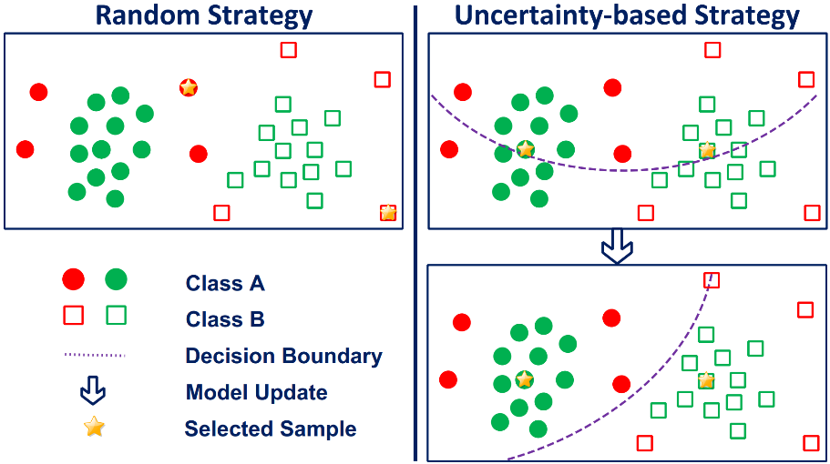
System
Uncertainty-based Division
A glance at MAML from a theoretical view
$$g_{MAML}= \frac{∂ℒ_{1}(θ_{tmp})}{∂θ_{i}}= \frac{∂ℒ_{1}(θ_{tmp})}{∂θ_{tmp}}∙\frac{∂θ_{tmp}}{∂θ_{i}}$$
$$=\left(I − αℒ_{0}^{′′}\left(θ_{i}\right)\right)\left(ℒ_{1}^{′}\left(θ_{i}\right)−αℒ_{1}^{′′}\left(θ_{i}\right)ℒ_{0}^{′}\left(θ_{i}\right)\right)+ 𝒪(o^{2})$$
$$≈ℒ_{1}^{′}\left(θ_{i}\right) −αℒ_{1}^{′′}\left(θ_{i}\right)ℒ_{0}^{′}\left(θ_{i}\right) −αℒ_{0}^{′′}\left(θ_{i}\right)ℒ_{1}^{′}\left(θ_{i}\right)$$
Constraint on bi-level optimization
$$𝔼\left(g_{MAML}\right)≈ 𝔼\left(ℒ_{1}^{′}\left(θ_{i}\right)\right)−𝔼(\frac{∂ℒ_{1}^{′}(θ_{i})∂ℒ_{0}^{′}(θ_{i})}{∂θ_{tmp}})$$
The division strategy of the source task is significant
Learning on a single task
[1] Nichol A, Schulman J. Reptile: a scalable metalearning algorithm. arXiv preprint arXiv:1803.02999, 2018, 2(3): 4.

Slide 17
System
Uncertainty-based Division
Uncertainty-based Division Strategy (Warmup)
Source Tasks
Model
$$Entropy_pre$$
update
Temp
Model
$$Entropy_diff$$
Our strategy selects support samples as expected
$$Entropy_pro$$
Division

Slide 18
Experiment
Experimental Environment
Activity Category
4 categories of activity
6 domains
9 volunteers
9156 samples
Comparison:
CNN, EI, MatNet, HDA, PACL, MAML, RFNet

Slide 19
Experiment
1 on 1 Domain Adaptation Results
TOSS achieves the SOTA performance

Slide 20
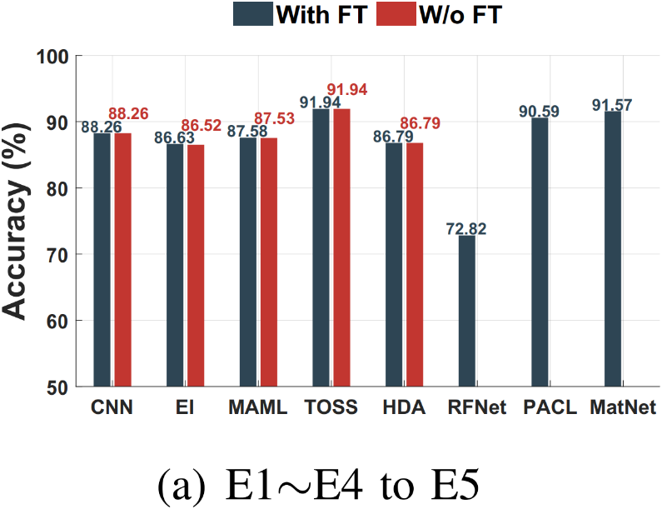
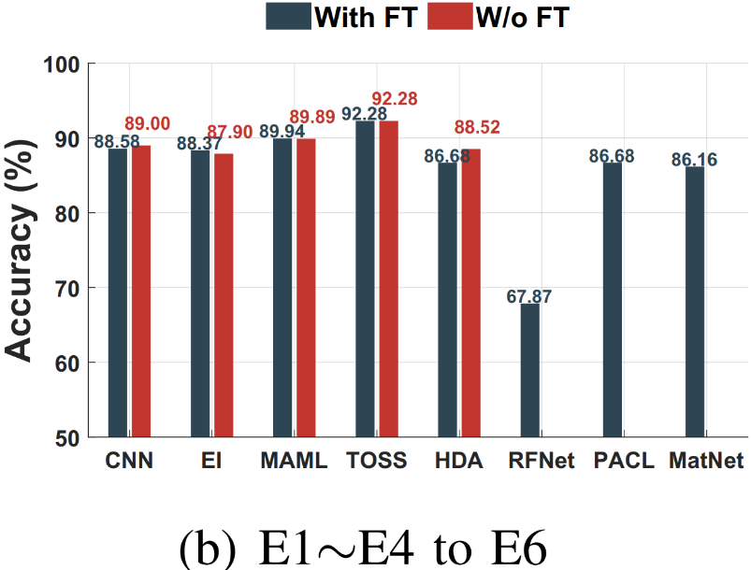
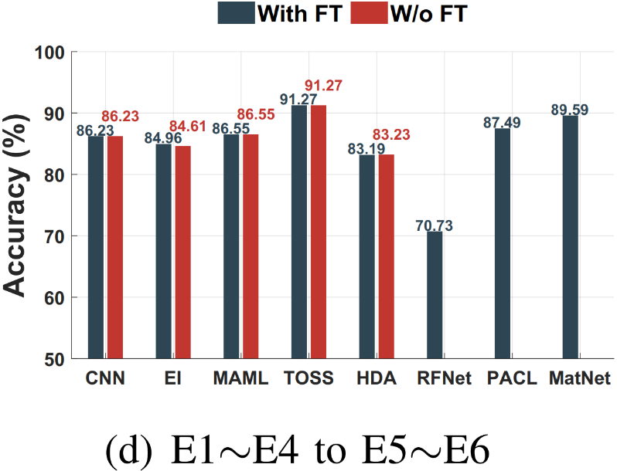
Experiment
Multi-source Domain Adaptation
TOSS achieves the SOTA performance

Slide 21
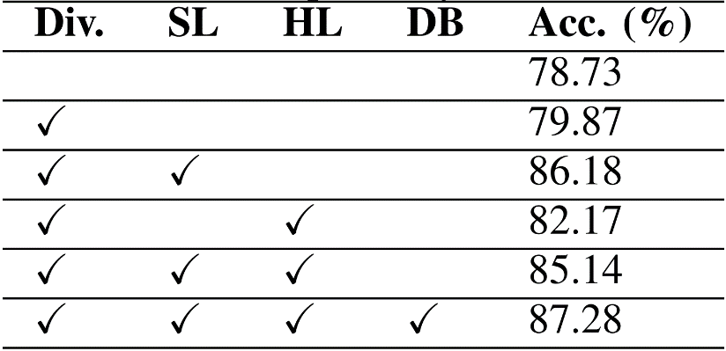
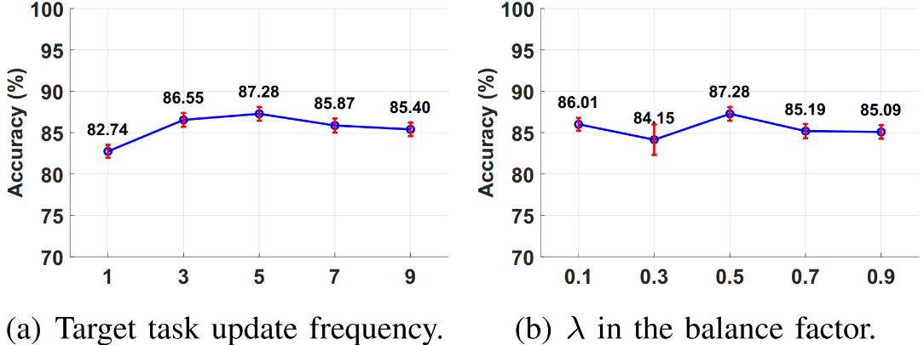
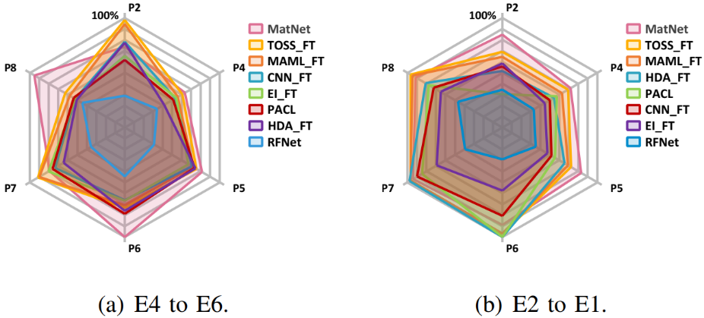
Experiment
Ablation Study
Analysis of hyper-parameters
Impacts of the preprocessing & task type
Robustness over different people
TOSS keeps consistent over all micro benchmarks

Slide 22
Contribution
To fully take advantage of the target domain samples, we develop a Target-Oriented Semi-Supervised (TOSS) domain adaptation method for WiFi-based HAR to jointly train with both labeled and unlabeled samples. To our best knowledge, TOSS is the first work striving to apply semi-supervised domain adaptation into WiFi-based HAR.
We carefully design a new dynamic pseudo label strategy to provide more target information. Besides, an uncertainty-based method is adopted to divide inner set so as to better benefit meta learner for fast adaptation on the source domain samples.
We implement TOSS with a typical meta learning model conducted extensive experiments to evaluate its performance, which shows that TOSS greatly outperforms state-of-the-art methods under comprehensive 1 on 1 and multi-source one-shot domain adaptation experiments across multiple real-world scenarios.

Slide 23
Thank You for Listening! Q&A Zhipeng Zhou University of Science and Technology of China zzp1994@mail.ustc.edu.cn

