Slide 1
Detecting temporal velocity changes using various methods
Haijiang Zhang
University of Science and Technology of China

Slide 2
Outline
Seismic tomography between different time periods
Repeating earthquakes
Coda wave interferometry
Ambient noise

Slide 3
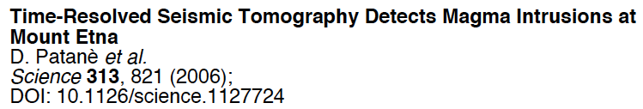
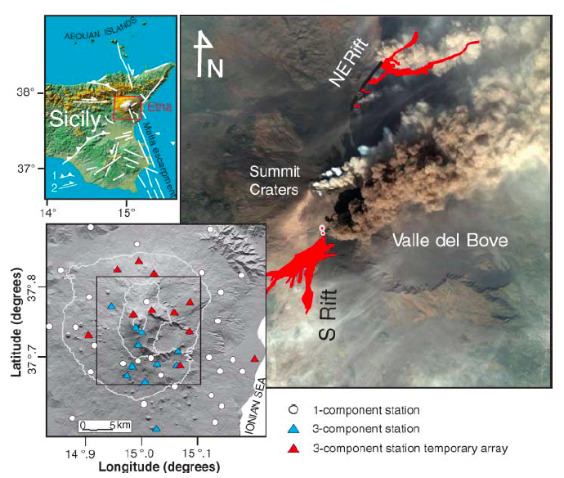

Slide 4
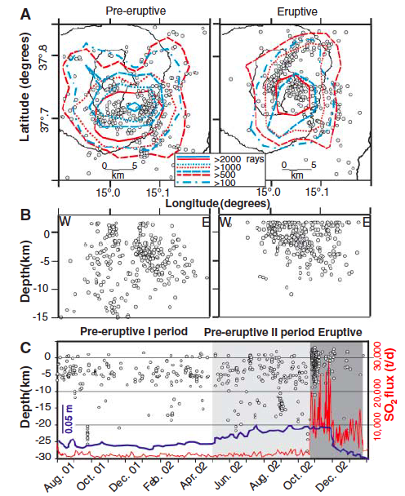

Slide 5
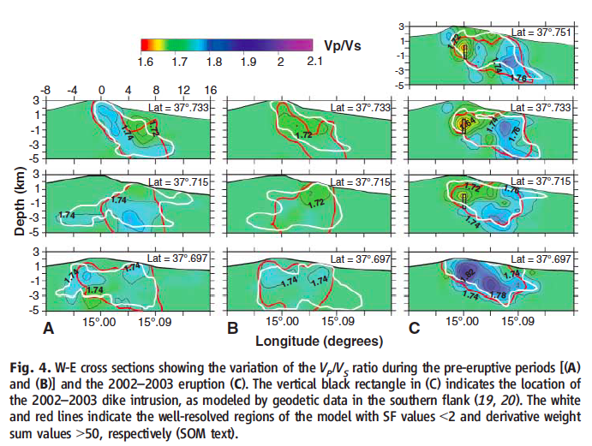

Slide 6
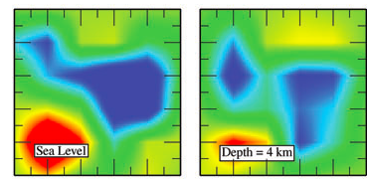
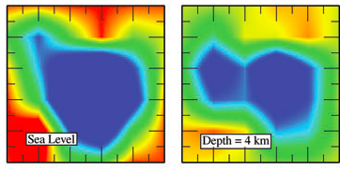

Different ray distribution on velocity models
Same theoretical models but with different ray distribution.
Separately Inverted models are different

Slide 7
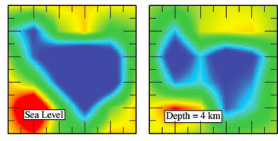
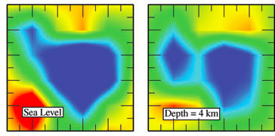
Different ray distribution on velocity models
Same theoretical models but with different ray distribution.
Jointly Inverted models are different

Slide 8
Regularization in time

Slide 9
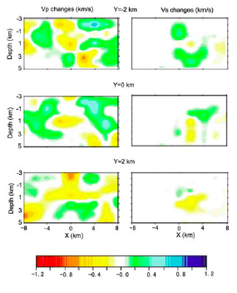

Slide 10
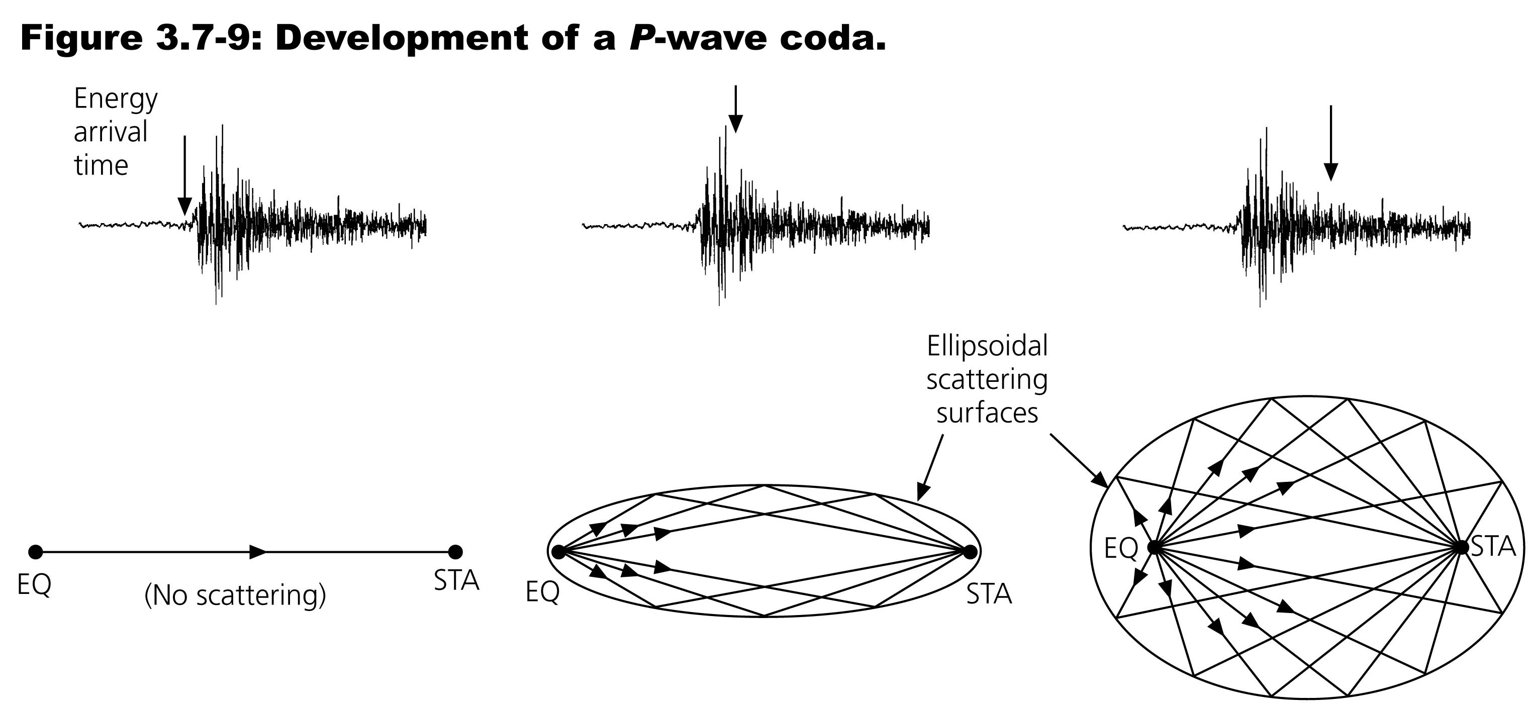
Scattering:
Scattering occurs when there are velocity heterogeneities in the medium with wavelengths on the order of λ of the wave.

Slide 11
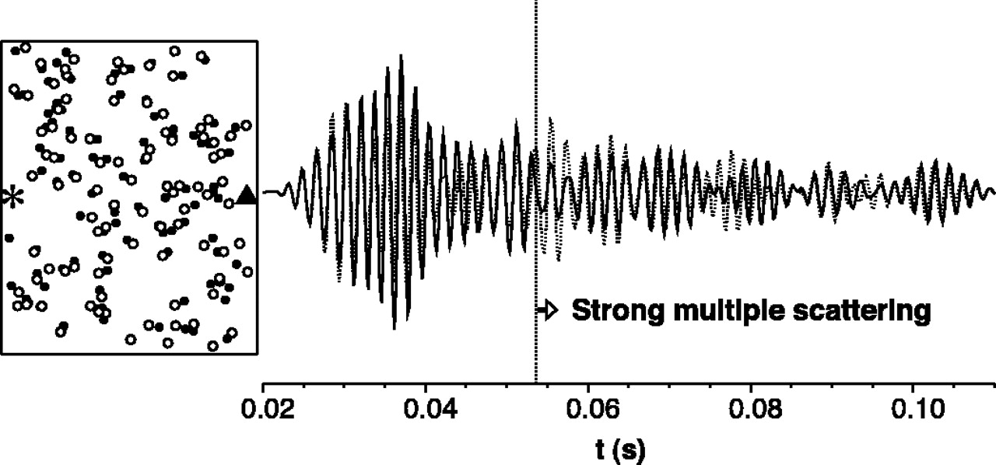

A simulation of 100 randomly-perturbed scatterers…
Snieder et al., Science, 2002
Moving the scatterers (here, 1/40th of the distance shown,
so the perturbation is visible) mostly changes the shapes
and amplitudes of the waveforms…
Notes:
Location of 100 scatterers before and after the perturbation (filled circles and open circles, respectively) with the source (asterisk) and receiver location (triangle). For the sake of clarity, the scatterer displacement is exaggerated by a factor 40. The scatterers are placed in an area of 40 m by 80 m. The waveforms recorded before and after the perturbation at the receiver are shown on the right with a solid and dashed line, respectively.

Slide 12
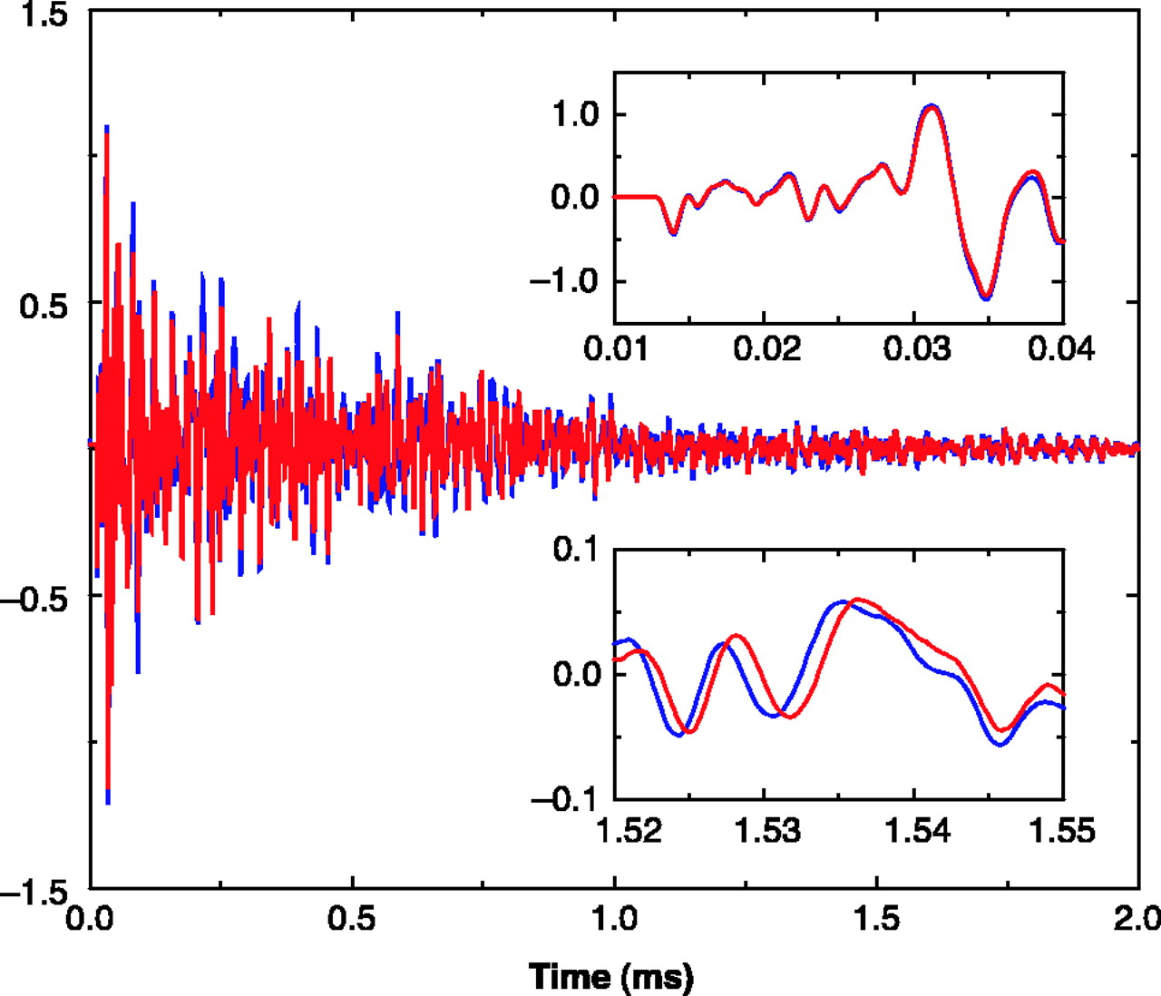
Waveforms
measured in a
granite sample
at temperatures
of 45°C (blue)
and 50°C (red).
Snieder et al., Science, 2002
Changing the matrix velocity, by contrast, introduces a shift
(delay or advance) that increases with coda time.
Notes:
Waveforms recorded in the granite sample for temperatures of 45° and 50°C, in blue and in red, respectively. The insets show details of the waveforms around the first arrival (top inset) and in the late coda (bottom inset).

Slide 13
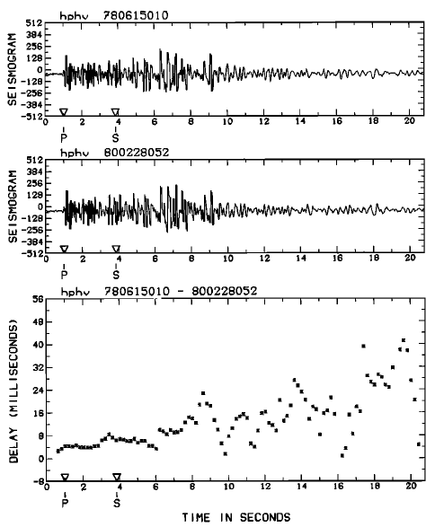
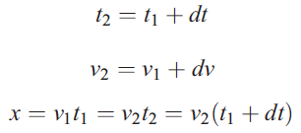




Slide 14
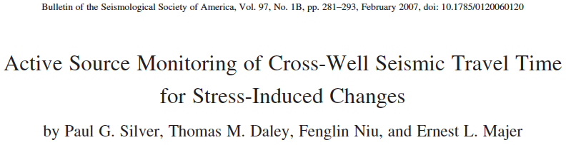

Slide 15
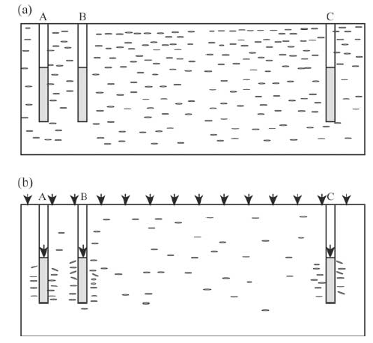
Near- and far-field effects of stress changes on cracks

Slide 16
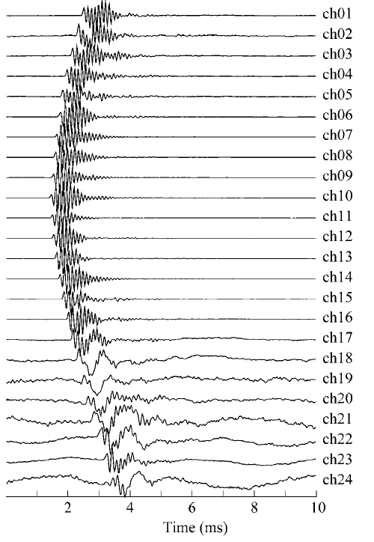
3-m separation between two wells

Slide 17
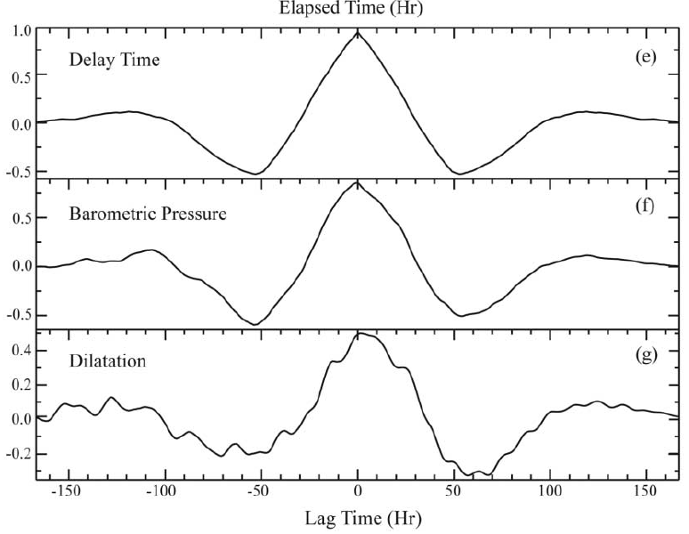

Slide 18
Near- and far-field effects of stress changes on cracks

Slide 19
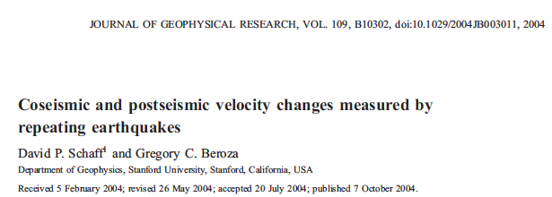

Slide 20
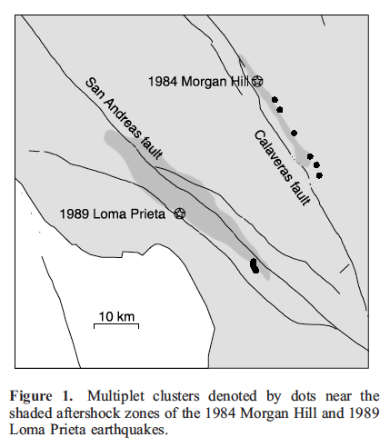

Slide 21
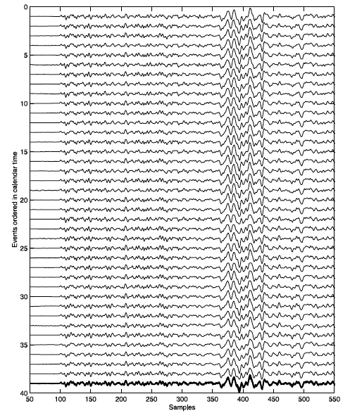
Repeating events
-with (almost) the same waveforms

Slide 22
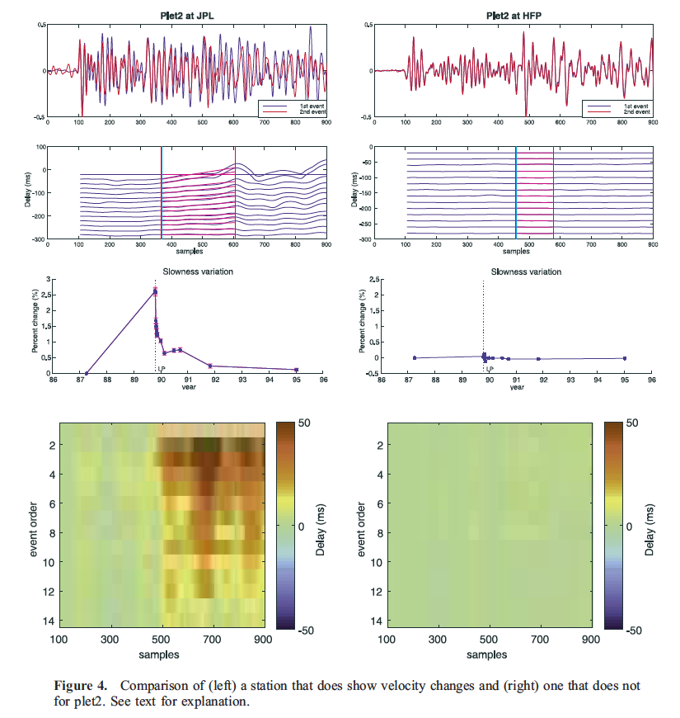

Slide 23
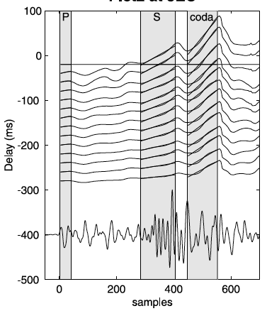
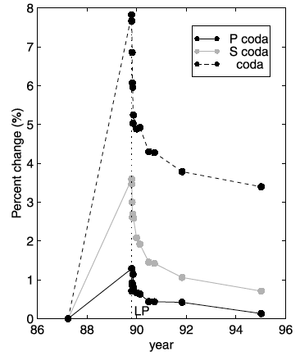

Slide 24
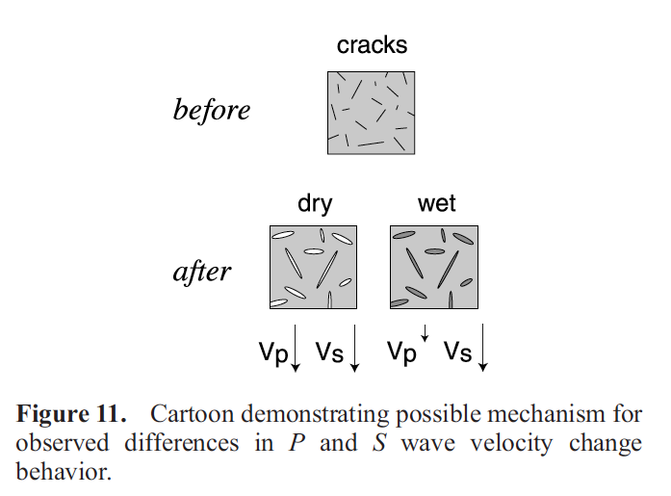

Slide 25
Seismic velocity imaging and monitoring of volcanic areas using ambient seismic noise
F. Brenguier (2008)

Slide 26
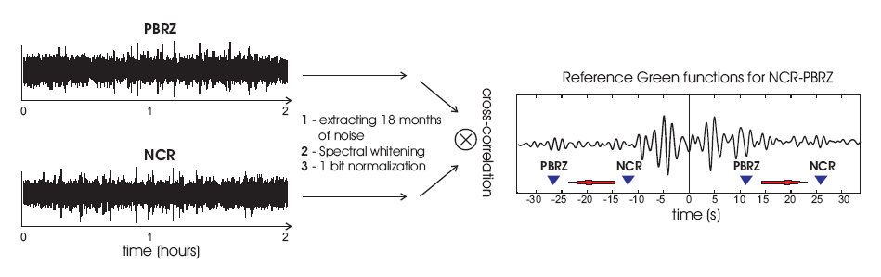
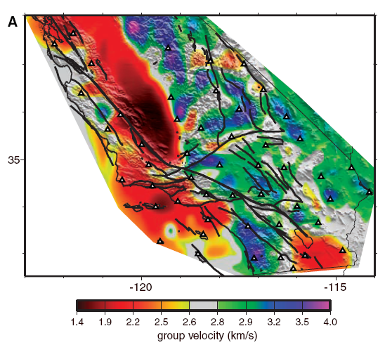
Virtual seismic source reconstruction
sensor
Noise sources
Shapiro et al. (2005)

Slide 27
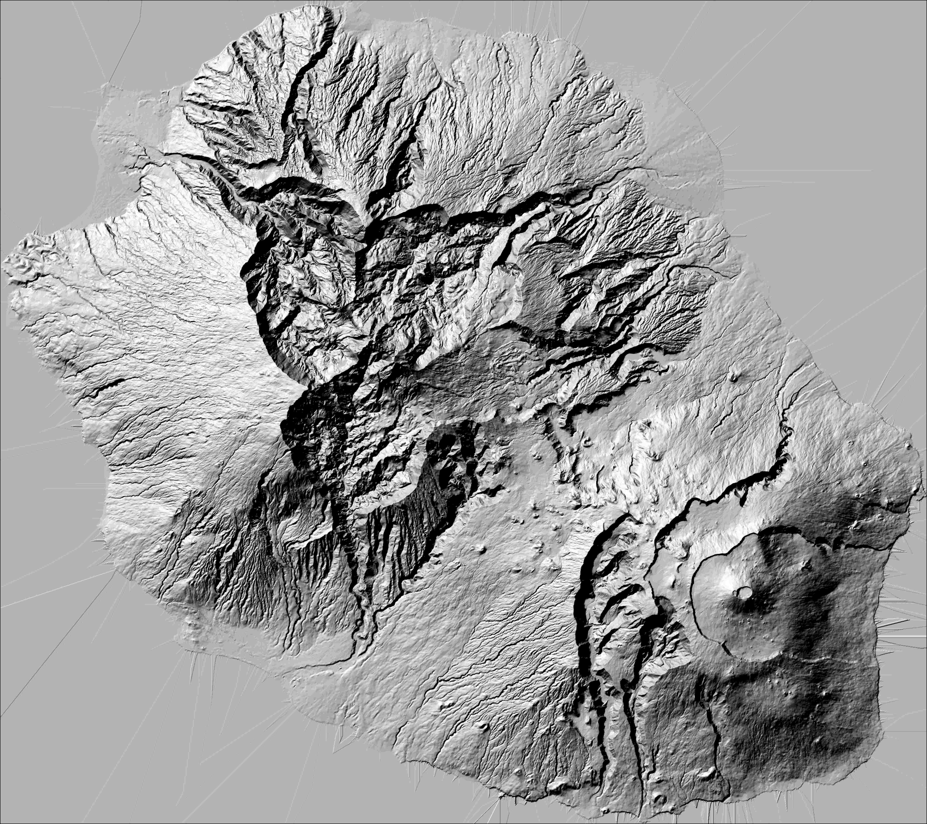
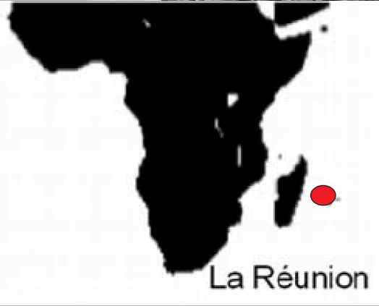
A case study: Piton de la Fournaise volcano, La Réunion island
S 21°
E 55°30

Slide 28
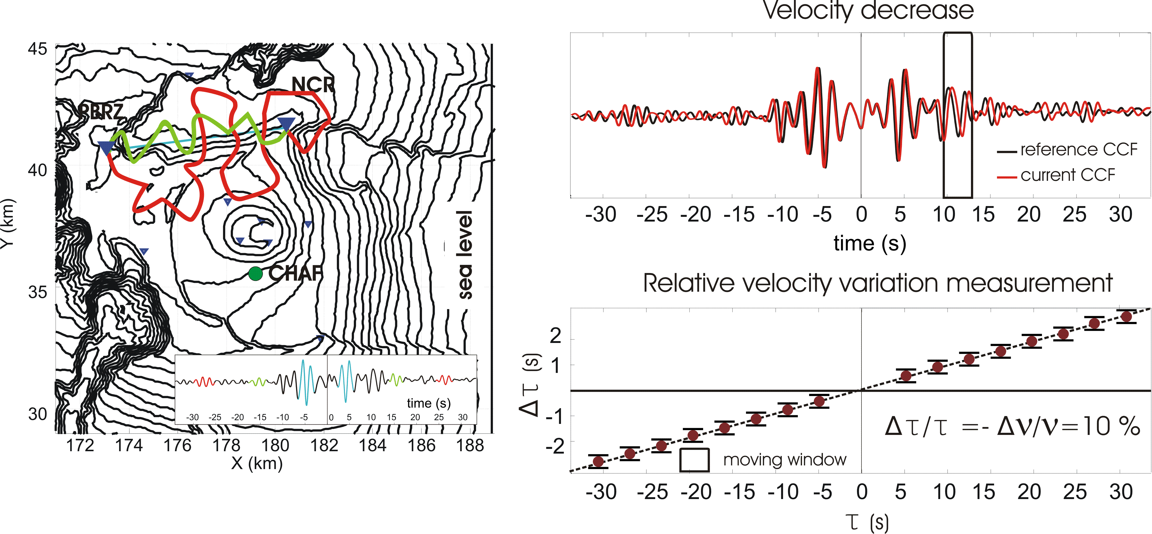
Temporal changes of seismic velocities using cross-correlations of seismic noise
Synthetic velocity decrease

Slide 29
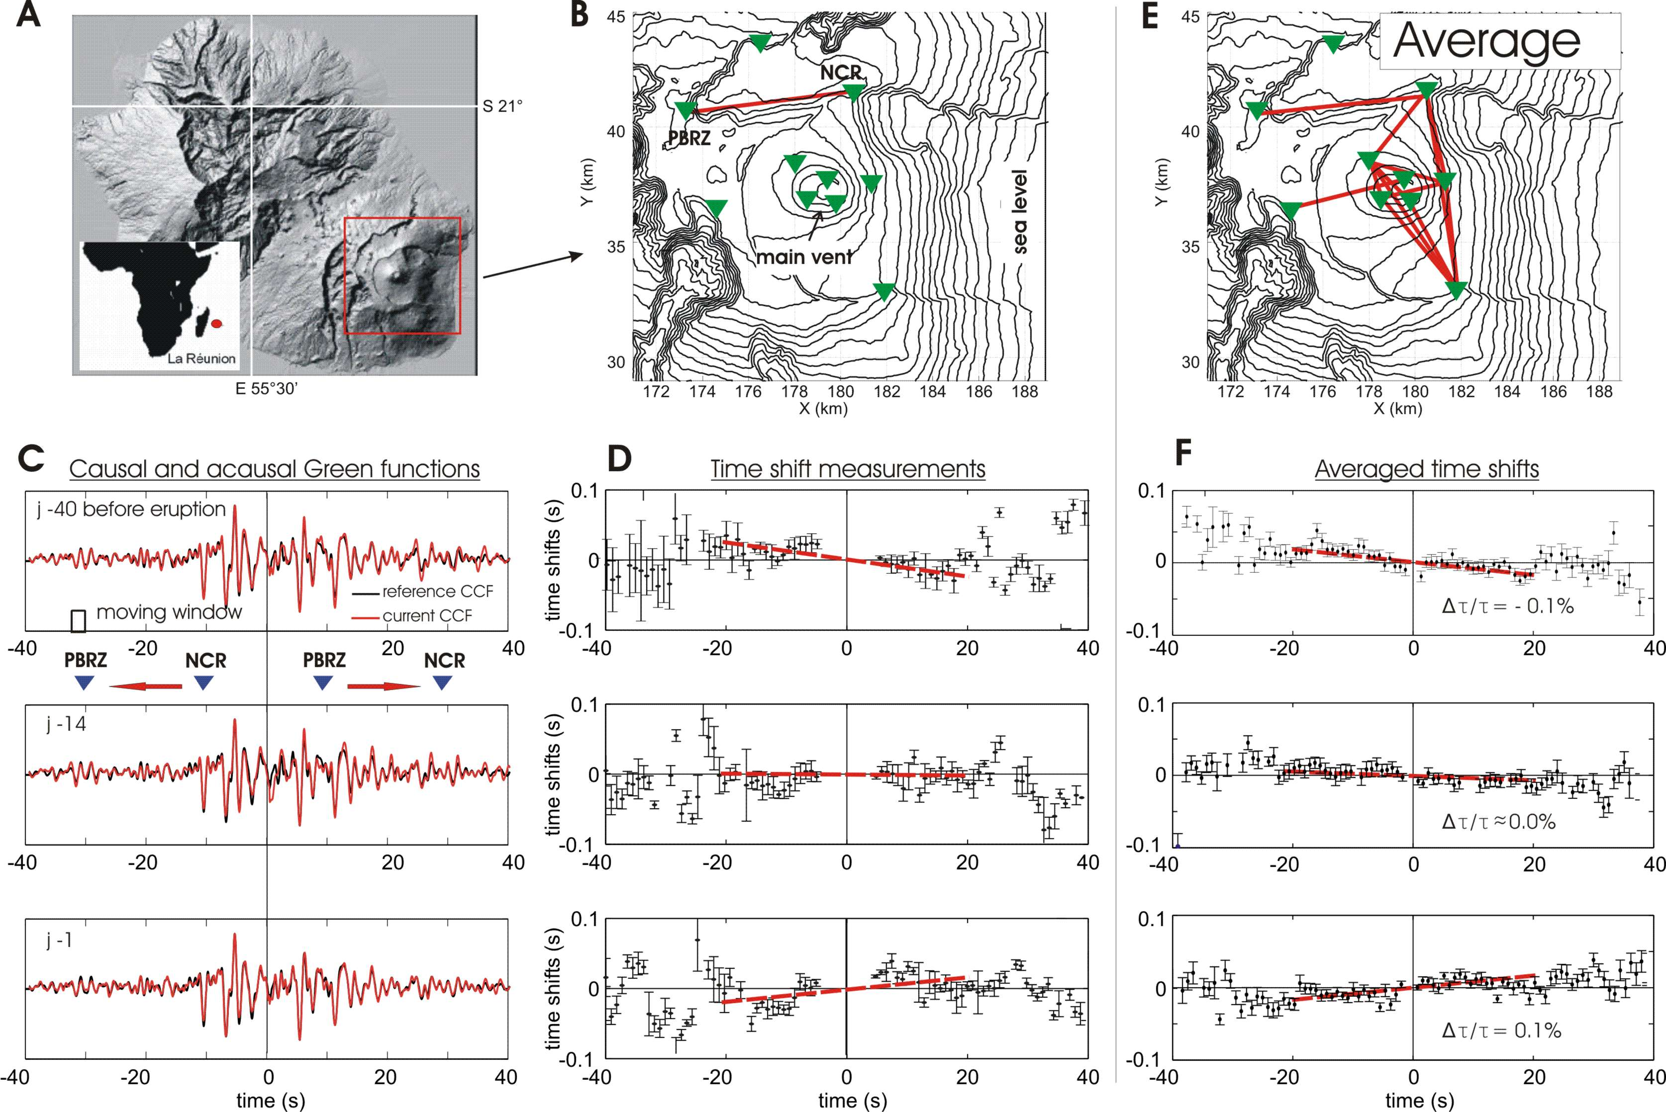
Velocity changes on Piton de la Fournaise

Slide 30
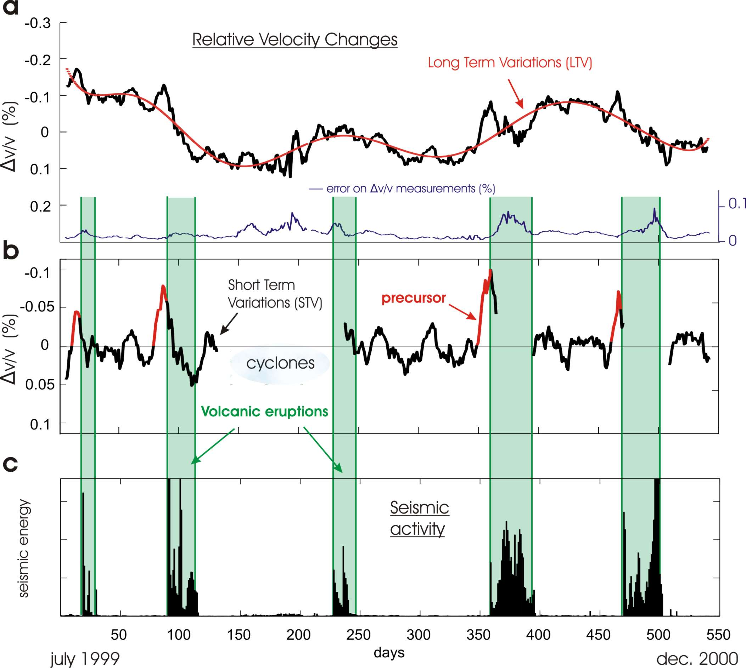
Velocity drops preceding eruptions
Brenguier et al., Nature Geoscience, 2008

Slide 31
Seismic velocity changes as a proxy for magma forcing
Seismic velocities are strongly sensitive to crack density.
O'Connell, R. J., and B. Budiansky (1974), Seismic Velocities in Dry and Saturated Cracked Solids, J. Geophys. Res., 79(35), 5412–5426

Slide 32
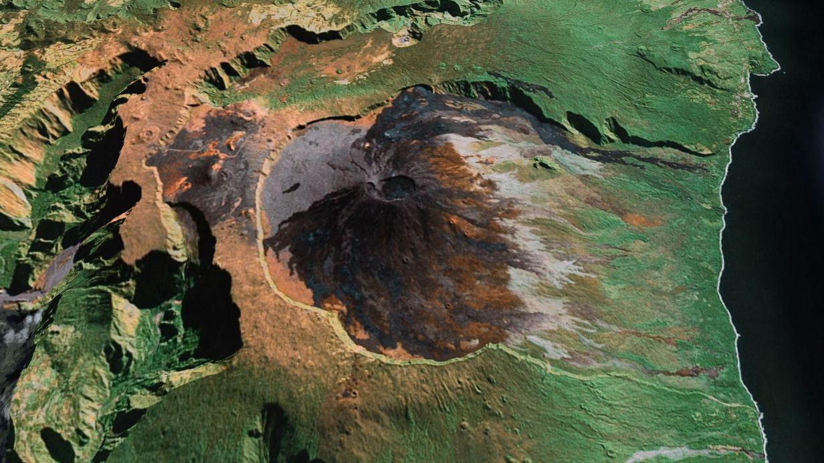
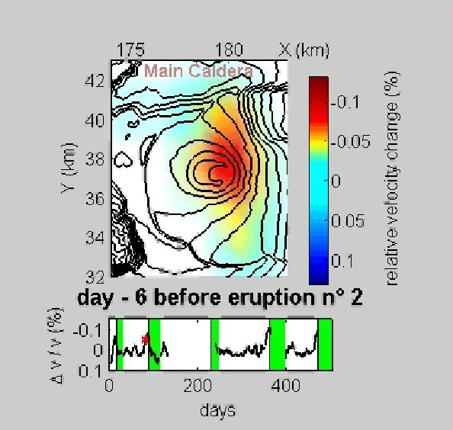
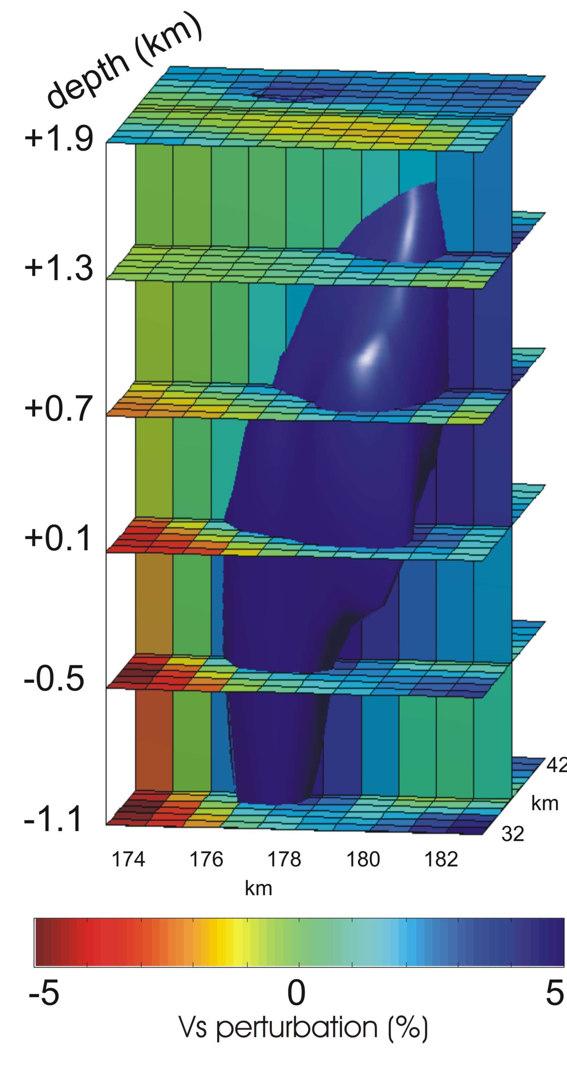
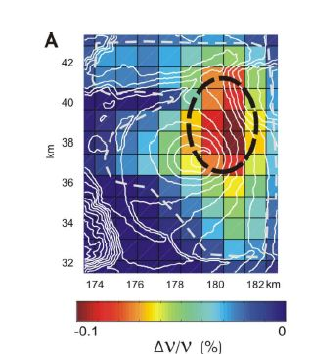
Link between temporal changes and structure
Magmatic intrusive complex
  These velocity changes are linked to dilatation induced by stress changes

