Slide 1
第十二章 目标检测与识别
Lecture 12 Object Detection and Recognition

Slide 2
12.1 视觉显著性与似物性采样

Slide 3
内容
什么是视觉显著性
怎样提取显著性区域
似物性采样

Slide 4

什么是显著图？

Slide 5
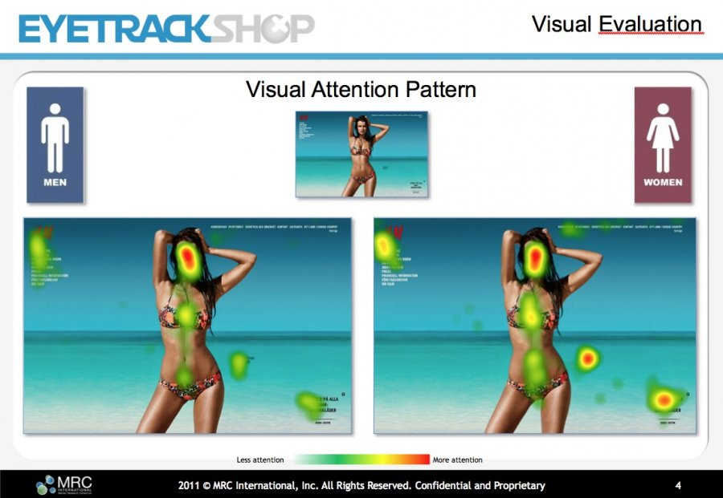

Slide 6
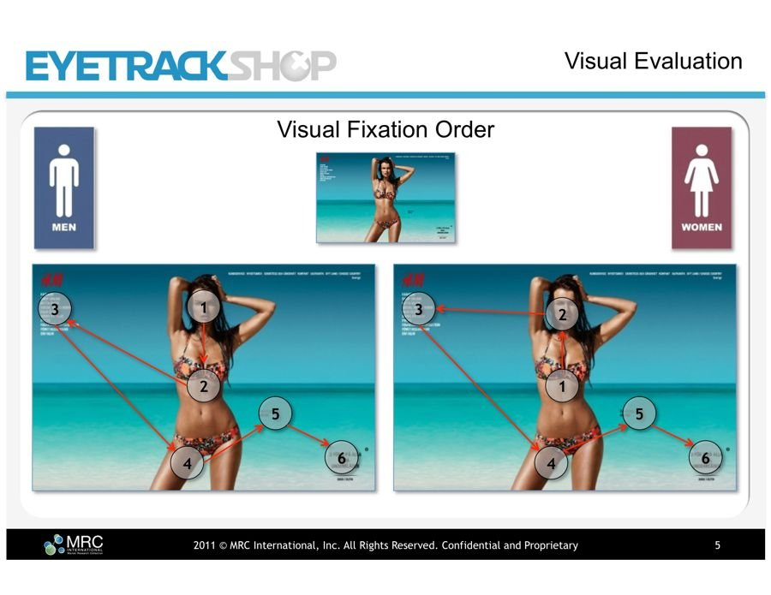

Slide 7
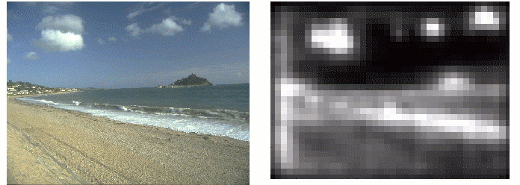
What is Saliency map?
The Saliency Map is a topographically arranged map that represents visual saliency of a corresponding visual scene.

Slide 8
How to detect Saliency map?
Buttom-up approach
  L. Itti’s approach
  Spectral Residual approach
  Frequency-tuned approach
  Global contrast based approach
Top-down approach
  Context-aware

Slide 9
How to detect Saliency map?
Button-up approach
  L. Itti’s approach
  Spectral Residual approach
  Frequency-tuned approach
  Global contrast based approach
Top-down approach
  Context-aware

Slide 10
How to detect Saliency map?
Button-up approach
  L. Itti’s approach
  Spectral Residual approach
  Frequency-tuned approach
  Global contrast based approach
Top-down approach
  Context-aware

Slide 11
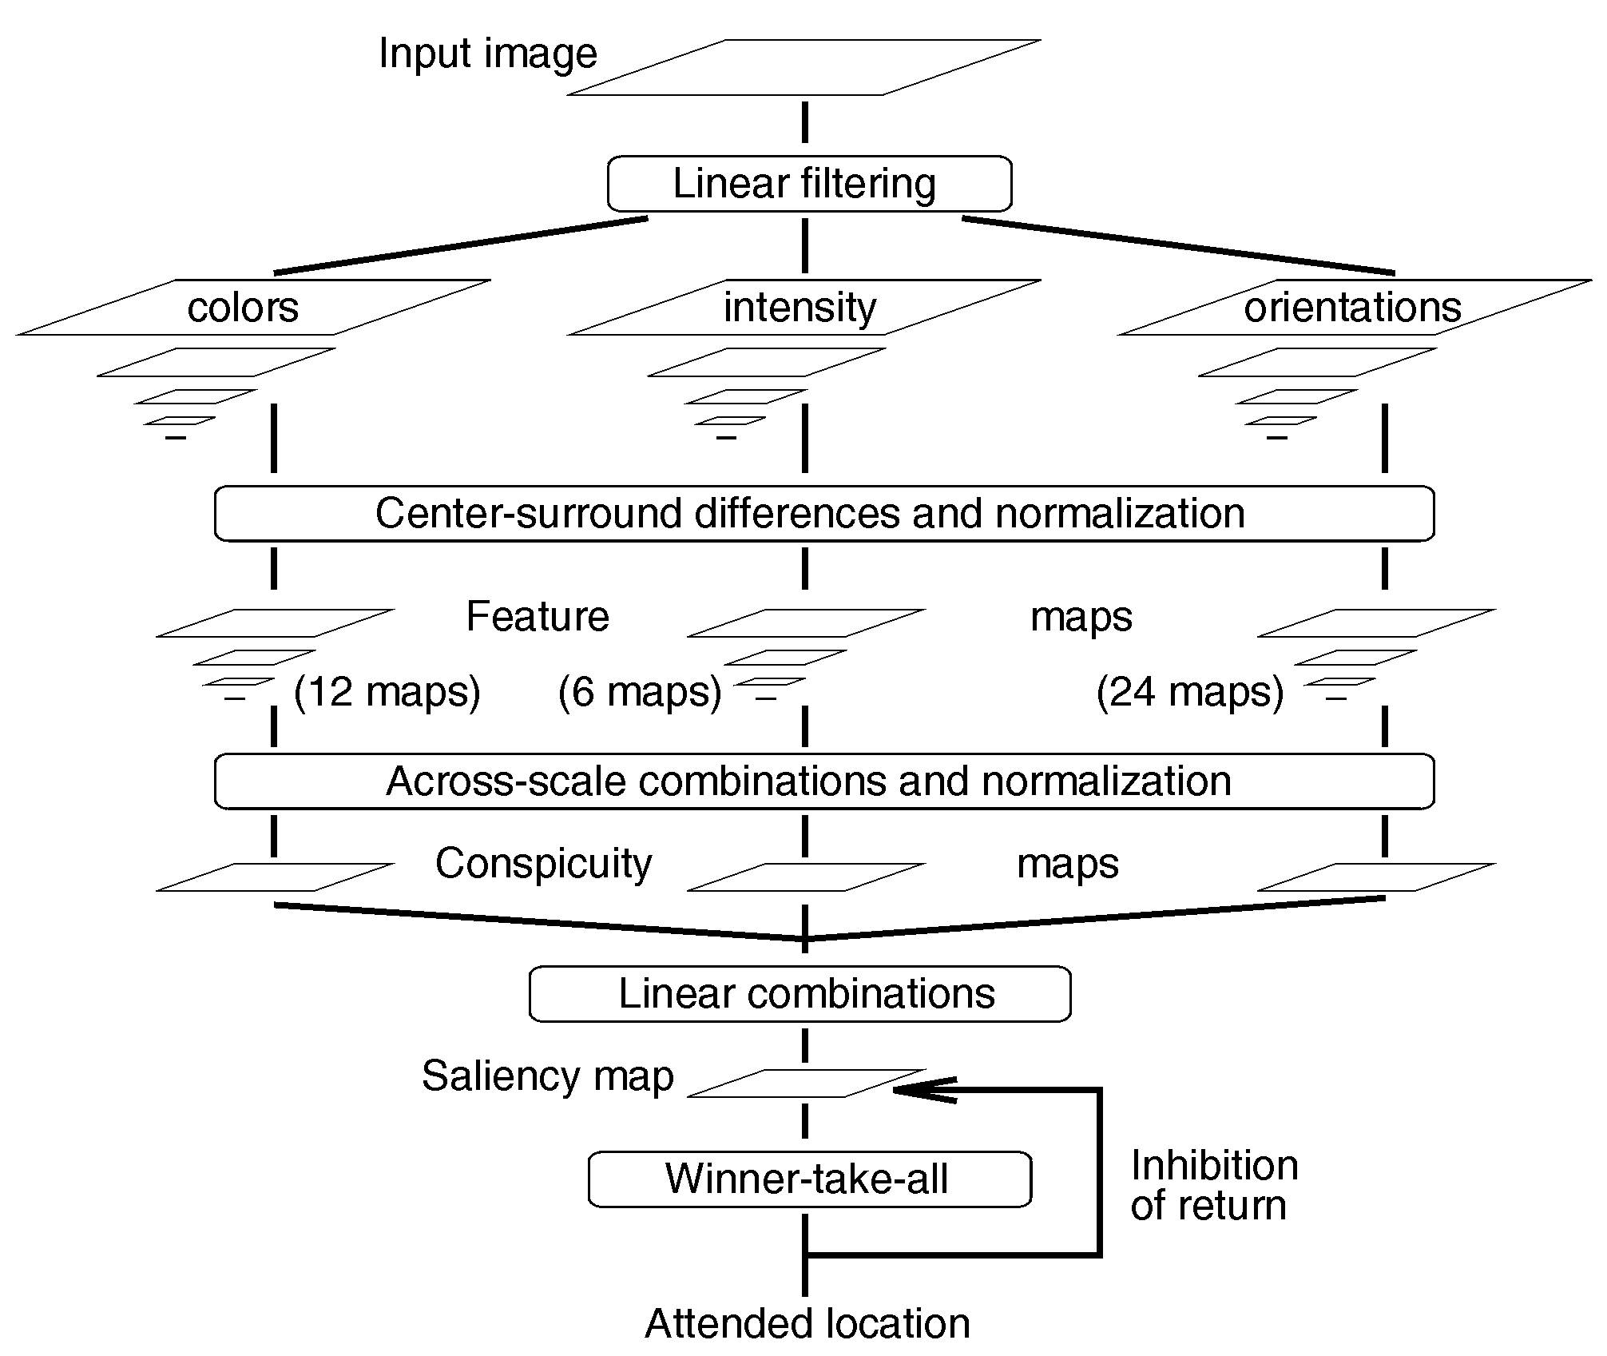
L. Itti’s approach (TPAMI,1998)
Gaussian Pyramids
R,G,B,Y
Gabor pyramids
for θ = {0º, 45º, 90º, 135º}

Slide 12


Gaussian Pyramid

Slide 13
Gabor Filter
Gabor filter, is a linear filter used for edge detection, texture representation and discrimination.
In the spatial domain, a 2D Gabor filter is a Gaussian kernel function modulated by a sinusoidal plane wave.
J. G. Daugman discovered that simple cells in the visual cortex of mammalian brains can be modeled by Gabor functions. Thus, image analysis by the Gabor functions is similar to perception in the human visual system.

Slide 14
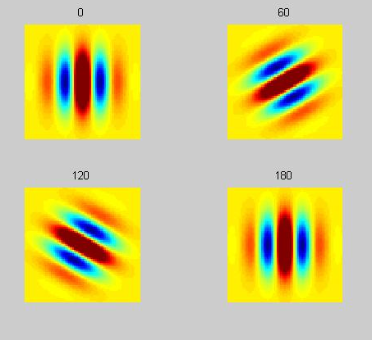
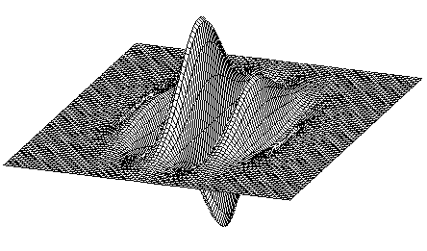
Gabor Filter

Slide 15
L. Itti’s approach (TPAMI,1998)
Gaussian Pyramids
R,G,B,Y
Gabor pyramids
for θ = {0º, 45º, 90º, 135º}

Slide 16
视觉神经结构
感受野:直接或间接影响某一特定神经细胞的光感受器细胞的全体

Slide 17
同心圆感受野
人的视觉细胞存在视觉场结构.视点的中心区域存在正性细胞．它们接收光能并产生一个正的反应。在该中心区域周围存在着负性细胞．它们在接收光能时产生相反的反应。负性细胞随中心距增大而迅速稀疏，代之而起的中性细胞不产生任何反应。这种解释由诺贝尔奖金获得者Hartline得到证实。
这种场结构所产生的视觉反应可由”墨西哥草帽”来表示.
这种场结构可以使人的视觉具有侧抑制作用，它使观察物体时保证“集中注意力”．即把视觉活动集中在注意圈内，不受圈外的变化所干扰。

Slide 18
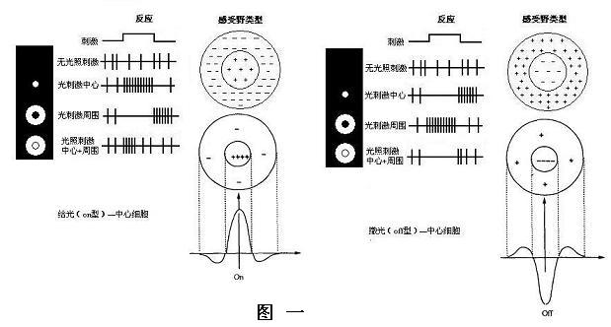
同心圆感受野
Notes:
库佛尔，1953

Slide 19
感受野同心圆拮抗式模型
（Rodieck, 1965）

Slide 20
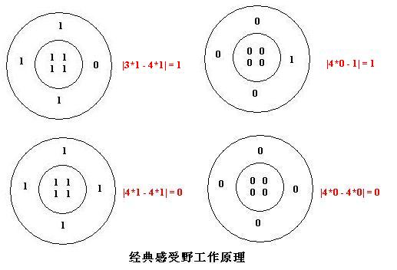
同心圆感受野工作原理

Slide 21
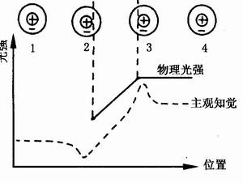
马赫带效应

Slide 22

马赫带－指人们在明暗变化的边界，常常在亮区看到一条更亮的光带，而在暗区看到一条更暗的线条。这就是马赫带现象，马赫带不是由于刺激能量的分布，而是由于受到视觉”惰性”的影响

Slide 23
L. Itti’s approach (TPAMI,1998)
Gaussian Pyramids
R,G,B,Y
Gabor pyramids
for θ = {0º, 45º, 90º, 135º}

Slide 24
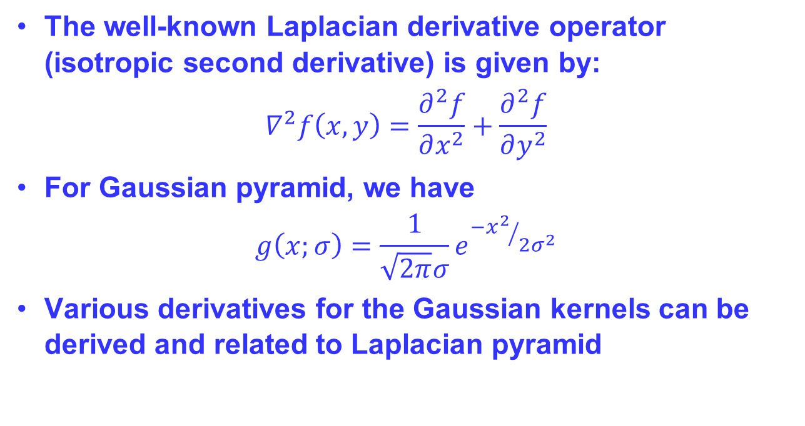
Laplacian of Gaussian (LOG)

Slide 25
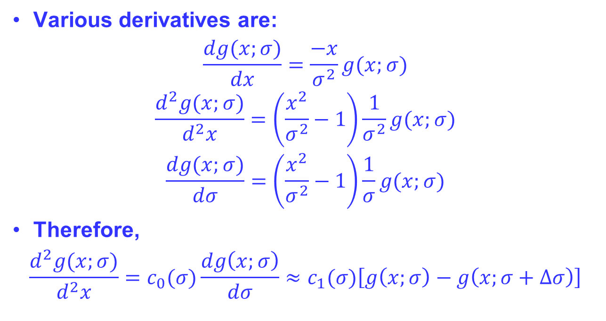
Relations between DOG and LOG
Various derivatives are:
$$\frac{dg(x;σ)}{dx}=\frac{−x}{σ^{2}}g(x;σ)$$
$$\frac{d^{2}g(x;σ)}{d^{2}x}=\left(\frac{x^{2}}{σ^{2}}−1\right)\frac{1}{σ^{2}}g(x;σ)$$
$$\frac{dg(x;σ)}{dσ}=\left(\frac{x^{2}}{σ^{2}}−1\right)\frac{1}{σ}g(x;σ)$$
Therefore,
$$\frac{d^{2}g(x;σ)}{d^{2}x}=c_{0}(σ)\frac{dg\left(x;σ\right)}{dσ}≈c_{1}(σ)\left[g\left(x;σ\right)−g\left(x;σ+∆σ\right)\right]$$

Slide 26
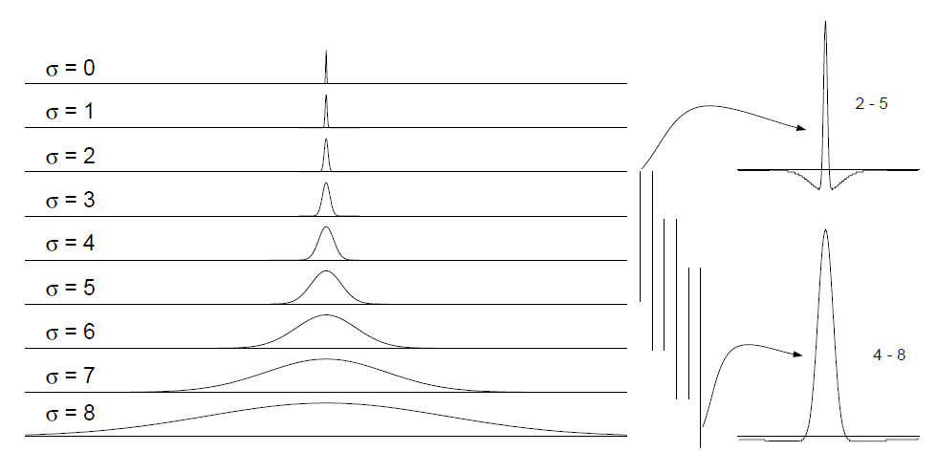
L. Itti’s approach (TPAMI,1998)
Center-surround Difference
Achieve center-surround difference through across-scale difference
Operated denoted by Θ: Interpolation to finer scale and point-to-point subtraction
One pyramid for each channel: I(σ), R(σ), G(σ), B(σ), Y(σ)
where σ ∈ [0..8] is the scale

Slide 27
L. Itti’s approach (TPAMI,1998)
Center-surround Difference
  Intensity Feature Maps
I(c, s) = | I(c) Θ I(s)|
c ∈ {2, 3, 4}
s = c + δ where δ ∈ {3, 4}
So I(2, 5) = | I(2) Θ I(5)|
I(2, 6) = | I(2) Θ I(6)|
I(3, 6) = | I(3) Θ I(6)|
…
→ 6 Feature Maps

Slide 28
L. Itti’s approach (TPAMI,1998)
Center-surround Difference
  Color Feature Maps
Center-surround Difference
  Orientation Feature Maps
Red-Green and Yellow-Blue
Same c and s as with intensity
+B-Y
+R-G
+G-R
+B-Y
+Y-B
+G-R
+R-G
+Y-B
+B-Y
RG(c, s) = | (R(c) - G(c)) Θ (G(s) - R(s)) |
BY(c, s) = | (B(c) - Y(c)) Θ (Y(s) - B(s)) |
Notes:
opponency theory introduced by Ewald Hering (1878) assumes that our vision perception is characterized by three counterbalancing processes: blackwhite,yellow-blue, and red-green.

Slide 29
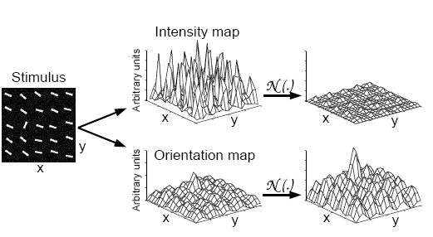
L. Itti’s approach (TPAMI,1998)
Normalization Operator
  Promotes maps with few strong peaks
  Surpresses maps with many comparable peaks

Slide 30
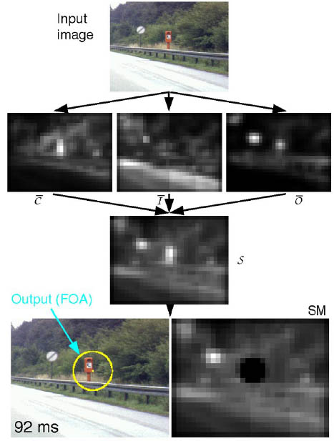
L. Itti’s approach (TPAMI,1998)
Inhibition of return
Notes:
返回抑制

Slide 31
How to detect Saliency map?
Button-up approach
  L. Itti’s approach
  Spectral Residual approach
  Frequency-tuned approach
  Global contrast based approach
Top-down approach
  Context-aware

Slide 32

Spectral Residual Approach(CVPR,2007)
从信息理论角度：信息可分为冗余部分和变化部分。人们的视觉对变化部分更敏感。视觉系统的一个基本原则就是抑制对频繁出现的特征的响应，同时对非常规的特征保持敏感。那么就将图像分为如下两部分：
新的信息，反映图像内容变化。
冗余信息，可以通过统计方法得到。

Slide 33
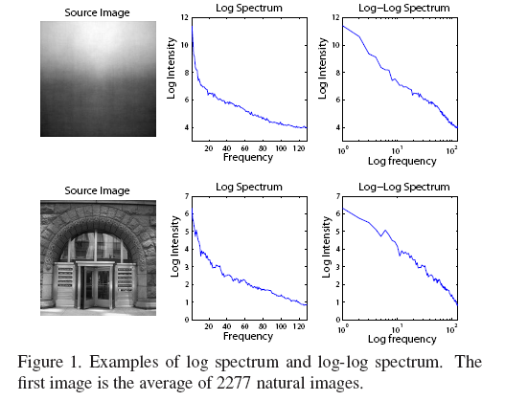
Spectral Residual Approach(CVPR,2007)
作者对图像的log频谱进行统计分析，得到了如下规律:大量图像的log频谱的平均值是和频率呈现正比关系的。
Notes:
文中的log频谱是对图像傅里叶变换后的振幅谱取自然对数。

Slide 34
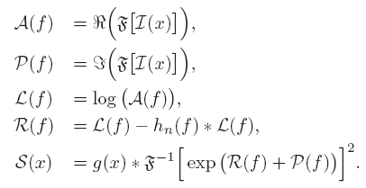

Spectral Residual Approach(CVPR,2007)
大量图像的log频谱和频率的曲线形状，在log-log scale上，几乎是一条直线。然后作者又提出了既然大量图像的log振幅谱都差不多趋近一条直线，那么一幅图像的log振幅谱减去平均log振幅谱不就是显著性部分了吗？这就是作者提出的：Spectral Residual理论。

Slide 35
Spectral Residual Approach(CVPR,2007)
First scaling image to 64x64.
hn(f) is a local average filter (n=3 in this paper).
Then the saliency map is smoothed with a gaussian filter g(x) ( σ = 8).

Slide 36
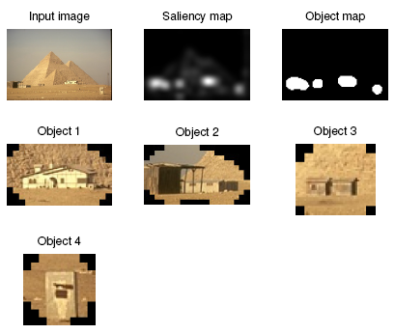
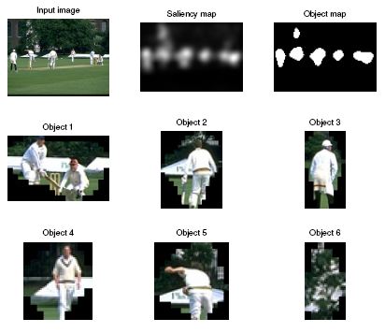
Spectral Residual Approach(CVPR,2007)

Slide 37
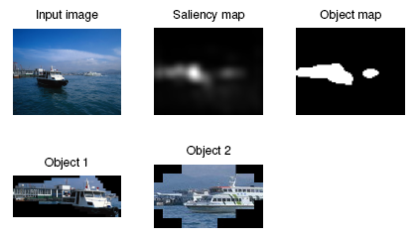
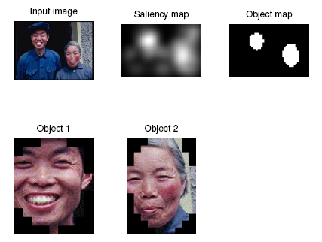
Spectral Residual Approach(CVPR,2007)

Slide 38
Spectral Residual Approach(CVPR,2007)
clear
Clc
%% Read image from file
inImg = im2double(rgb2gray(imread('256.png')));
%%inImg = imresize(inImg, 64/size(inImg, 2));
%% Spectral Residual
myFFT = fft2(inImg);
myLogAmplitude = log(abs(myFFT));
myPhase = angle(myFFT);
mySpectralResidual = myLogAmplitude - imfilter(myLogAmplitude, fspecial('average', 3), 'replicate');
saliencyMap = abs(ifft2(exp(mySpectralResidual + i*myPhase))).^2;
%% After Effect
saliencyMap = mat2gray(imfilter(saliencyMap, fspecial('gaussian', [10, 10], 2.5)));
imshow(saliencyMap);

Slide 39
How to detect Saliency map?
Button-up approach
  L. Itti’s approach
  Spectral Residual approach
  Frequency-tuned approach
  Global contrast based approach
Top-down approach
  Context-aware

Slide 40
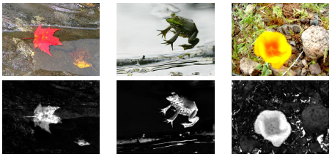
Frequency-tuned (CVPR,2009)

Slide 41
Frequency-tuned (CVPR,2009)
Set the following requirements for a saliency detector:
  Emphasize the largest salient objects.
  Uniformly highlight whole salient regions.
  Establish well-defined boundaries of salient objects.
  Disregard high frequencies arising from texture, noise and blocking artifacts.
  Efficiently output full resolution saliency maps.

Slide 42
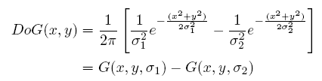
Frequency-tuned (CVPR,2009)
Choose the DoG filter for band pass filtering.
Parameter selection
  To implement a large ratio in standard deviations, σ1 is driven to infinity.

Slide 43




Frequency-tuned (CVPR,2009)
Image Average
Gaussian blur

Slide 44
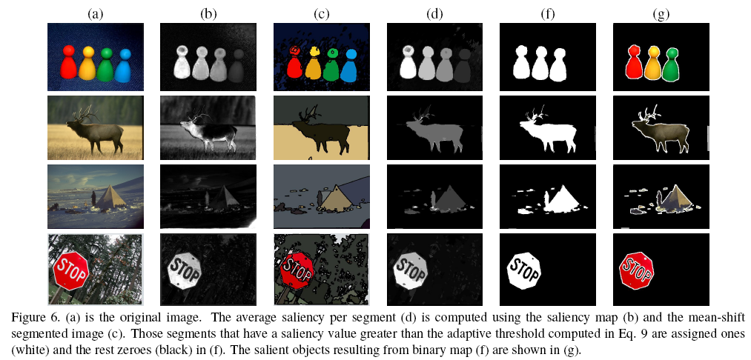
Frequency-tuned (CVPR,2009)

Slide 45
Frequency-tuned (CVPR,2009)
% Read image and blur it with a 3x3 or 5x5 Gaussian filter
img = imread('input_image.jpg');%Provide input image path
gfrgb = imfilter(img, fspecial(‘gaussian’, 3, 3), ‘symmetric’, ‘conv’);
% Perform sRGB to CIE Lab color space conversion (using D65)
cform = makecform('srgb2lab', 'whitepoint', whitepoint('d65'));
lab = applycform(gfrgb,cform);
% Compute Lab average values (note that in the paper this
% average is found from the unblurred original image, but the results are quite similar)
l = double(lab(:,:,1)); lm = mean(mean(l));
a = double(lab(:,:,2)); am = mean(mean(a));
b = double(lab(:,:,3)); bm = mean(mean(b));
% Finally compute the saliency map and display it.
sm = (l-lm).^2 + (a-am).^2 + (b-bm).^2;
imshow(sm,[]);

Slide 46
How to detect Saliency map?
Button-up approach
  L. Itti’s approach
  Spectral Residual approach
  Frequency-tuned approach
  Global contrast based approach
Top-down approach
  Context-aware

Slide 47
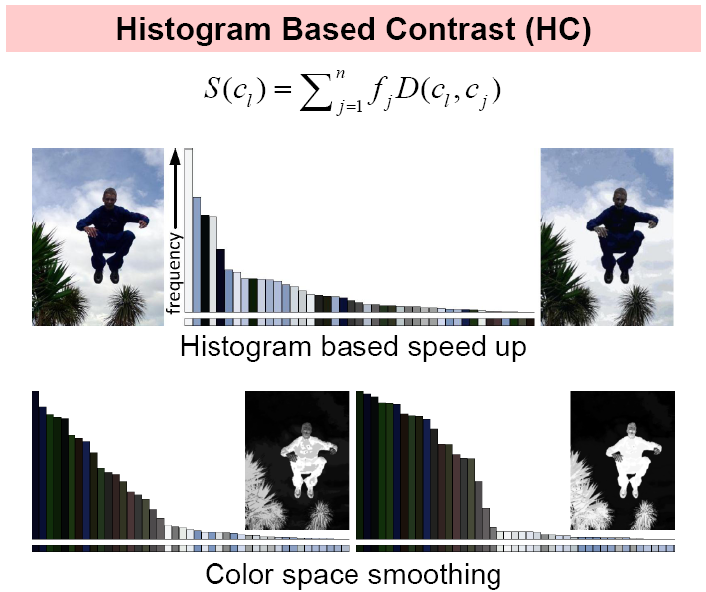
Global contrast-based (CVPR,2011)
Notes:
In lab將m個顏色與接近的saliency直做平均，做為C的salient

Slide 48
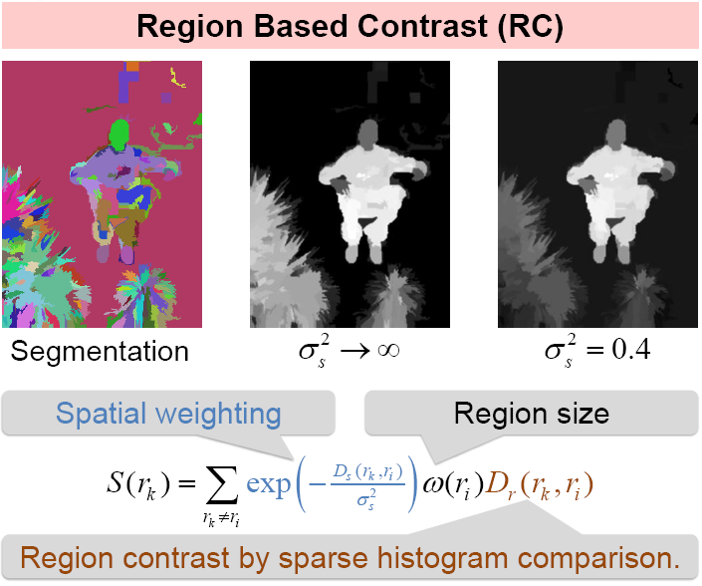
Global contrast-based (CVPR,2011)

Slide 49
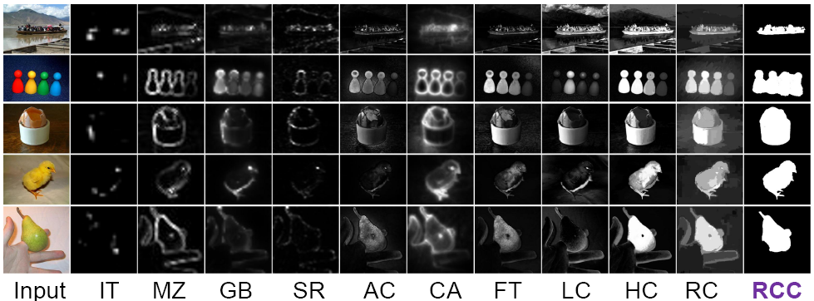
Global contrast-based (CVPR,2011)
RC based saliency Cut achieves P = 90%, R = 90%, compared to previous best results P = 75%, R = 83% on this dataset.
P = Precision; R = Recall.
Notes:
In lab
將m個顏色與接近的saliency直做平均，做為C的salient

Slide 50
How to detect Saliency map?
Button-up approach
  L. Itti’s approach
  Spectral Residual approach
  Frequency-tuned approach
  Global contrast based approach
Top-down approach
  Context-aware

Slide 51
How to detect Saliency map?
Button-up approach
  L. Itti’s approach
  Spectral Residual approach
  Frequency-tuned approach
  Global contrast based approach
Top-down approach
  Context-aware

Slide 52
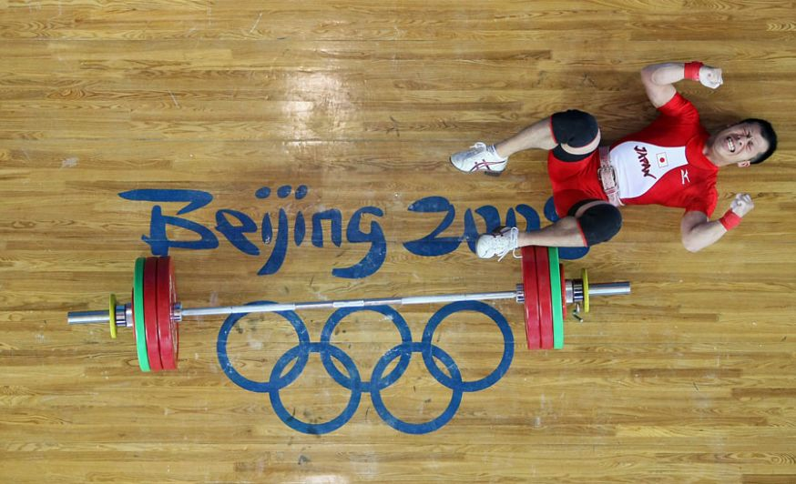
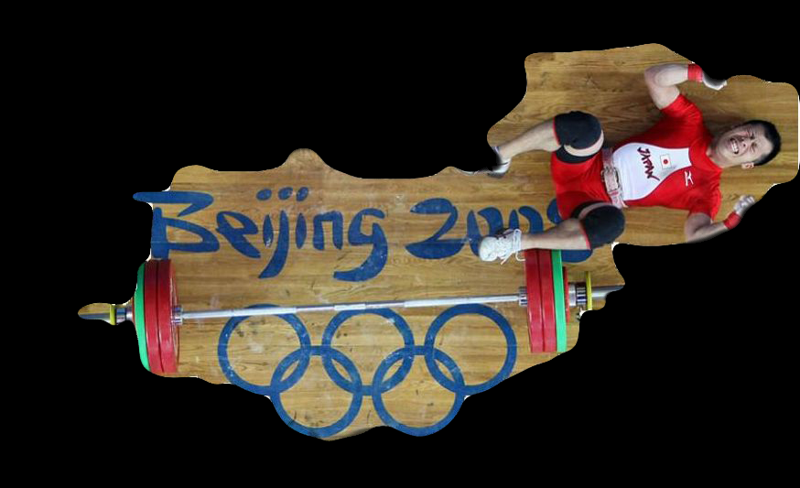
Context-Aware (CVPR,2010)
Goal: Convey the image content

Slide 53
Context-Aware (CVPR,2010)
Principles of context-aware saliency:
  1. Local low-level considerations, including factors such as contrast and color.
  2. Global considerations, which suppress frequently occurring features, while maintaining features that deviate from the norm.
  3. Visual organization rules, which state that visual forms may possess one or several centers of gravity about which the form is organized.
  4. High-level factors, such as human faces.

Slide 54
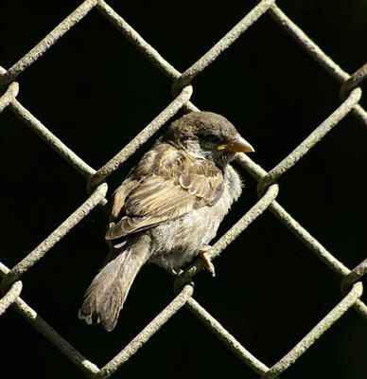
Context-Aware (CVPR,2010)
Distance between a pair of patches:
High
salient

Slide 55
Context-Aware (CVPR,2010)
Distance between a pair of patches:
K most similar patches at scale r
High for K most similar
Saliency

Slide 56
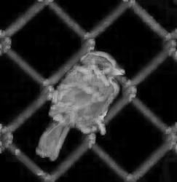

Context-Aware (CVPR,2010)
Salient at:
  Multiple scales ➔ foreground
  Few scales ➔ background
Scale 1
Scale 4

Slide 57
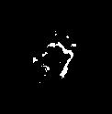
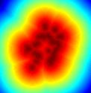
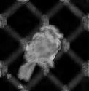
Context-Aware (CVPR,2010)
Foci =
Include distance map
X

Slide 58
Context-Aware (CVPR,2010)
High-level factors:
  The saliency map should be further enhanced using some high-level factors, such as recognized objects or face detection.
  In this paper, the face detection algorithm is incorporated , which generates 1 for face pixels and 0 otherwise.
  The saliency map is modified by taking the maximum value of the saliency map and the face map.

Slide 59
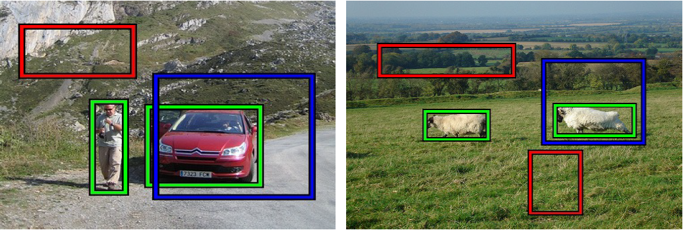
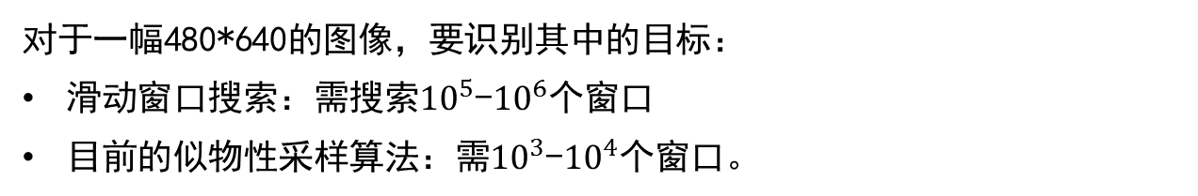
似物性采样？
对于一幅480*640的图像，要识别其中的目标：
滑动窗口搜索：需搜索${10}^{5}$-${10}^{6}$个窗口
目前的似物性采样算法：需${10}^{3}$-${10}^{4}$个窗口。
Notes:
如人类对于近处的目标和远处的目标很容易区分开来。

Slide 60
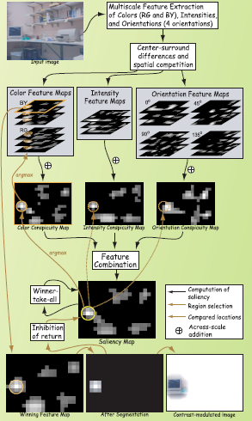
Is bottom-up attention useful for object recognition? (CVPR,2004)
This paper investigate empirically to what extent pure bottom-up attention can extract useful information about the location, size and shape of objects from images and demonstrate how this information can be utilized to enable unsupervised learning of objects from unlabeled images.
The experiments demonstrate that the proposed approach to using bottom-up attention is indeed useful for a variety of applications.

Slide 61
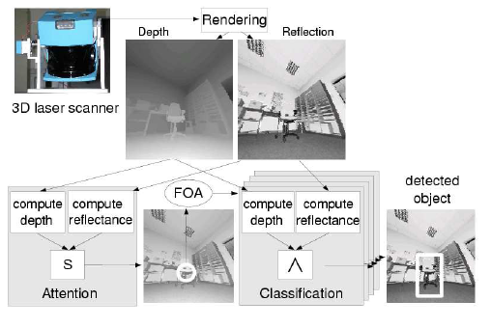
Saliency-based Object Recognition in 3D Data (IROS,2004)

Slide 62
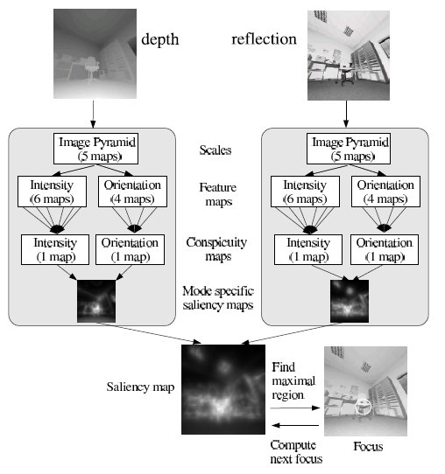
Saliency-based Object Recognition in 3D Data (IROS,2004)

Slide 63
似物性采样研究现状及方法
表1 目前流行的似物性采样算法性能对比
算法 | 发表期刊或会议 | 类型 | 是否输出分割 | 是否输出得分 | 计算时间(s) | 召回率
Bing | CVPR2014 | 窗口评分 | 否 | 是 | 0.2 | 一般
CPMC | CVPR2010 | 分组合并 | 是 | 是 | 250 | 良好
EdgeBoxes | ECCV2014 | 窗口评分 | 否 | 是 | 0.3 | 优秀
Endres | ECCV2010 | 分组合并 | 是 | 否 | 100 | 优秀
Geodesic | ECCV2014 | 分组合并 | 是 | 是 | 1 | 优秀
MCG | T-PAMI2016 | 分组合并 | 是 | 是 | 30 | 优秀
Objectness | T-PAMI2012 | 窗口评分 | 否 | 是 | 3 | 一般
Rahtu | ICCV2011 | 窗口评分 | 否 | 否 | 3 | -
RandomizedPrim’s | ICCV2013 | 分组合并 | 是 | 否 | 1 | 一般
Rantalankila | CVPR2014 | 分组合并 | 是 | 否 | 10 | -
Rigor | CVPR2014 | 分组合并 | 是 | 否 | 10 | 良好
SelectiveSearch | IJCV2013 | 分组合并 | 是 | 是 | 10 | 优秀
Notes:
A. Saxena等，Make3d: Learning 3d scene structure from a single still image. PAMI, 2009
K. Karsch等，Depth extraction from video using non-parametric sampling. In Computer Vision–ECCV 2012
M. Liu等，Discrete-continuous depth estimation from a single image. In Computer Vision and Pattern Recognition (CVPR), 2014
D. Eigen等，Depth map prediction from a single image using a multi-scale deep network. NIPS 2014
F. Liu等，Learning Depth from Single Monocular Images Using Deep Convolutional Neural Fields. T-PAMI 2015

Slide 64
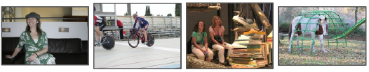
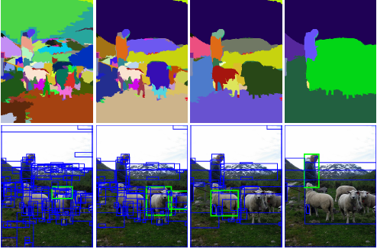
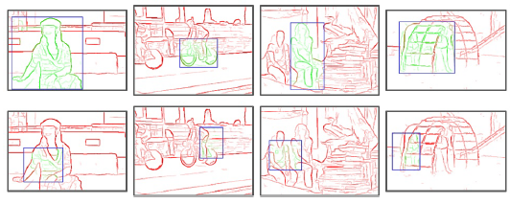
似物性采样研究现状及方法
目前基于RGB图像的似物性采样研究
基于窗口评分的方法
基于分组合并的方法

Slide 65
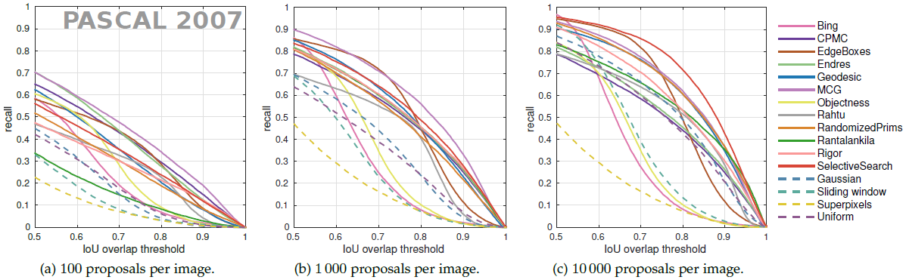
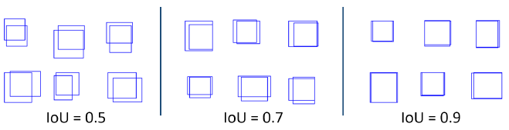
似物性采样vs滑动窗口搜索

Slide 66

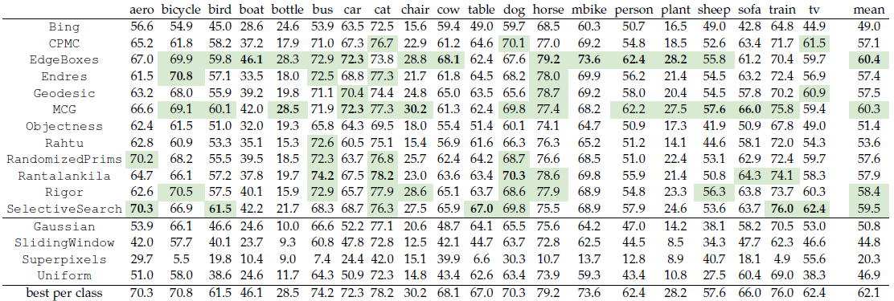
似物性采样在目标识别中的作用
R-CNN分类器在PASCAL VOC 2007目标识别数据集中，应用不同似物性采样算法下的识别精度。

