Slide 1
Lower Bounds on Tree Covers
Hangyu Xu
University of Science and Technology of China
Based on joint work with Yu Chen (NUS) and Zihan Tan (UMN)
Notes:
Hello everyone, my name is …, a grad. Stu in USTC. Today I will introduce the work “Lower B ,,,”. This is a joint work with …

Slide 2
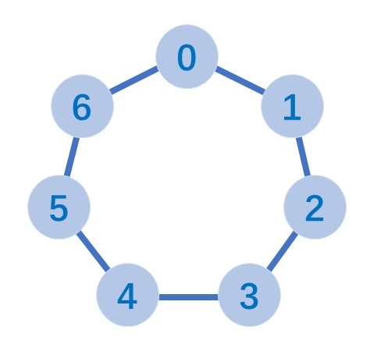
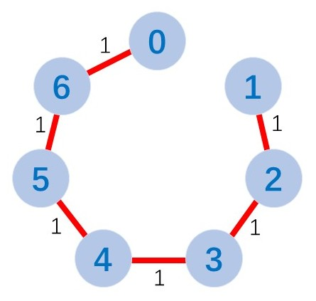
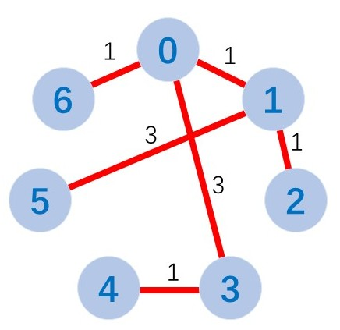
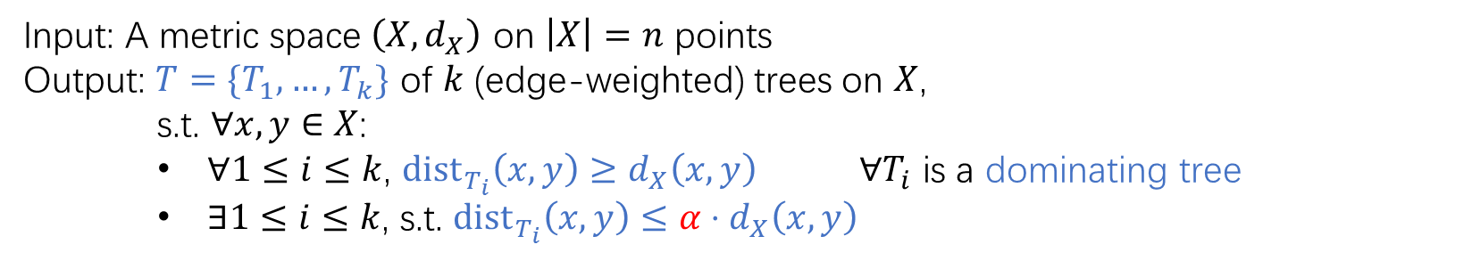


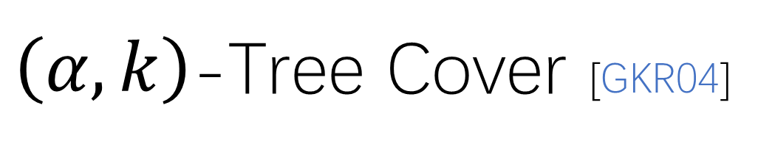
$\left(α,k\right)$-Tree Cover [GKR04]
Input: A metric space $\left(X,d_{X}\right)$ on $\left|X\right|=n$ points
Output: $T=\{T_{1},…,T_{k}\}$ of $k$ (edge-weighted) trees on $X$,
s.t. $∀x,y∈X$:
    $∀1≤i≤k$, ${dist}_{T_{i}}\left(x,y\right)≥d_{X}\left(x,y\right)$ $∀T_{i}$ is a dominating tree
    $∃1≤i≤k$, s.t. ${\text{dist}}_{T_{i}}\left(x,y\right)≤α⋅d_{X}\left(x,y\right)$
distortion/stretch
$$T_{1}$$
$$T_{2}$$
Notes:
First, let me briefly introduce …. Given a metric space X, a k tree cover is a set of k trees that can well approximate the apsd in the metric.
We say distortion \alpha if, … within factor \alpha.
W.o.l.g, we may assume all the trees are dominating trees.
Here is an example. …
However, if we add another tree T2, …
Also note that, the trees do not need to be spanning trees, that is,…, just like T2 here.
2:00

Slide 3
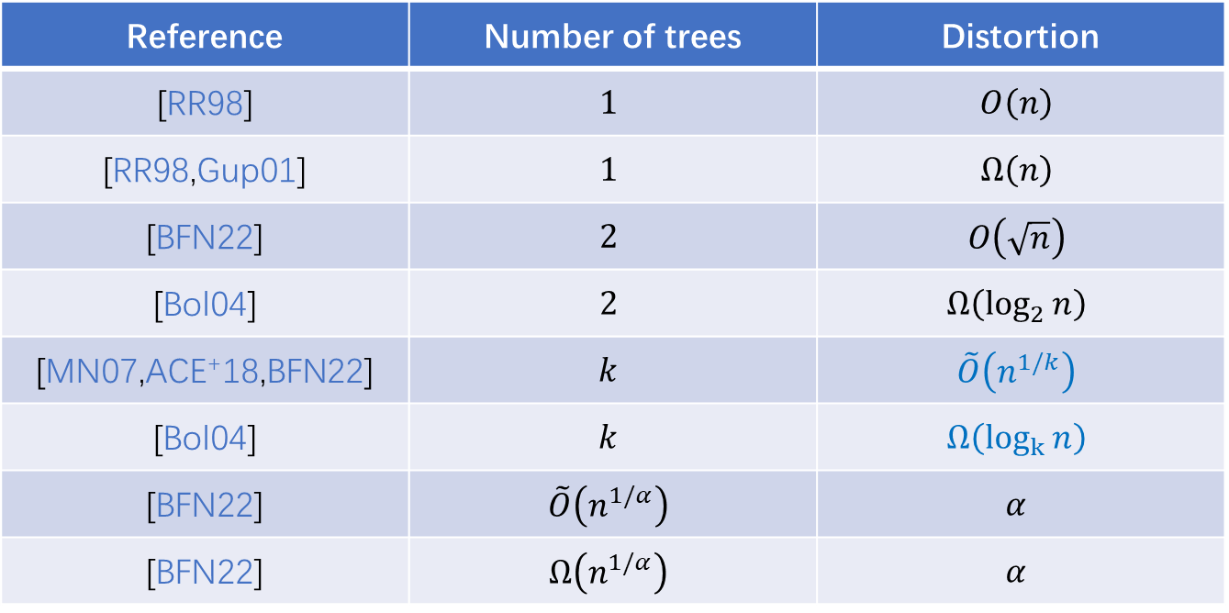
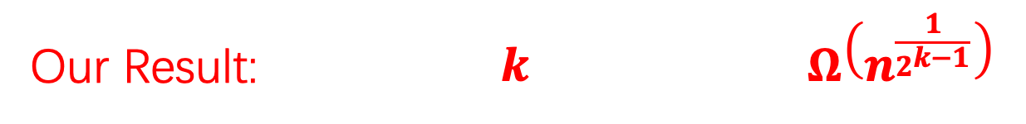
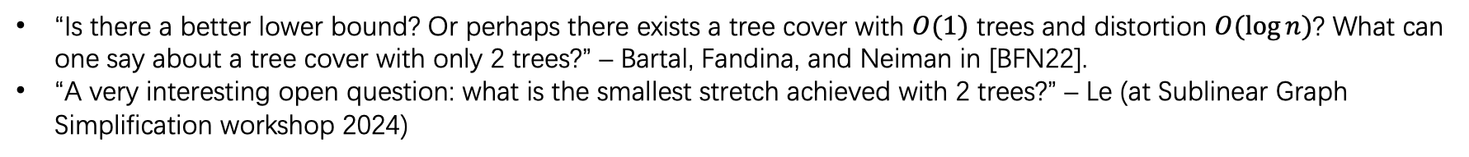
Previous Work
Reference | Number of trees | Distortion
[RR98] | $$1$$ | $$O\left(n\right)$$
[RR98,Gup01] | $$1$$ | $$Ω\left(n\right)$$
[BFN22] | $$2$$ | $$O\left(\sqrt{n}\right)$$
[Bol04] | $$2$$ | $$Ω\left(\log_{2}{n}\right)$$
[MN07,ACE⁺18,BFN22] | $$k$$ | $$\tilde{O}\left(n^{1/k}\right)$$
[Bol04] | $$k$$ | $$Ω\left(\log_{k}{n}\right)$$
[BFN22] | $$\tilde{O}\left(n^{1/α}\right)$$ | $$α$$
[BFN22] | $$Ω\left(n^{1/α}\right)$$ | $$α$$
Our Result: $k$ $Ω\left(n^{\frac{1}{2^{k−1}}}\right)$
connection to combinatorial fixed-point theorems
“Is there a better lower bound? Or perhaps there exists a tree cover with $O(1)$ trees and distortion $O(log⁡n)$? What can one say about a tree cover with only 2 trees?” – Bartal, Fandina, and Neiman in [BFN22].
“A very interesting open question: what is the smallest stretch achieved with 2 trees?” – Le (at Sublinear Graph Simplification workshop 2024)
Notes:
There has been a line of work studies the distortion for constant size tree covers.
For general k tree covers, …. However, even for k=2, …, leaving an exponential gap.
In this work, we show…, which is this first poly. l.b. for this problem.
Also note that for k=2, the lower bound is \omega(\sqrt{n}), which is already tight with the best known upper bound.
3:00

Slide 4
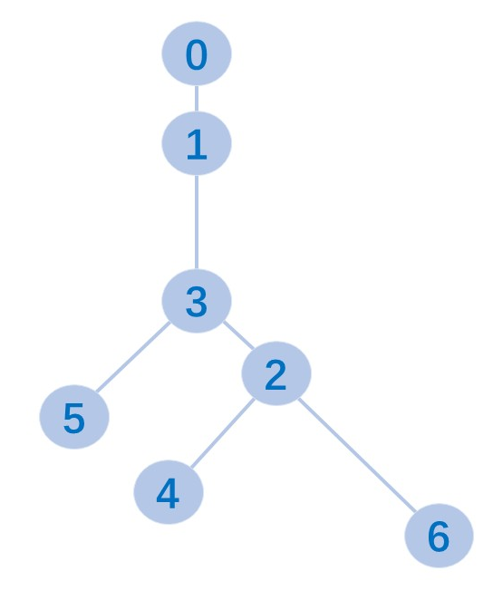
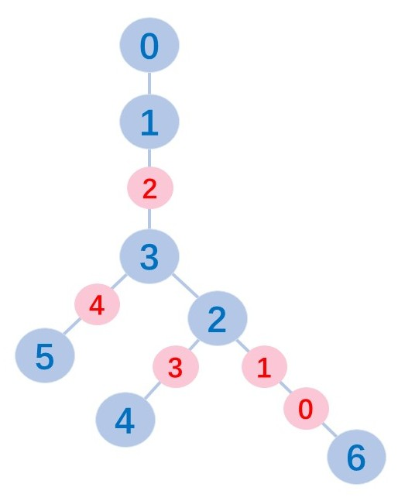
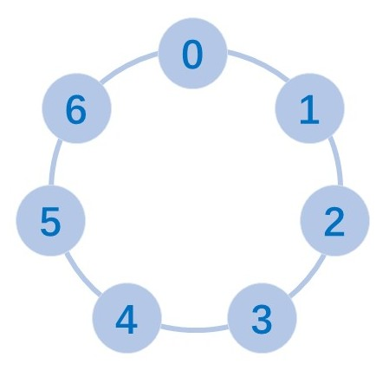
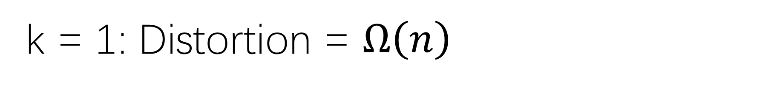
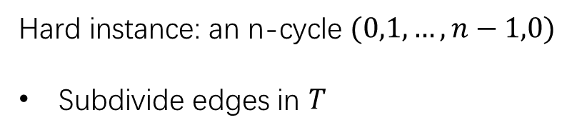
k = 1: Distortion = $Ω\left(n\right)$
Similar to [RR98] and [Gup01]
Hard instance: an n-cycle $(0,1,…,n−1,0)$
Subdivide edges in $T$
Notes:
Let us start with the simplest case when k=1. The hard instance we use is an n-cycle.
Given a single tree, we may first subdivide the edges in the tree. That is …
3:30

Slide 5
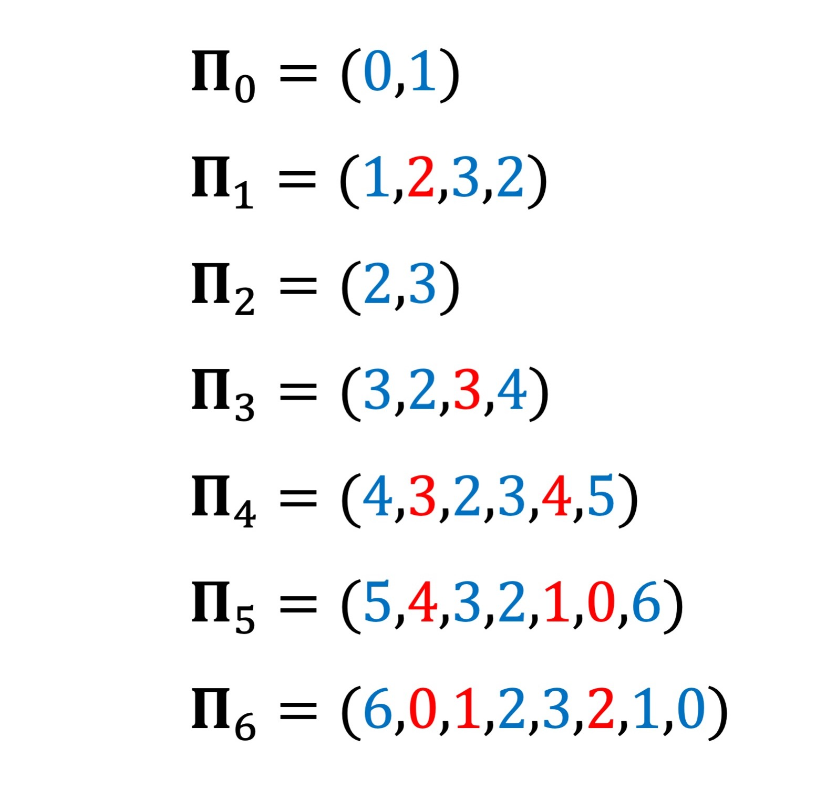
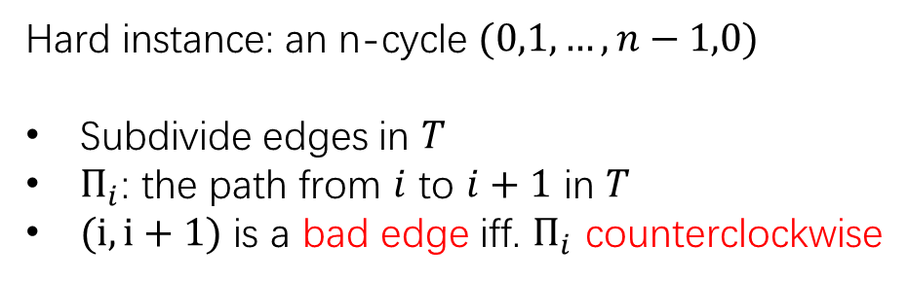
k = 1: Distortion = $Ω\left(n\right)$
Similar to [RR98] and [Gup01]
Hard instance: an n-cycle $(0,1,…,n−1,0)$
Subdivide edges in $T$
$Π_{i}$: the path from $i$ to $i+1$ in $T$
$(i,i+1)$ is a bad edge iff. $Π_{i}$ counterclockwise
(5,6): bad edge
always exists in a cycle
Notes:
Then we may consider all the paths from i to i+1 as walks on the cycle.
Although … wander arbitrarily left and right on the cycle, a key observation is this: if the path goes from i to i+1 counterclockwise, its length must be at least $n−1$.
We call such an edge a bad edge. In this example, (5,6) is the bad edge.
One can prove that given any tree, there is always at least one bad edge. This implies l.b.
4:45

Slide 6
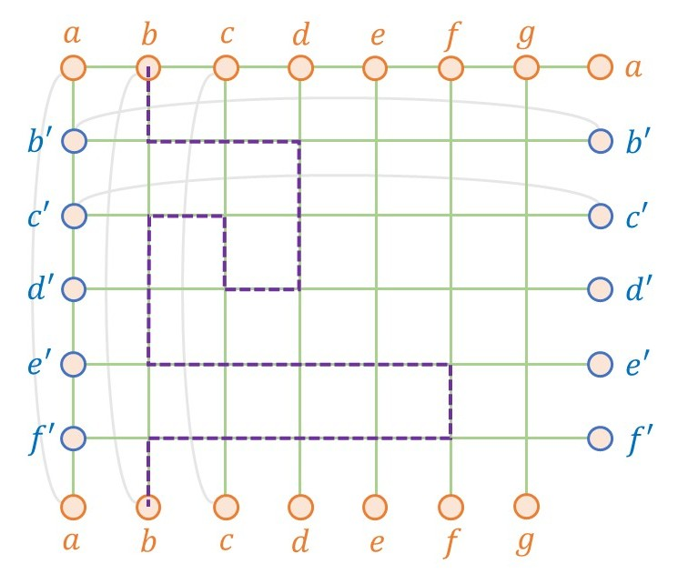
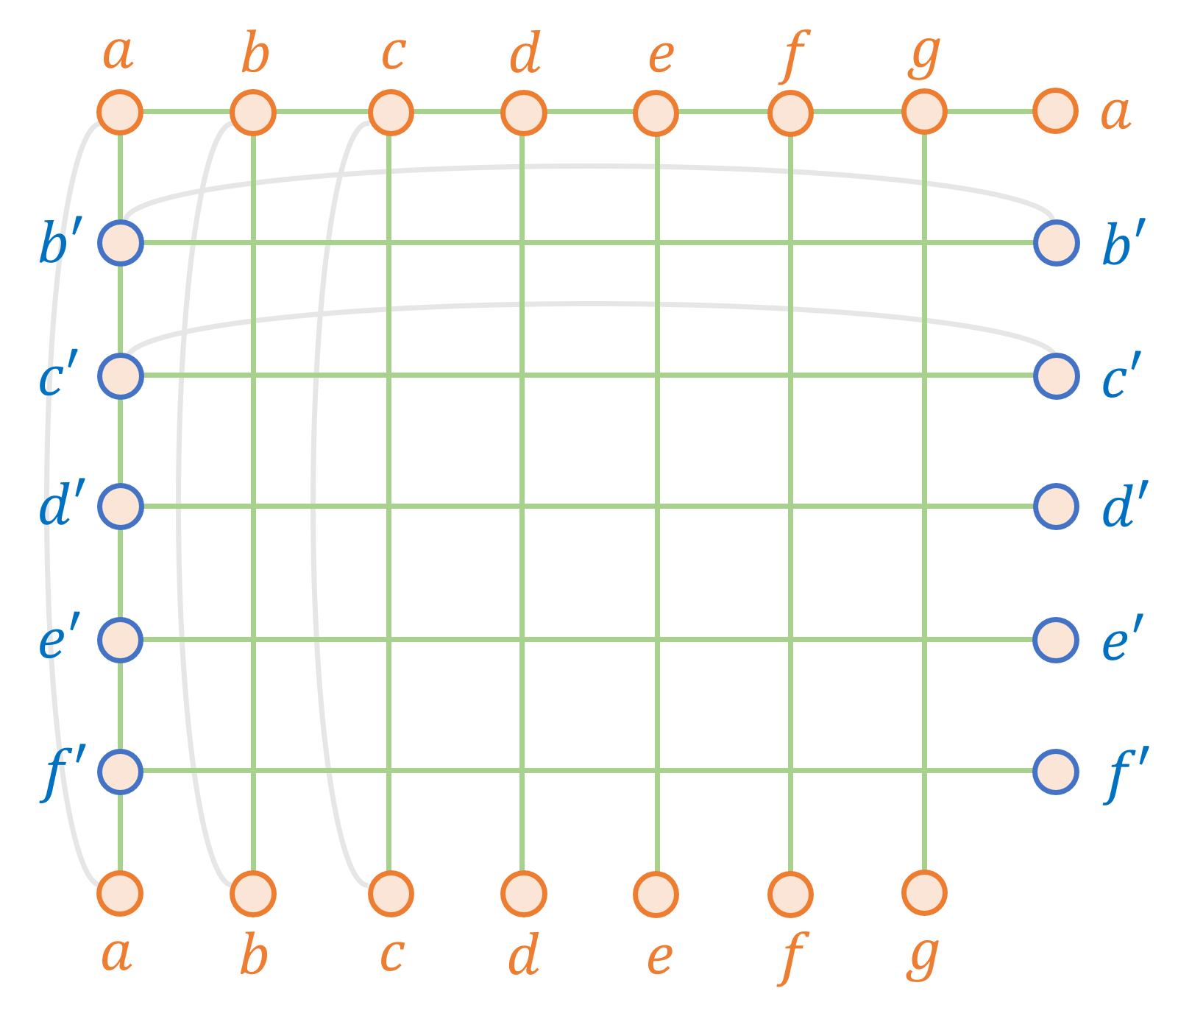
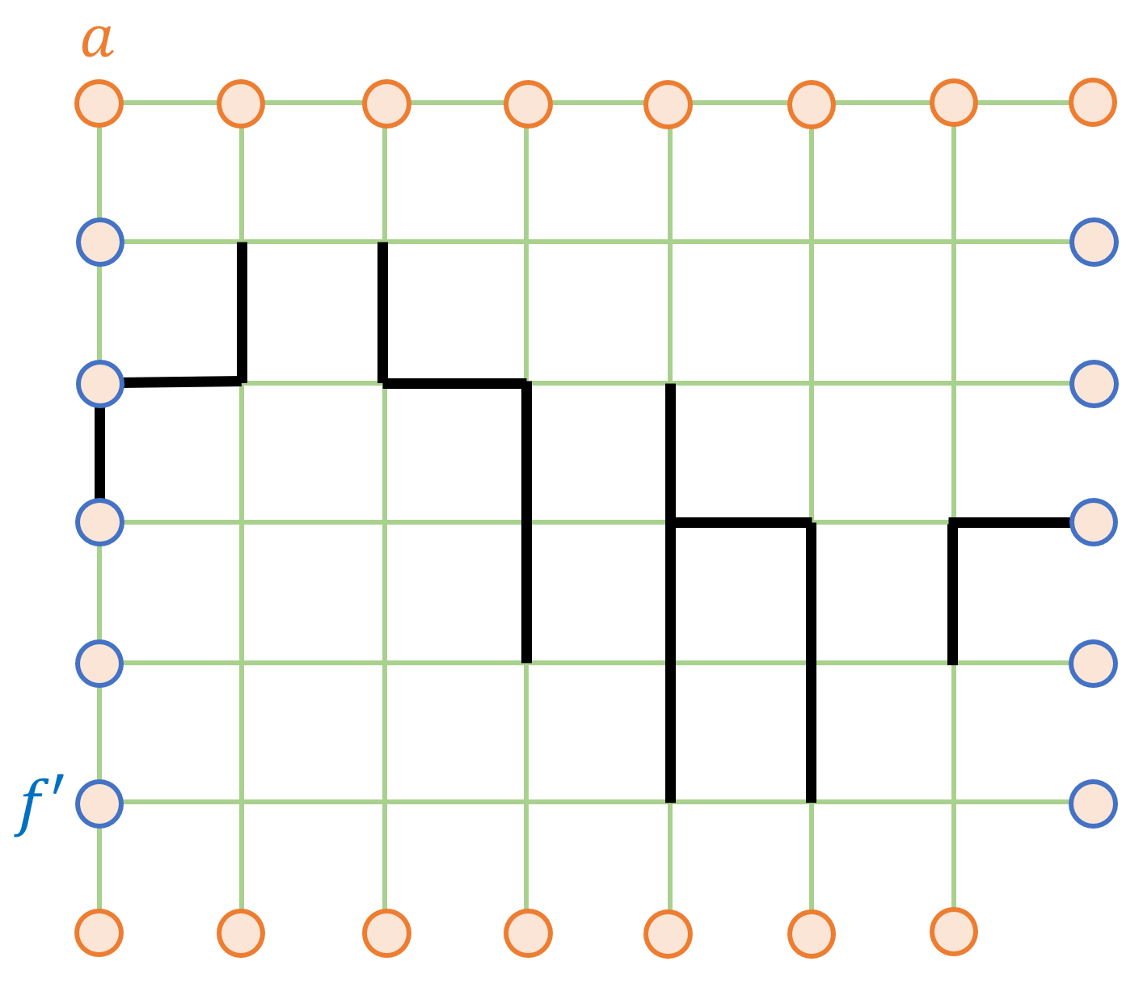
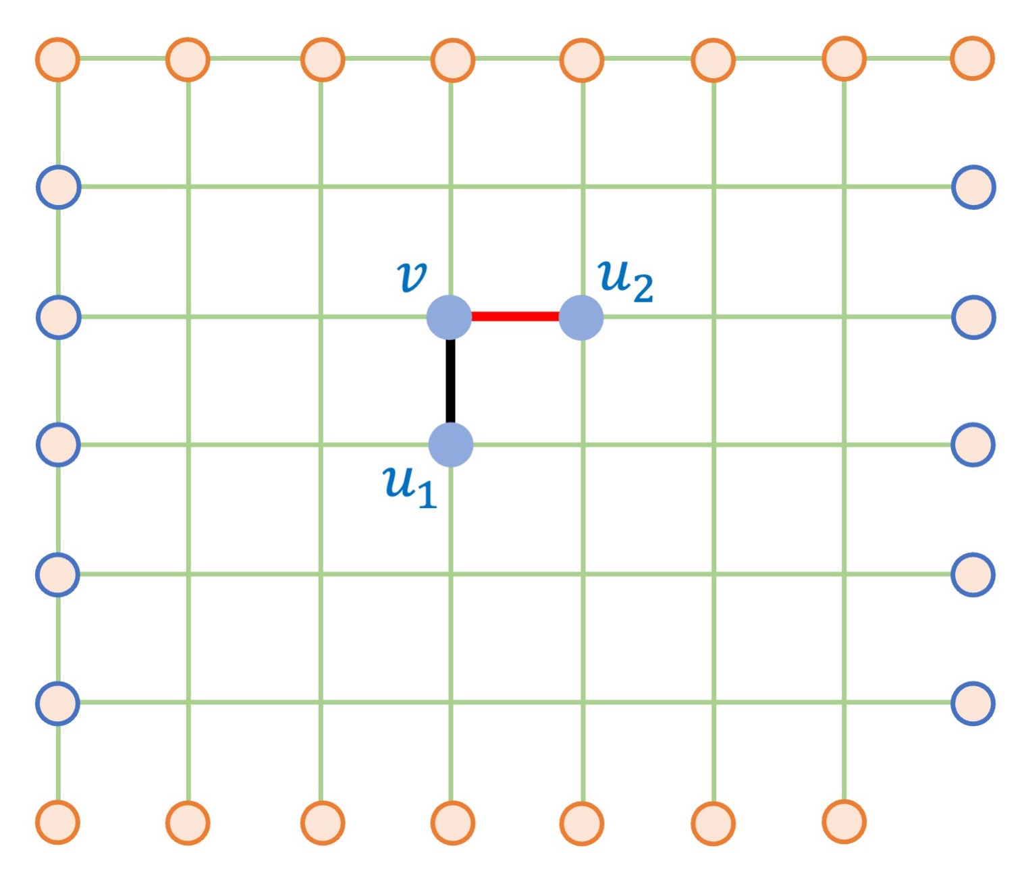
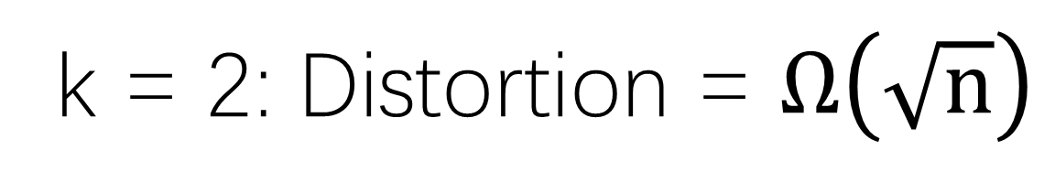
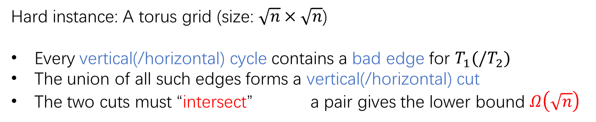
k = 2: Distortion = $Ω\left(\sqrt{n}\right)$
Grid can be covered by 2 trees in constant factor. [CTX25,LMSZ25,BKT25]
Hard instance: A torus grid (size: $\sqrt{n}×\sqrt{n}$)
Every vertical(/horizontal) cycle contains a bad edge for $T_{1}(/T_{2})$
The union of all such edges forms a vertical(/horizontal) cut
The two cuts must “intersect” a pair gives the lower bound $Ω\left(\sqrt{n}\right)$
Notes:
Now, let‘s move to the case of two trees. A natural starting point ….. However, we show that, grid can be actually covered ….
We use the torus grid instead. A torus grid is somehow wrapping the grid around both sides. That is to say, the top nodes and bottom nodes are actually the same point. Left nodes and right also the same.
From the single-tree case, every vertical cycle … bad edge in $T_{1}$.
(example)
As a result, the union …, which divides the grid into ..
Similarly, for tree T2, …. … intersect. This intersection further implies a pair that finally derives …
6:30

Slide 7
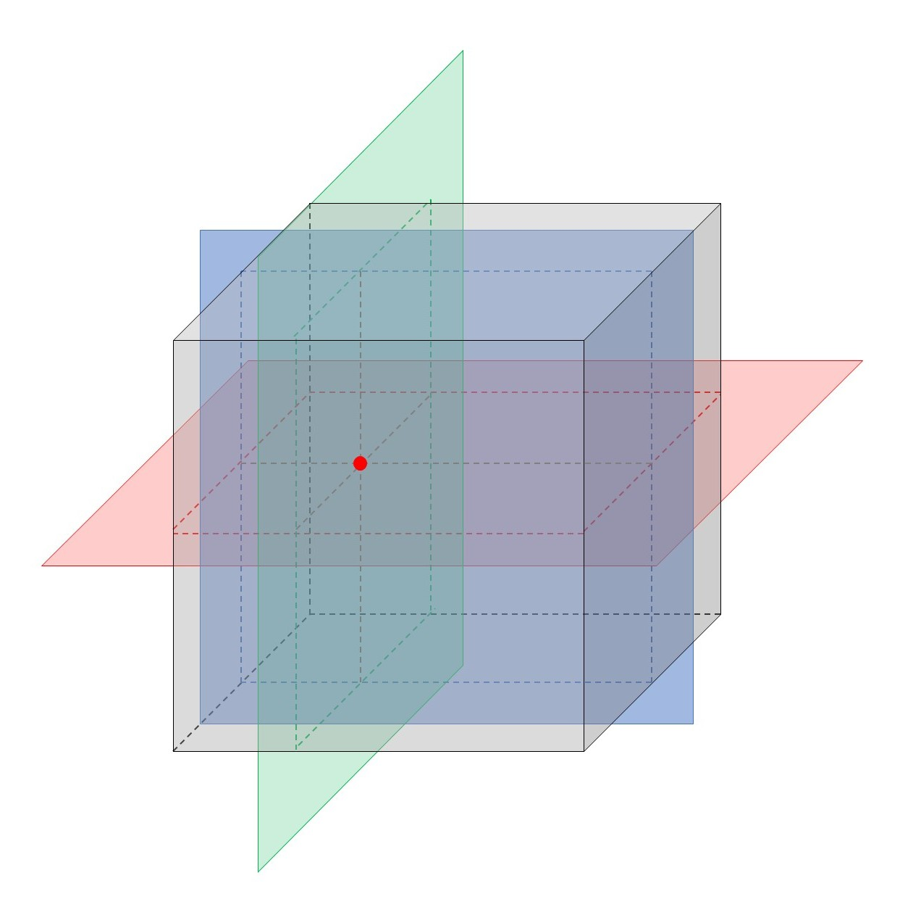
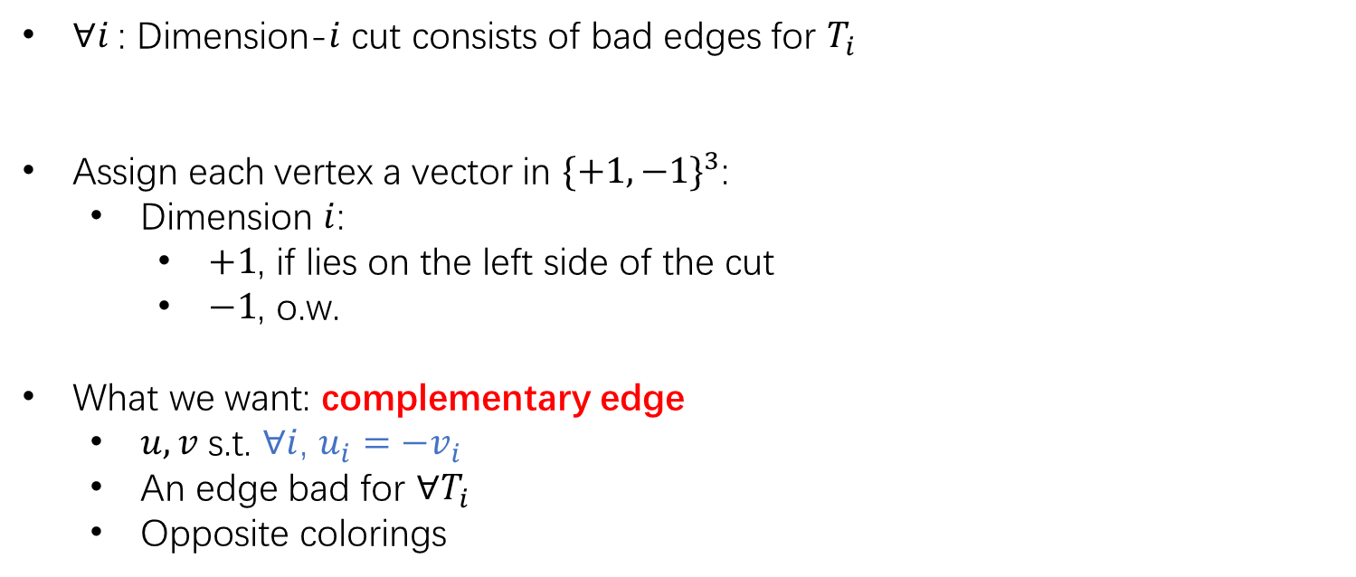
k = 3: Connection to Topology
$∀i$: Dimension-$i$ cut consists of bad edges for $T_{i}$
Assign each vertex a vector in $\{+1,−1\}^{3}$:
  Dimension $i$:
    $+1$, if lies on the left side of the cut
    $−1$, o.w.
What we want: complementary edge
  $u,v$ s.t. $∀i$, $u_{i}=−v_{i}$
  An edge bad for $∀T_{i}$
  Opposite colorings
not work
coloring
l.b. for tree cover
connecting to combinatorial fixed-point theorems
Notes:
However, this method does not work when k is larger.
Important inspiration: … sign vector: in dimension $i$, the value is $+1$ if …, and ….. We can consider the vector … as a coloring.
Find a comp. edge, an edge whose endpoints have opposite colorings.
This insight naturally leads us to think about coloring theorems, especially ….
7:30

Slide 8
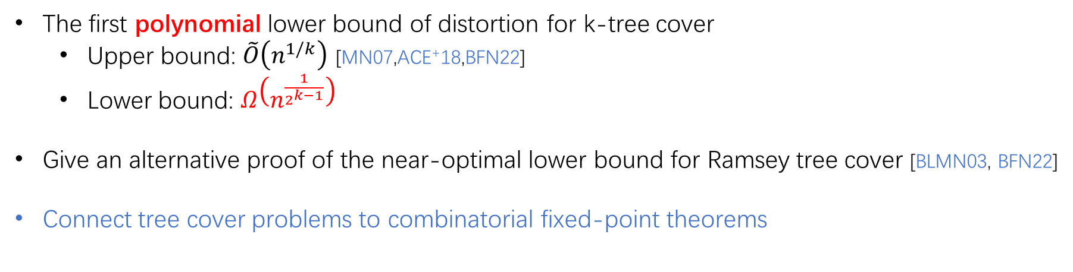
Summary
The first polynomial lower bound of distortion for k-tree cover
  Upper bound: $\tilde{O}\left(n^{1/k}\right)$ [MN07,ACE⁺18,BFN22]
  Lower bound: $Ω\left(n^{\frac{1}{2^{k−1}}}\right)$
Give an alternative proof of the near-optimal lower bound for Ramsey tree cover [BLMN03, BFN22]
Connect tree cover problems to combinatorial fixed-point theorems
Thanks for listening!
Notes:
In a conclusion, we propose ….
We also introduce a novel connection ….
The open question is, what is the best distortion can be achieved?
8:00

Slide 9
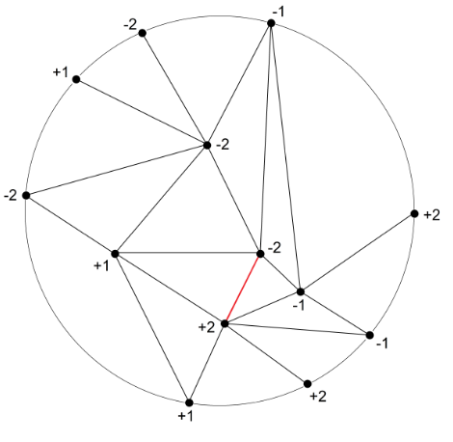
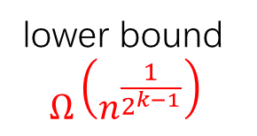
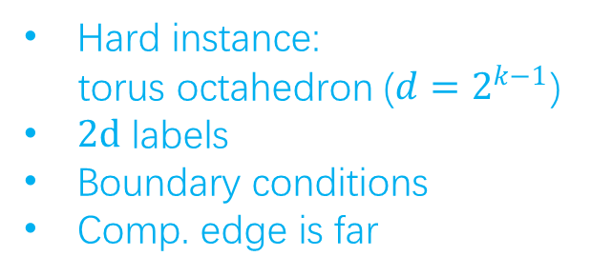

Tucker’s Lemma
$Γ$ is a triangulation of d-dimension unit ball
$ℓ$ is a labeling:
  $ℓ:V\left(Γ\right)→\{−l_{d},…,−l_{2},−l_{1},l_{1},l_{2},…,l_{d}\}$
  $ℓ\left(v\right)=−ℓ\left(−v\right)$ for all $v∈$ boundary
Then $Γ$ contains a complementary edge
coloring
an edge with opposite labels
Hard instance:
torus octahedron ($d=2^{k−1}$)
$2d$ labels
Boundary conditions
Comp. edge is far
lower bound
$$Ω\left(n^{\frac{1}{2^{k−1}}}\right)$$
https://en.wikipedia.org/wiki/Tucker's_lemma
Notes:
Tucker’s Lemma, a comb. form of …. This lemma uses $2d$ labels, which corresponds to colorings. If graph satisfies some boundary conditions, then …..
The following steps: First, hard instance. Second, labelling. Third, show boundary condition. Finally, we need to show the comp. edge is far apart. This implies l.b. ….

