Slide 1
A Retargetable System-Level DBT Hypervisor
USENIX ATC’ 2019
Tom Spink, Harry Wagstaff, Björn Franke
University of Edinburgh
Presented by Xiaoyang Wang, USTC
October 10th, 2019
Notes:
可重定向 动态二进制翻译 虚拟化

Slide 2
Outline
Background
Design & Implementation
Evaluation
Conclusion

Slide 3
Why Virtualization ?
User
User1
User2
User3
OS1
OS2
OS3
Virtualization
OS
VM1
VM2
VM3
Hypervisor
Device
Device
Server
Server

Slide 4
How to virtualize CPU?
Software Virtualization
VMware (early stage)
Qemu
Hardware Assisted Virtualization
Intel VT
AMD SVM
KVM
User
Guest OS
Hypervisor
vCPU
Device
CPU
Server

Slide 5
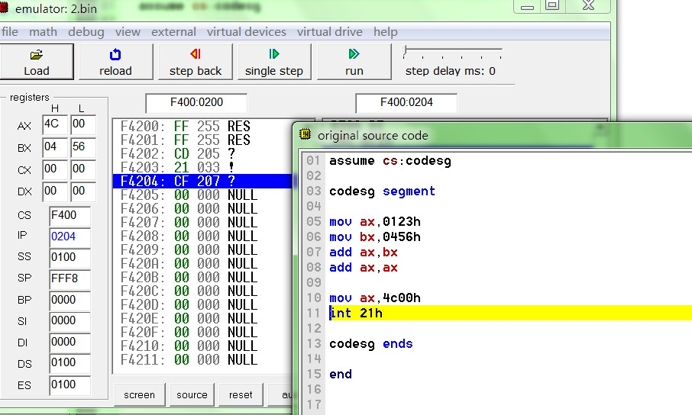
Software Virtualization -- Simulation
emu8086
Software – Ring 3

Slide 6
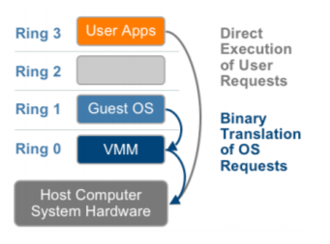
Software Virtualization -- BT
VMware – Binary Translation

Slide 7
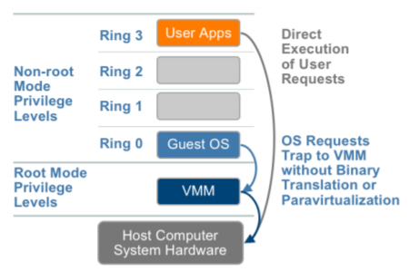
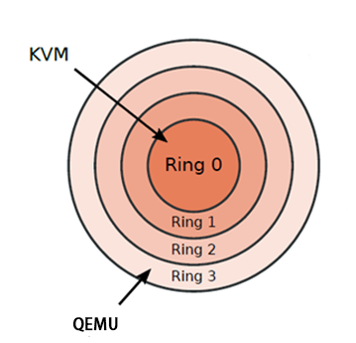
Hardware Assisted Virtualization
(root mode)
(non-root mode)
VMware Intel-VT
Virtual Machine Extension support
QEMU-KVM

Slide 8
Hardware Assisted Virtualization
(root mode)
Only x86!
(non-root mode)
VMware Intel-VT
Virtual Machine Extension support
QEMU-KVM

Slide 9
Dynamic Binary Translation
OS(ARMv8-A)
ARMv8-A Binary Instruction
Hypervisor
DBT
Critical!
X86-64 Binary Instruction
CPU(x86-64)

Slide 10
Dynamic Binary Translation
Xbox One(AMD x86) support Xbox 360(IBM PowerPC) games
Android Emulator for mobile app development
Sandbox environment for hostile program analysis
Huawei Ascend Processor support x86

Slide 11
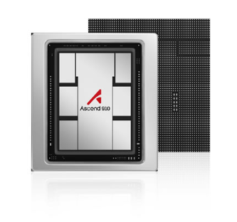
State-of-the-art DBT
DBT is always coded by hand
QEMU 4.1.0 – ARM translation module’s LoC: 80,238
QEMU commit logs contain more than 90 entries to bugfixes related to its ARM model alone
Just-In-Time translation is performance critical
QEMU’s DBT runs in ring3 (application layer)
Only QEMU is publicly available

Slide 12
Outline
Background
Design & Implementation
Evaluation
Conclusion

Slide 13
Main idea
high-level architecture descriptions
offline and online optimization
DBT hypervisor

Slide 14
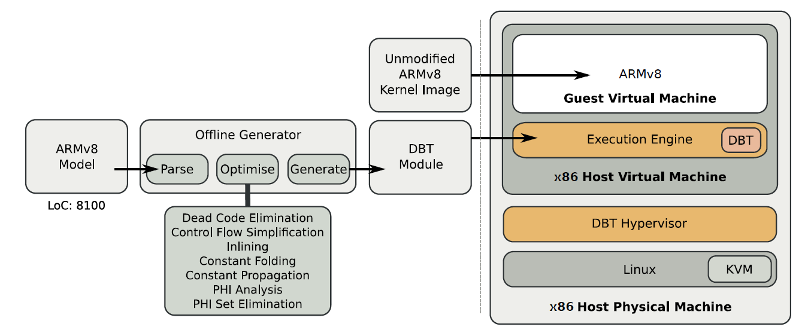
Overview

Slide 15
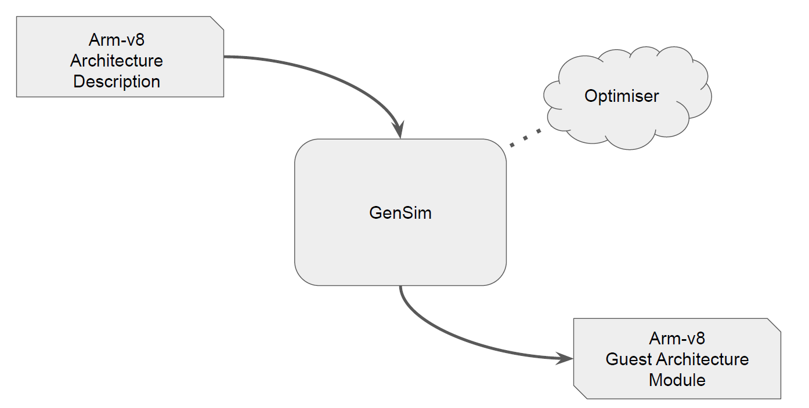
Offline stage

Slide 16
Architecture Description Language(ADL)
Instruction syntax (i.e. how to decode instructions)
Instruction semantics (i.e. how to execute instruction)
Architectural features (i.e. register file size, word size)
QEMU/ADL Comparison

Slide 17
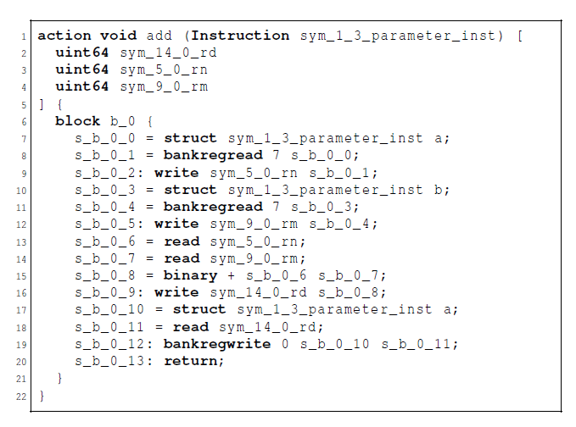
Intermediate Static Single Assignment (SSA) Form
SSA Form

Slide 18
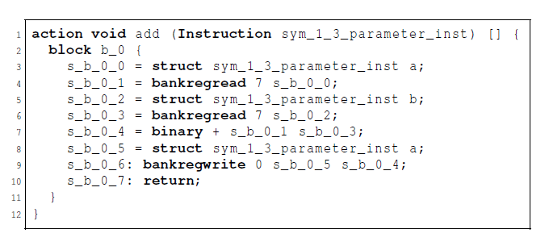
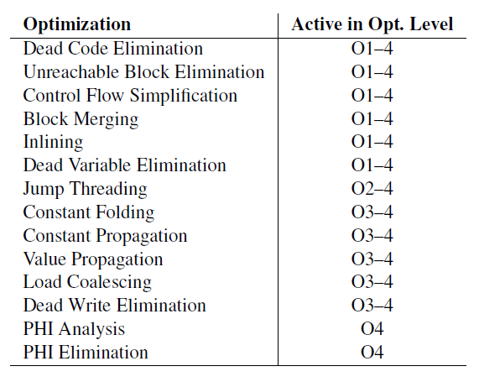
Optimization
Optimization

Slide 19
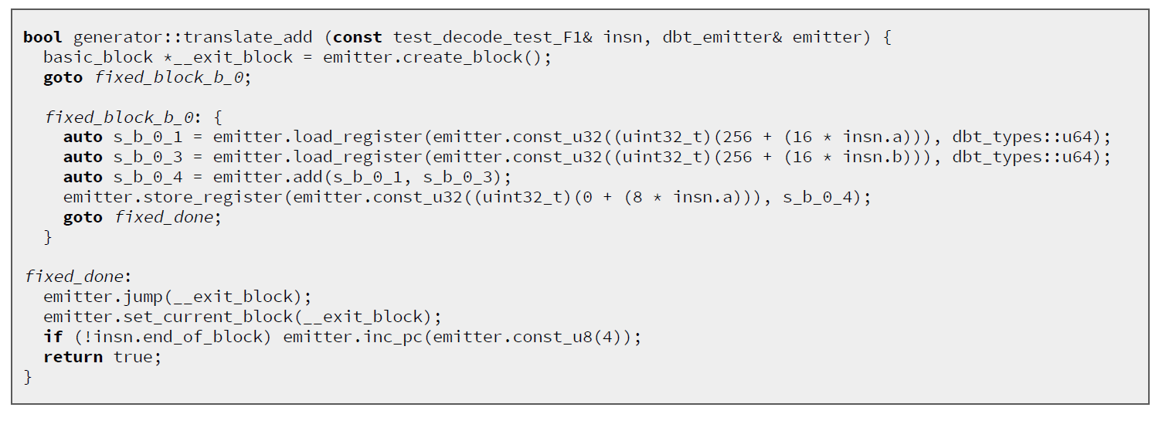
Generator Function

Slide 20
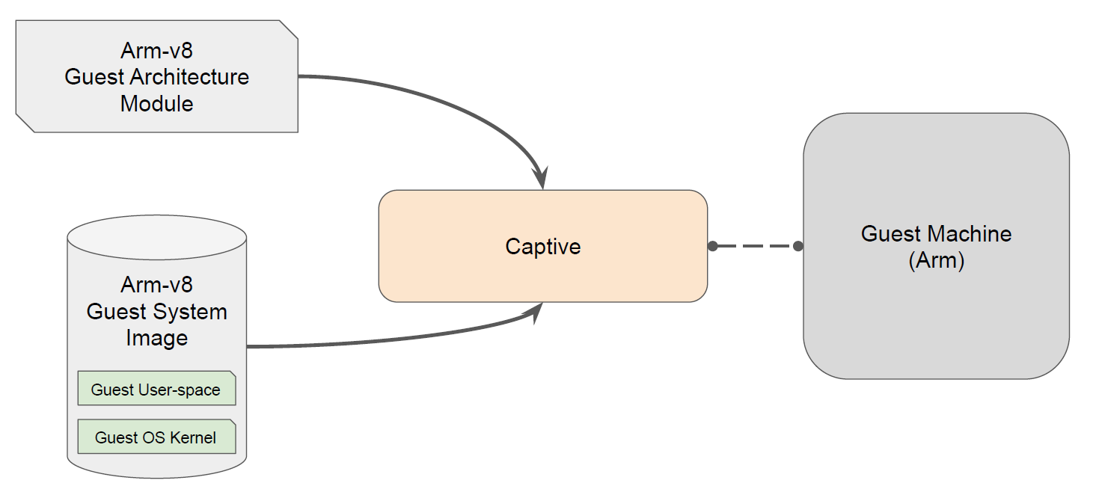
Online stage

Slide 21
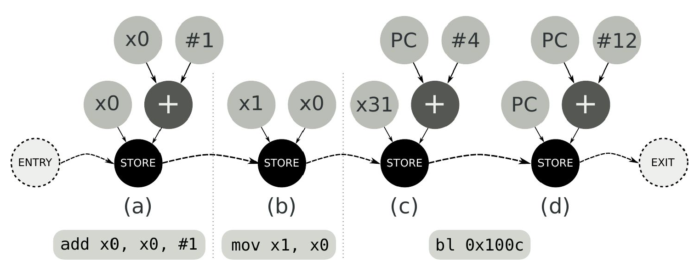
Translation

Slide 22
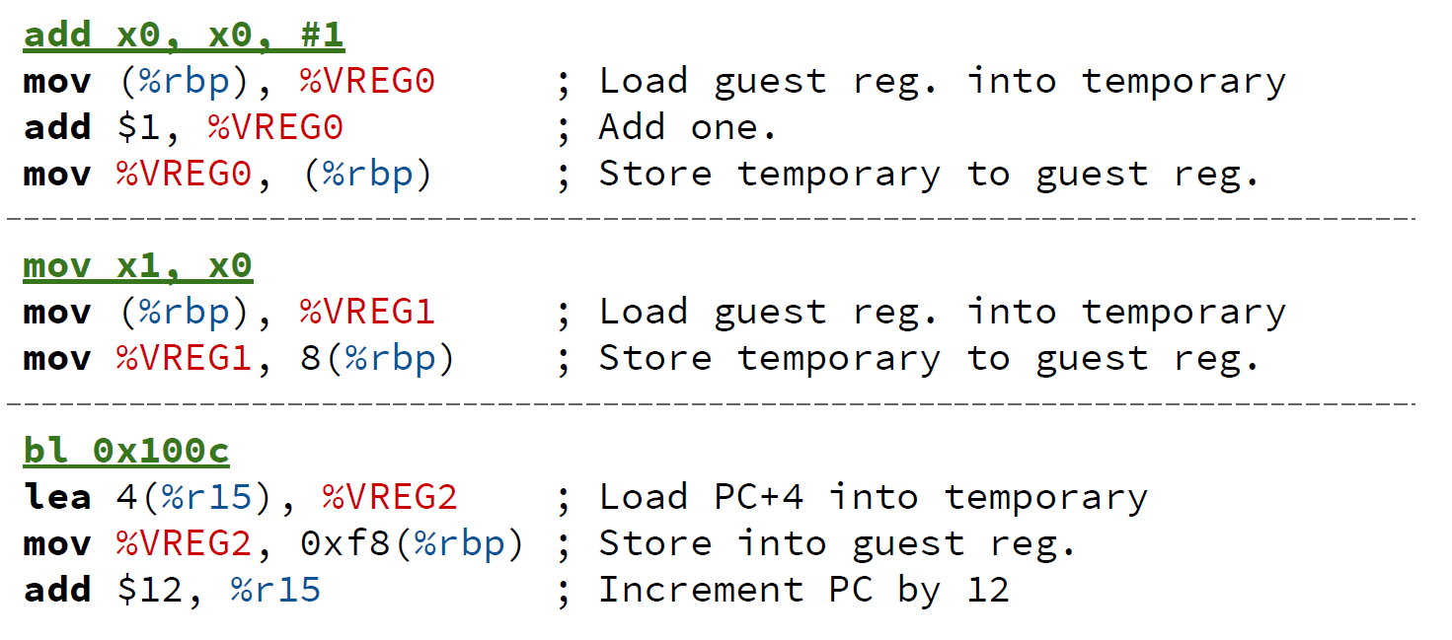
DAG Lowering

Slide 23
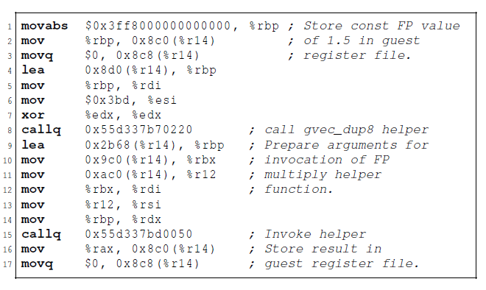
Floating Point Support
QEMU

Slide 24
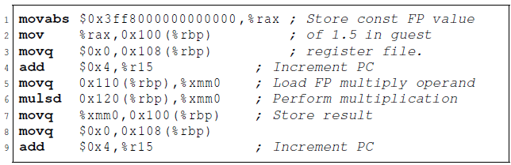
Floating Point Support
Captive

Slide 25
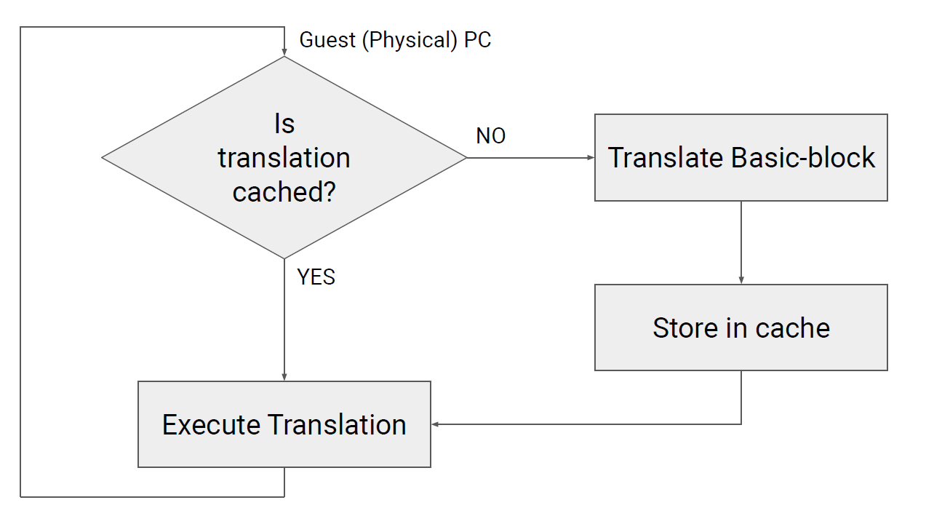
Other Implementations
Translated Code Cache

Slide 26
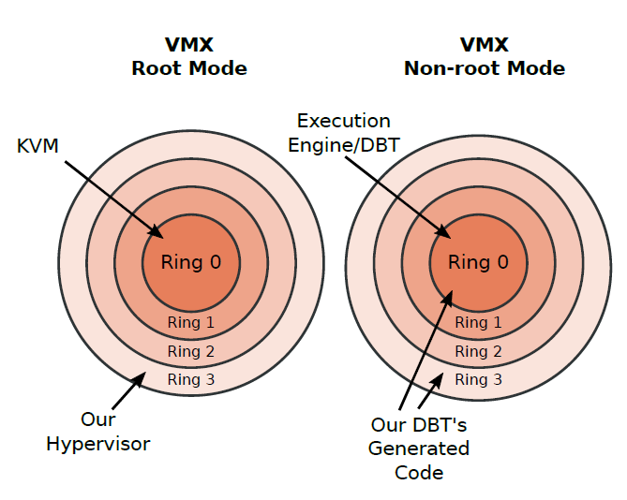
Other Implementations
Translated Code Cache
Exploiting Host Architectural Features
Guest Page Table == Host Page Table (GVA -> HPA)
x86 software interrupt mechanism
x86 fast system call instructions
x86 port-based I/O instructions

Slide 27
Other Implementations
Translated Code Cache
Exploiting Host Architectural Features
Guest Page Table == Host Page Table (GVA -> HPA)
x86 software interrupt mechanism
x86 fast system call instructions
x86 port-based I/O instructions
SIMD Support

Slide 28
Outline
Background
Design & Implementation
Evaluation
Conclusion

Slide 29
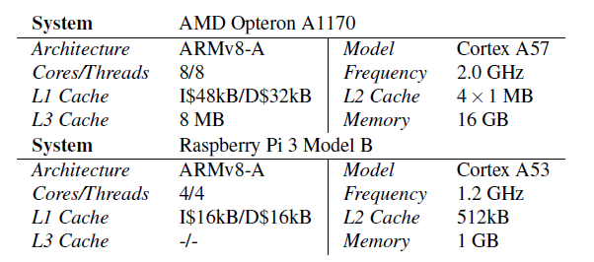
Experiment setups
Hardware
Host : x86-64
Guest : ARMv8-A
Software
QEMU 2.12.1
SPEC CPU2006
Integer
C++ floating-point
SimBench

Slide 30
Integer benchmarks performance
average 2.2X
suboptimal register allocation in hot code

Slide 31
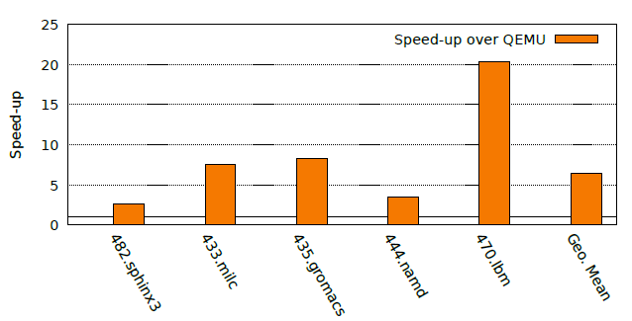
Floating point performance
average 6.49x

Slide 32
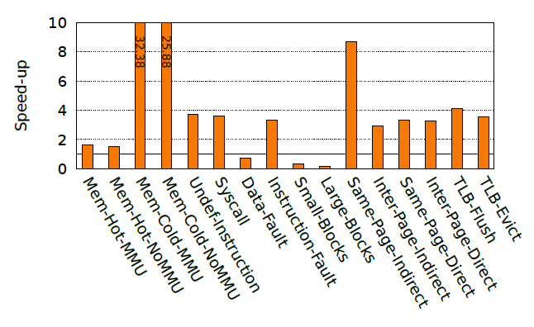
SimBench Result

Slide 33
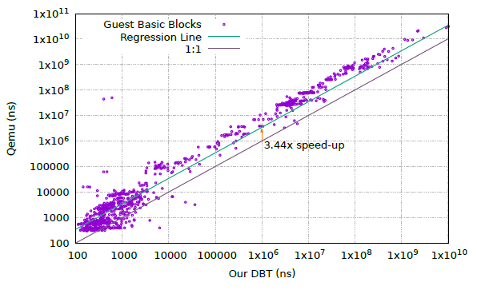
Code quality (SPEC 429.mcf)

Slide 34
Comparison to Native Execution
1.2GHz Cortex-A53
2.0GHz Cortex-A57

Slide 35
Outline
Background
Design & Implementation
Evaluation
Conclusion

Slide 36
Conclusion
A novel system-level DBT hypervisor
Retargeting to new guest system using high-level ADL
Combining offline and online optimizations

Slide 37
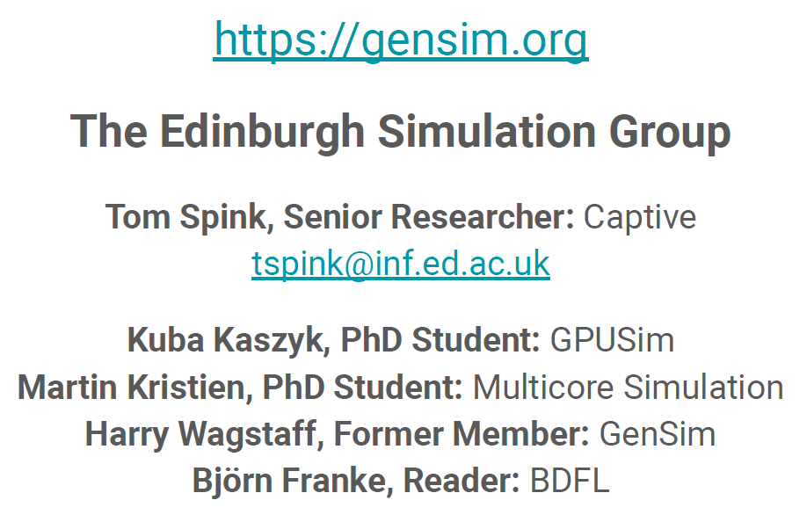
About Author

Slide 38
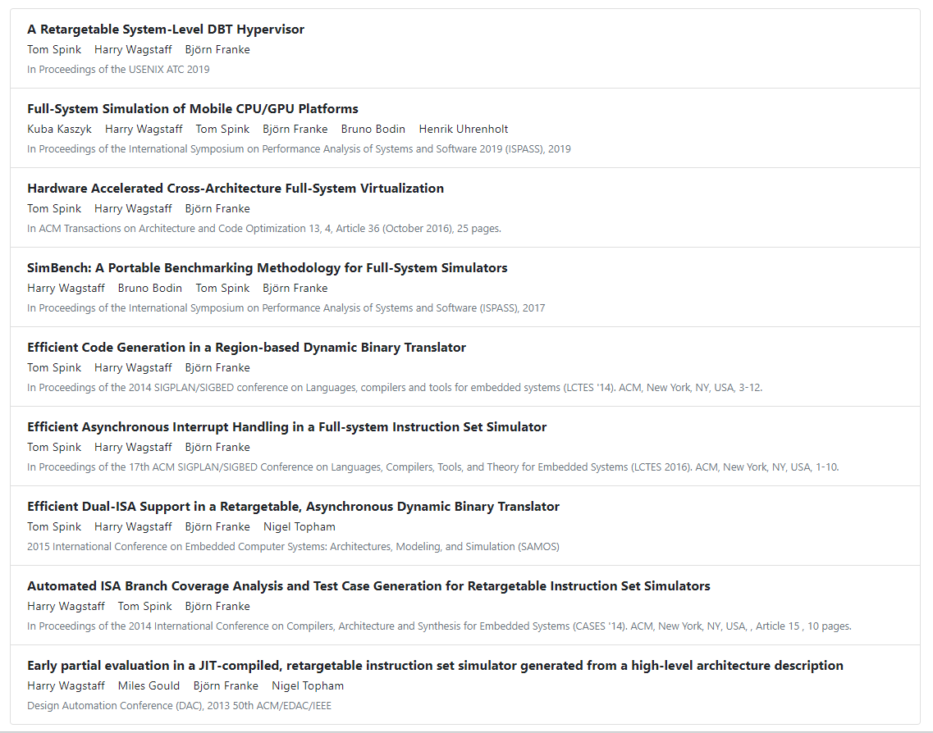
About Author

Slide 39
A Retargetable System-Level DBT Hypervisor
Thanks & QA!
October 10th, 2019

