Slide 1
KVell: the Design and Implementation of a
Fast Persistent Key-Value Store
SOSP 19
Baptiste Lepers, Oana Balmau∗, Willy Zwaenepoel University of Sydney
Karan Gupta Nutanix
Presented by Yirui Lai, USTC
October 23, 2019

Slide 2
Outline
Background
Motivation
Design
Evaluation
Conclusion

Slide 3
Outline
Background
Motivation
Design
Evaluation
Conclusion

Slide 4
KV store
Widely used in many systems
caching (Redis)
metadata management
messaging (Facebook using HBase)
online shopping (Facebook using RocksDB)
data deduplication
3 client operations：Set(k, v), Get(k), Scan(k1, k2)
2 types: Memory KV & Disk KV

Slide 5
KV store
Widely used in many systems
3 client operations：Set(k, v), Get(k), Scan(k1, k2)
2 types: Memory KV & Disk KV
Memory KV: Redis
Disk KV:
LSM-tree based :LevelDB, RocksDB, PebblesDB
B-tree based: WiredTiger, TokuMX
Others: LSM-trie

Slide 6
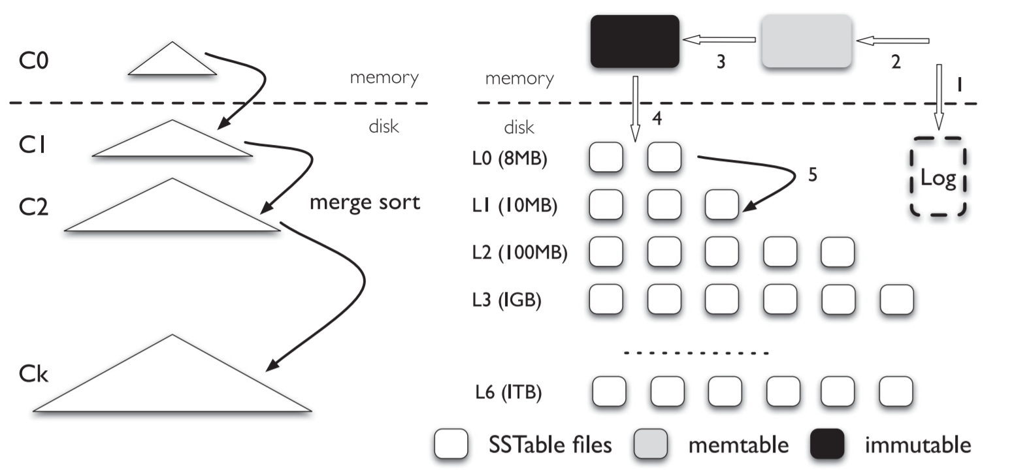
LSM-tree structure
Mem: 2 Memtable, mutable & immutable
Disk: SSTable files

Slide 7
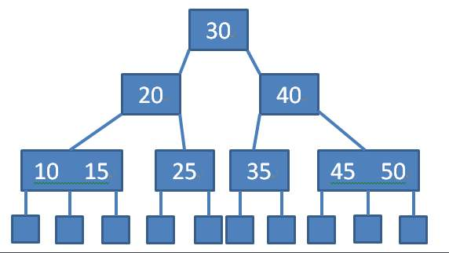
B-tree structure
Every node(not root) can have from m/2 to m children
Root has at least 2 children
Data stored in internal nodes

Slide 8
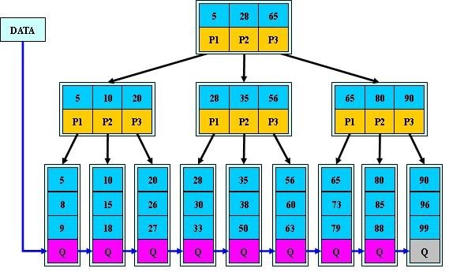
B+ tree structure
Store data in leaves
Internal vertices only store index
All request need to reach a leaf
Leaves are linked for range scan

Slide 9
B+ tree structure
Better than B-tree
More predictable latency
Fewer disk IO during read, due to smaller internal nodes

Slide 10
Outline
Background
Motivation
Design
Evaluation
Conclusion

Slide 11
SSD disk
Much more faster than traditional HDD disk
Lower latency and higher throughput
More useful improvement
We use 3 different SSD to show this

Slide 12
SSD disk
Config | CPU | MEM | SSD | Year
SSD | 32core 2.4GHz Intel Xeon | 128GB | 480GB Intel DC S3500 | 2013
Amazon-8NVMe | 72cores 2.3GHz AWS i3.metal instance | 488GB | 8*1.9TB NVMe SSD | 2016
Optane | 4core 4.2GHz Intel i7 | 60GB | 480GB Intel Optane 905P | 2018

Slide 13
SSD disk
Gap between read and write is smaller

Slide 14
SSD disk
Gap between sequential IO and random IO is smaller

Slide 15
SSD disk
As queue depth increase, both latency and bandwidth get higher
So, there is a tradeoff between low latency and high bandwidth
64 depth maybe a good balance

Slide 16
SSD disk
Furthermore, new SSDs do not have throughput degradation problem
Optane has better performance in latency spikes

Slide 17
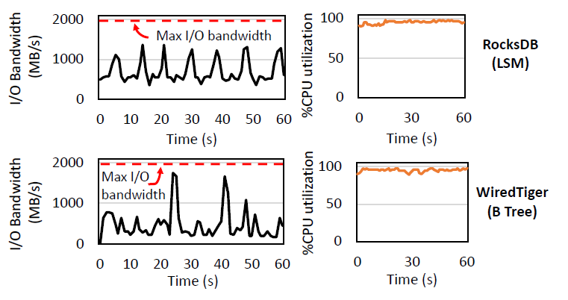
Old KV with new device
We run RocksDB(lsm-tree) and WiredTiger(B+ tree) on config-Optane
YCSB-A workload: 50%read+50%write, uniform distribution, 1KB KV pair

Slide 18
Old KV with new device
Problem:
Old KV cannot make full use of disk bandwidth, while CPU become system’s bottleneck
Why？
Both these two KV system need internal operation to preserve data structure

Slide 19
Why LSM-Tree perform bad？
2 kinds of internal operation: flush and compaction

Slide 20
Why LSM-Tree perform bad？
In the experiment before, most of the CPU time is used in compaction
Up to 60% of CPU time！
28% merging data
15% indexing
17% calling disk IO

Slide 21
Why B-Tree perform bad？
2 kinds of internal operation: checkpointing & eviction
Spending too much time waiting
In the experiment before, worker threads spend 47% of the total time busy waiting
Only 25% of the time spent in the kernel is dedicated to read and write calls

Slide 22
What we can learn from this
Keeping data sorted in disk gets fewer benefits, due to SSDs’ better random performance
Cost of keeping data sorted in disk remains the same
Synchronization between threads is costly
Batching IO request is a good choice

Slide 23
Outline
Background
Motivation
Design
Evaluation
Conclusion

Slide 24
KVell principles
Share nothing
Do not sort on disk, but keep indexes in memory
Aim for fewer syscalls, not for sequential I/O
No commit log

Slide 25
Share nothing
Partition key ranges, like region in TiKV
Each working thread is assigned to a region
All the request in this region is handled by this thread
A-G
H-N
O-T
U-Z
Worker 1
Worker 2
Worker 3
Worker 4

Slide 26
Do not sort on disk
We use an in-memory B-tree in each thread to store index
Because we store unordered data in disk, there is no need to move them if we don’t update it
All the CPU time spent on sorting can be saved
A-G
B-tree
Store Key-index pairs
Worker 1

Slide 27
Aim for fewer syscalls & No commit log
As we mentioned, an appropriate queue depth is needed to achieve both low latency and high bandwidth
We still batch IO request, but not for sequential IO
Fewer syscalls also reduce CPU utilization
Since we can store data at its final position, we just acknowledges updates after they have been persisted

Slide 28
KVell design – Disk component
We store KV pairs fit in the same size range in slab files
KVell access slabs in block granularity, 4k in our machine
For KV size<4k, update is done in place
For KV size>4k, we append them to slab and put a tombstone
For KV size change, we write it in new slab and delete it from the old

Slide 29
KVell design – Disk component
For item<2k
Timestamp, size, key-value
Tombstone+info
For item<4k
For item>4k
Timestamp, size, key-value(part)
Timestamp, size, key-value(next part)
All information is on disk！

Slide 30
KVell design – Memory component
B-tree
Page cache
Free list
Worker 1 (A-G range)

Slide 31
KVell design – Memory component
In memory B-tree use key as index, store KV pair’s disk location
We use key but not hash(key) as index for scan
In average, an item need 19B to store, so a 100GB database with 1KB KV pair need 1.7GB memory
We also support flushing this tree to disk, but not suggest

Slide 32
KVell design – Memory component
Freelist is used to recycle those tombstones and provide enough blocks for an IO batch
Each worker has a freelist with a constant length(64 in our config)
Freelist works as a queue, every block need to be pushed into it
When freelist is full, it pops the 1st block, push the new block, and write the 1st block’s index in new block
3
65
66
Tombstone+info
This info stores another free block
1
2

Slide 33
KVell design – Client interface
Set(k, v)
Insert in worker’s B-tree
Write in page cache
Flush cache
Get(k)
Search worker’s B-tree
Read from cache or disk
Scan(k1, k2)
Need a master thread to search on all workers
Merge results from workers
Read disk

Slide 34
KVell design – Recovery
Designed for failurefree situation
Once crash, scan all slabs and rebuild in-mem B-tree
Slow but safe
All information is on disk！

Slide 35
KVell design scope
About 128B~4KB KV pair, not for small KV pairs
Work on Optane SSD
System have a sizable memory
Not much scan

Slide 36
Outline
Background
Motivation
Design
Evaluation
Conclusion

Slide 37
Experimental setting
Config as before
Config | CPU | MEM | SSD | Year
SSD | 32core 2.4GHz Intel Xeon | 128GB | 480GB Intel DC S3500 | 2013
Amazon-8NVMe | 72cores 2.3GHz AWS i3.metal instance | 488GB | 8*1.9TB NVMe SSD | 2016
Optane | 4core 4.2GHz Intel i7 | 60GB | 480GB Intel Optane 905P | 2018

Slide 38
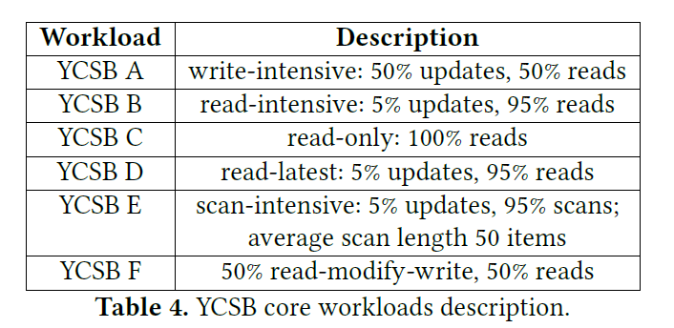
Experimental setting
Rivals: RocksDB, PebblesDB, TokuMX, WiredTiger
YCSB settings:
KV pair size:1KB
Numbers: 100M
Total size: 100GB
Memory setting: available
memory<1/3 total size

Slide 39
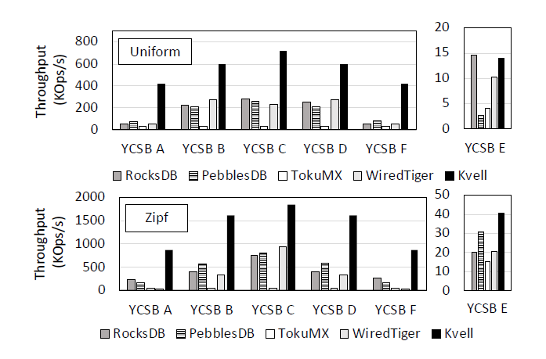
Experiment results - Throughput
On config-Optane
YCSB A-F
YCSB E is bad because KVell performs bad in scan
A: 5.8*
B, C: 2.2* & 2.7*
E: slightly lower, 32% better on Zipfian

Slide 40
Experiment results – Device utilization
On config-Optane
YCSB A, Uniform
Nearly 100% disk bandwidth is used
Theoretically, best performance is 500K IOPS/1.17 = 428K, while we reach 420K IOPS

Slide 41
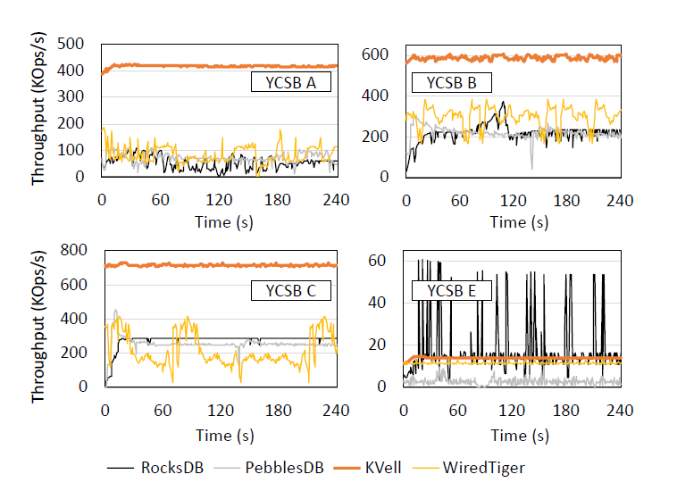
Experiment results – Throughput over time
On config-Optane
YCSB A,B,C,E
Uniform
Measured every second
KVell present a steady line

Slide 42
Experiment results – Tail latency
On config-Optane
YCSB A
Uniform
KVell don’t suffer from tail latency because no internal operation is needed

Slide 43
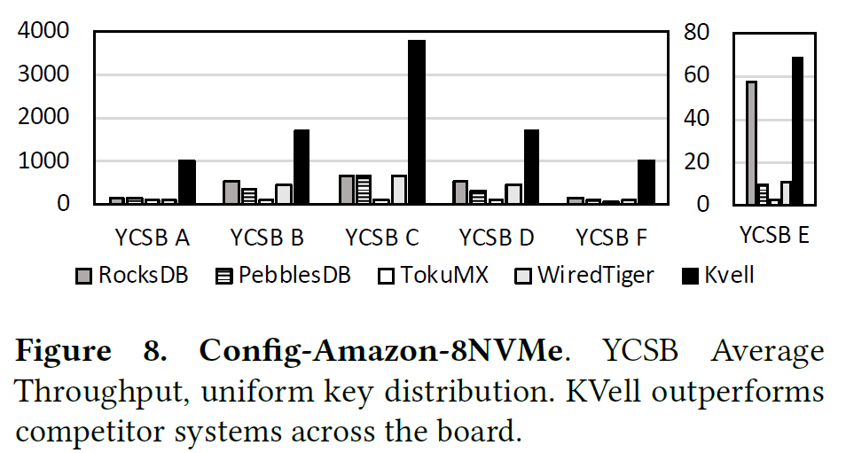
Experiment results
On config-8NVMe
YCSB A-F
Uniform
In YCSB A, KVell is 6.7*, 8*, 13* and 9.3* better than rivals
In YCSB E, KVell slightly better than RocksDB

Slide 44
Experiment results – Real workload
Real workloads, from Nutanix Inc
57:41:2 write:read:scan ratio
KV size: 250B~1KB, 400B average
Total dataset size: 256GB
Workload 1 is uniform
Workload 2 is skewed

Slide 45
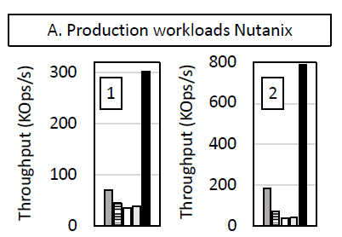
Experiment results – Real workload
Nutanix Inc workloads
On config-Optane
Only 30GB mem
Almost 4* better

Slide 46
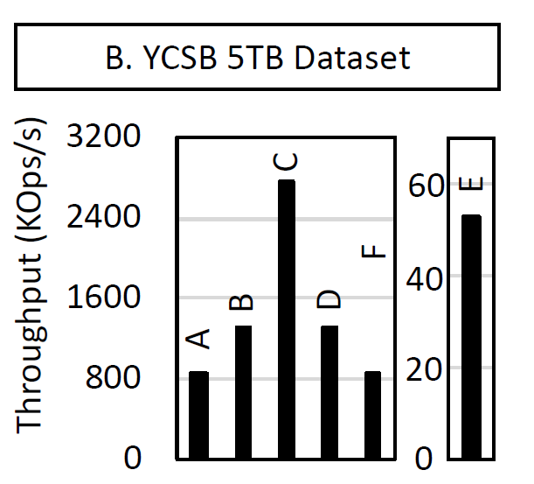
Experiment results - Scalability
YCSB 5TB Dataset
30GB mem
Uniform
Just slightly lower than 100GB test
Achieve 92% of peak bandwidth

Slide 47
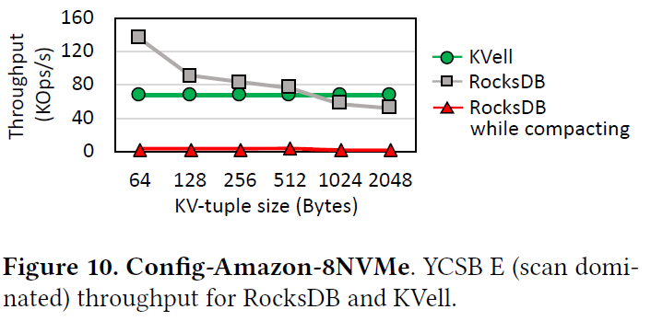
Experiment results - Limitations
Impact of item size
KVell performs steady when size changes
Small item is not suitable for it

Slide 48
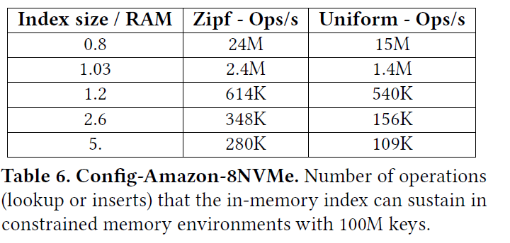
Experiment results - Limitations
Impact of memory size
KVell put index in memory
Lack of memory will slow system down

Slide 49
Experiment results – Recovery time
Recover from failure with a 100GB database(YCSB A) on Config-Amazon-8NVMe
Even though KVell need to scan all files, it still recovers faster
No commit log is main reason
DB | KVell | RocksDB | WiredTiger
Time/s | 6.6 | 18 | 24

Slide 50
Outline
Background
Motivation
Design
Evaluation
Conclusion

Slide 51
KVell
Base: Optane is too fast and cause CPU bound
About 128B~4KB KV pair, not for small KV pairs
Work on Optane SSD
System have a sizable memory
Not much scan
Achieve much more better performance in this situation

Slide 52
KVell vs wisckey
KV Separate
Wisckey: ordered lsm in disk & unordered KV in disk
KVell: ordered index in mem & unordered KV in disk
Mem >> disk

Slide 53
Thanks for your listening
Q& A

