Slide 1
C:聚集度指数
A:非对称度指数
S:平滑度指数
G:基尼系数
$M_{20}:$矩阵指数
其中C一般取80%和20%

Slide 2
Merging galaxy：
(A>0.35)&(A>S)
G>-0.14* $M_{20}$+0.33

Slide 3
Ishape
作者：Søren S. Larsen
适用对象：具有与图像的点扩展函数(PSF)的FWHM相当或更小的固有尺寸的源
如：star clusters in external galaxies
目前包含在BAOLab软件中
工作原理：
将源建模为内部存储的几种可能的分析轮廓之一，估算给定源的固有轮廓，然后调整FWHM,椭圆率和方向，并将模型与根据经验确定的图像PSF卷积，直到获得与观察的源轮廓的最佳匹配。
确定拟合度的公式：
其中$σ_{ij}代表$位置(i,j)处像素的统计不确定性，$N_{i}是$像素数， $N_{free}$是自由度，(x,y)是光源的中心坐标，a，b是振幅和背景， $w_{x}{,w}_{y},α$是长轴短轴及位置角的FWHM.
主要的输入参数：源，源的中心位置坐标(x , y), PSF

Slide 4
工作过程：
1.读取要计算的源
2.提取用户提供的位置($x_{0}{,y}_{0}$)处的对象，并储存在数组$I_{ij}$中
3.计算权重图$W_{ij}$
4.沿长轴，短轴($w_{x}{,w}_{y}$)和位置角$(α)$初始化HWFM
5.找到$X_{min}^{2}(w_{x}{,w}_{y},α)的$最小值
(a)将模型S $(w_{x}{,w}_{y},α)$以十倍的分辨率储存在数组中
(b)与PSF进行卷积 M=S*P
(c)将M乘以振幅a，加上背景b，计算$X_{w_{x}{,w}_{y},α}^{2}(x,y,a,b)$,调整x,y,a,b直到得到最小的$X_{min}^{2}\left(w_{x}{,w}_{y},α\right)$
(d)调整$w_{x}{,w}_{y},α$
(e)重复a-d步骤，直到得到$X_{min}^{2}(w_{x}{,w}_{y},α$)最小的可能值
6.在步骤c中对于固有形状重复使用$δ函数$选择，这对应于纯PSF拟合。同时会将$X_{min}^{2}$打印输出，以便用户判断拟合度
7.当拟合结果收敛时，打印拟合结果，并且保存源，最佳拟合结果M,权重图W,和残差图I-M,

Slide 5
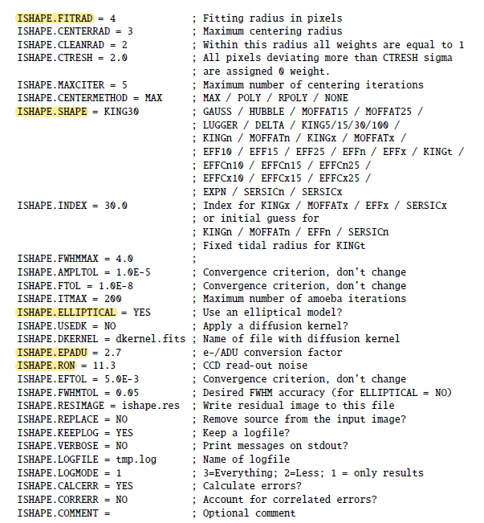
Ishape的主要配置参数：

Slide 6
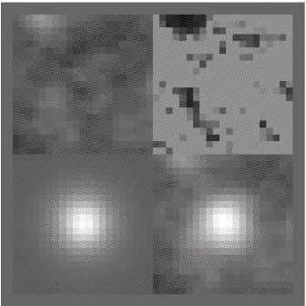
左上：残差图 右上：权重图
左下：模型 右下：源

Slide 7
Gglfit
作者：Chien Y. Peng Galfit2is an image analysis algorithm that can model profiles of galaxies, stars, and other astronomical objects in digital images. If successful, the features of interest are summarized into a small set of numbers, such as size, luminosity, and profile central concentration, which one can compare against other objects for doing science
工作原理：
依据非线性最小二乘法，将源图像和建模得到的图像进行比较，通过迭代得到使$X_{v}^{2}最小$的模型，并将结果输出：
其中$N_{DOF}为$自由度，$f_{data}为$源， $f_{model}为模型$，$σ(x,y)可$由程序计算出

Slide 8
主要控制参数：
A)源文件
B)Imgblocks.fits:输出文件名，包含源，拟合图像，残差图
C)Sigma image(可选）
D)PSF
F)Bad pixel mask
H)Image region to fit(Xmin,Xmax,Ymin,Ymax)
I)Size of the convolution box (X,Y)
J)Magnitude Zeropoint
K)Plat scale: [mag/arcsec2]
P)Option :0&1&2&3
设置为0：正常运行
设置为1：读取输入的参数建立模型图像并立即退出
设置为2：根据当前的拟合参数输出结果
设置为3：记录每次拟合的结果

Slide 9
Galfit同时可以测量多个对象，针对每个对象
Item 0：object name（内部定义的拟合不同种类天体的函数类型）
Item 1，2：对于星系，是星系的位置
Item 3：对于sersic，是星系的总流量
Item 4：拟合星系的标尺长度
Item 5：浓度指数n
Item 9：长轴与短轴的比值
Item 10：位置角
针对item 0，galfit内部定义了很多拟合不同种类的函数，如拟合星系图像时，使用sersic函数，拟合恒星图像时，使用psf函数，拟合天空图像时，使用sky。

Slide 10
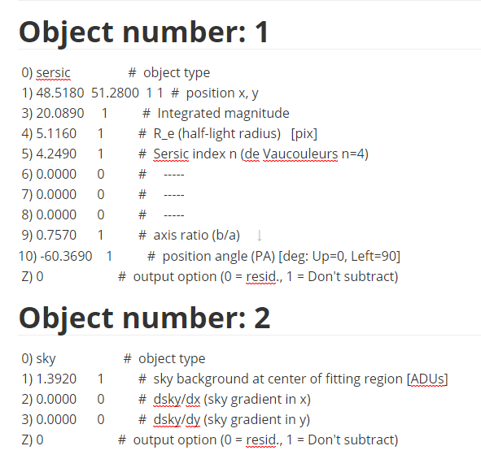
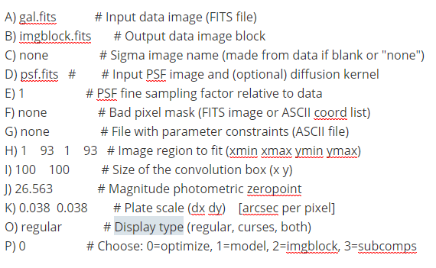
输入参数举例：

Slide 11
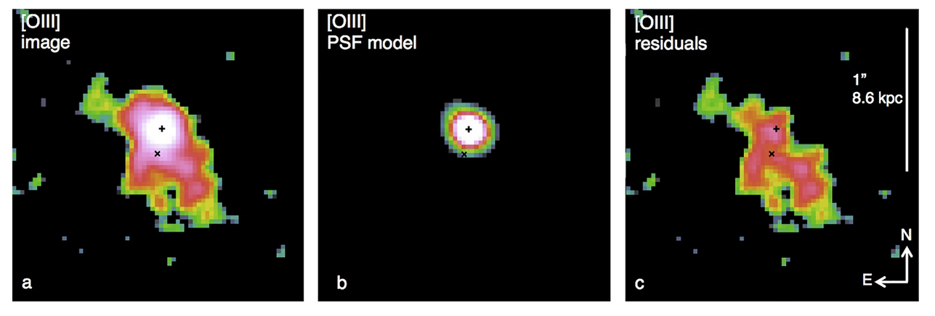

Slide 12
PyMorph
作者：Vinu Vikram
PyMorph is a software pipeline which computes non-parametric and parametric morphological parameters of galaxies .
依赖的库：
(1)Python 2.7 or greater not python 3.0 or greater
(2)numpy
(3)matplotlib
(4)pyfits
(5)GALFIT
(6)sextractor
(7)xpa(optional, if you want to select PSF)
(8)MySQLdb(optional)

Slide 13
工作模式：
1.Normal mode:
2.PSF selection: To select the PSFs from image
3.Repepeat mode: he parameter estimation process can be failed dueto several reasons. If the user feels that the fitting can be improved by adjusting the initialvalues or using an efficient mask, this mode can be used. Here the pipeline will run again onthe failed galaxies using the user specified parameters and images.
4.Find and fit: generate parameters of objects which satisfy the magnitude range specified by the user.

Slide 14
主要输入参数：config.py
1.Imagefile: 源文件
2.Whtfile:权重图(可选）
3.sex_cata:sex的配置文件
4.clus_cata:需要拟合的对象的列表
5.Datadir:保存输出文件的路径
6.Outdir:输出的参数
7.Psfselect: 0=>使用用户给的PSF文件
1=>只生成PSF文件
2=>生成PSF并用该PSF运行程序
8.Psflist:输入的PSF
9.Mode:工作模式
10.GALFIT_PATH:GALFIT的安装路径
11.SEX_PATH:SEX的安装路径
12.PYMORPH_PATH:pymorh的安装路径
13.galfitv:galfit的版本

Slide 15
输出参数：
1.gal_id:星系的标识符
2.ra1,ra2,ra3:星系的RA值
3.dec1,dec2,dec3:星系的DEC值
4.Z:红移
5.Wimg:星系的权重图
6.Psf:PSF图像
7.Ximg:星系的X中心
8.Yimg:星系的Y中心
9.Bxcntr:背景的X中心
10.Bycntr:背景的Y中心
11.C:聚集度指数
12.A:非对称指数
13.S:簇集指数
14.G:基尼系数
15.$M_{20}$:矩阵指数
11.flag

Slide 16
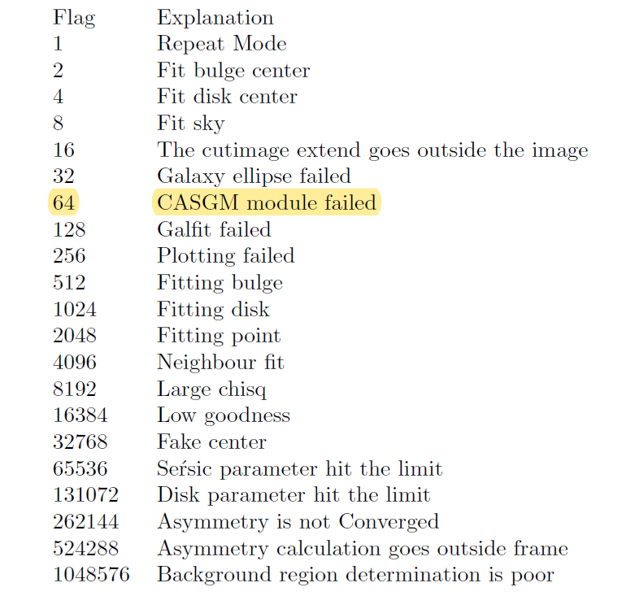
Flag的取值：

Slide 17
statmorph
statmorph is a Python package for calculating non-parametric morphological diagnostics of galaxy images (e.g., Gini-M_{20} and CAS statistics), as well as fitting 2D Sérsic profiles.
The main interface between the user and the code is the source_morphology function, which calculates the morphological parameters of a set of sources

Slide 18
The statmorph code requires the following data:
(i)image: An image containing the object(s) of interest, given as a 2D array . The code assumes that the input image is already background subtracted.
(ii)segmap: The corresponding segmentation map, given as a2D array (of the same size as the image) with different integer values used to label different sources. A value of zero is reserved for the background.
(iii)Weight map or gain: The weight map is a 2D array (of the same size as the image) representing the 1σvariation of each pixel value, including the contribution from the sky background.12If the weight map is not provided by the user, a ‘gain’ parameter must be provided instead, i.e. a multiplicative factor that converts the image units into electron counts per pixel. This is used internally by the code to estimate the weight map assuming Poisson statistics.

Slide 19
The following two input arguments are optional ,but their use is strongly recommended if:
(iv)mask: A 2D array (of the same size as the image) with boolean values indicating the pixels that should be excluded from the calculation (e.g. pixels contaminated by foreground stars).
(v)PSF: A 2D array (usually smaller than the image) representing the PSF of the observations. This is only used for the Sersic profile fitting.

Slide 20
For a given (background-subtracted) image and a corresponding segmentation map indicating the source(s) of interest, statmorph calculates the following morphological statistics for each source:
Gini-M20 statistics
Concentration, Asymmetry and Smoothness (CAS) statistics
Multimode, Intensity and Deviation (MID) statistics
Outer asymmetry and shape asymmetry
Sérsic index
Several shape and size measurements associated to the above statistics

Slide 21
Apart from the morphological parameters, statmorph also produces two different “bad measurement” flags (where values of 0 and 1 indicate good and bad measurements, respectively):
flag : indicates a problem with the basic morphological measurements (e.g., a discontinuous Gini segmentation map).
flag_sersic : indicates if there was a problem during the Sersic profile fitting.
In general, users should enforce flag == 0, while flag_sersic == 0 should be applied only when actually interested in Sersic fits (which can fail for merging galaxies and other “irregular” objects).

Slide 22
几种工具的比较：
ishape
优点：操作相对简单，用C语言编写，运行应该较快
缺点：只适合计算特定种类源的参数
pymorph：
优点：操作相对简单
缺点：依赖过多，且不支持python3.0
Galfit：
优点：功能强大
缺点：操作相对繁琐
Statmorph相较上述软件，操作相对简单，在各种环境下均能运行，适用范围广，可测量参数多，但开发时间较短，可能存在的bug多。

