Slide 1
Compact Star-Forming Galaxies as Old Starbursts Becoming Quiescent

Slide 2
1. INTRODUCTION
main sequence (MS) of star formation
secular evolution is the dominant mode of stellar growth where gas inﬂows, outﬂows, and consumption through star formation are in equilibrium.
SFGs spend most of their time evolving as extended star-forming disks.
quiescent galaxies (QGs), having low speciﬁc star formation rate (sSFR), are located below the MS and are typically more compact than SFGs for a ﬁxed stellar mass and redshift
compact star-forming galaxies (cSFGs)
Did the build-up of the stellar core, formation of cSFGs, and subsequent quenching of star formation happen as the product of the slow secular evolution or rapidly?
Notes:
4,The quenching of star formation and the departure from the MS must imply the build-up of a central stellar core
5,A population of galaxies have been proposed to be the missing link between the extended SFGs and the more compact QGs,
6,Or in other words, is it the natural endpoint of secular galaxy evolution when a suﬃciently large bulge has build up or does it require an external event like a merger-induced starburst to compress the gas at the center of the collision and quickly convert it into stars?

Slide 3
2.SELECTION OF COMPACT STAR-FORMING GALAXIES
cSFGs are galaxies that follow the structural relation of QGs, while being star-forming.
compactness selection threshold
the core density
QGs selection threshold
2.1. Optical Sample
3D-HST survey catalogs
0.5 < z < 3.0
13703 galaxies (7222 in COSMOS and 6481 in GOODS-North)
with 416 cSFGs (227 in COSMOS and 189 in GOODSNorth).

Slide 4
2.2. Far-Infrared Sample
The ”super-deblended” FIR to submillimeter photometric catalogs in COSMOS and GOODS-North
968 galaxies (357 in COSMOS and 611 in GOODS-North)
with 73 cSFGs (26 in COSMOS and 47 in GOODSNorth).
2.2.1. Rayleigh-Jeans and Radio Subsets
RayleighJeans (R-J) side of the FIR spectral energy distribution (SED):S/N ≥ 3 above a rest-frame wavelength of 250 µm ------required to obtaingas mass estimates.
59 galaxies (24 in COSMOS and 35 in GOODS-North)
with 5 cSFGs (4 in COSMOS and 1 in GOODS-North).
cross-matched our FIR catalog with radio catalogs from the Giant Metrewave Radio Telescope (GMRT). at least two S/N ≥ 5 detections at any available radio frequency.
60 galaxies (23 in COSMOS and 37 in GOODS-North) with 7 cSFGs (2 in COSMOS and 5 in GOODS-North).

Slide 5
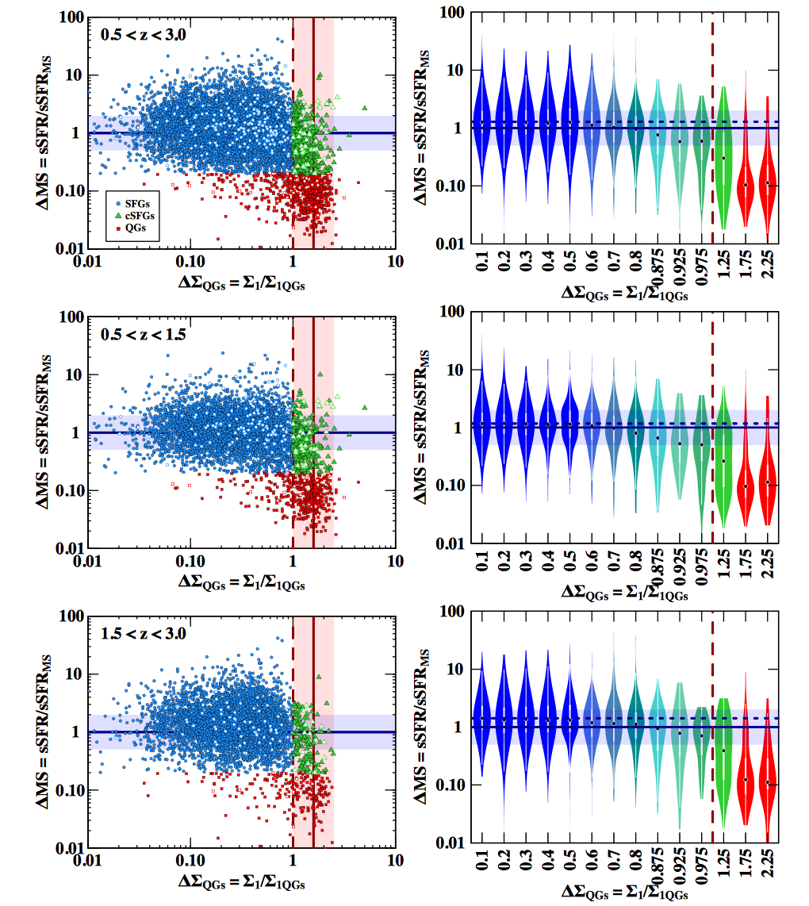
3. COMPACTNESS AND STAR FORMATION
extended
compact
Overall, galaxies start to transition smoothly towards quiescence, since ∆MS decreases continuously for increasing ∆Σ _{QGs} .
Some extended SFGs quench forming extended QGs as they build up their stellar cores. On the other hand, the sharp transition region at ∆Σ _{QGs} ∼1.0 indicates that other galaxies become compact before they quench.
Notes:
L-shape reported in Barro et al. (2017a), with the population of cSFGs forming the knee between extended SFGs and cQGs. This was used as an argument in favour of cSFGs as progenitors of QGs at later times, implying that SFGs become compact before they quench. Note that the majority of QGs are compact QGs.
Some extended SFGs become cSFGs and then compact QGs as they build up their stellar cores. The latter would be a more common track since the majority of QGs are compact QGs, Note that it has to be consider that SFGs do not evolve into QGs at the same epoch (i.e., redshift), but into QGs at later times.
This indicates that, at least some of the galaxies make the transition by increasing their sSFR and going above the scatter of the MS.
The general trends are similar at low and high redshift, although there are some important diﬀerences. This indicates that the MS is more aﬀected at the highredshift bin than at the low-redshift bin by galaxies that are already in transition towards quiescence and that lower its normalization.

Slide 6
Trends for Massive Galaxies
Overall, the trends are similar than those discussed in the previous section.
∆MS is not approximately constant up to ∆Σ QGs = 0.5 anymore, but it rather starts to decay since the ﬁrst bin centered at ∆Σ _{QGs} = 0.1.
Notes:
This is expected as a consequence of massive galaxies being more dominated by galaxies that are already in transition towards quiescence than low-mass galaxies.

Slide 7
4. ARE COMPACT STAR-FORMING GALAXIES NORMAL STAR-FORMING GALAXIES OR STARBURSTS?
Revealing their nature implies revealing whether the transition to quiescence occurred secularly or rapidly.
three diagnostics of the burstiness of star formation:
SFE
2) ISM
3) radio emission.

Slide 8
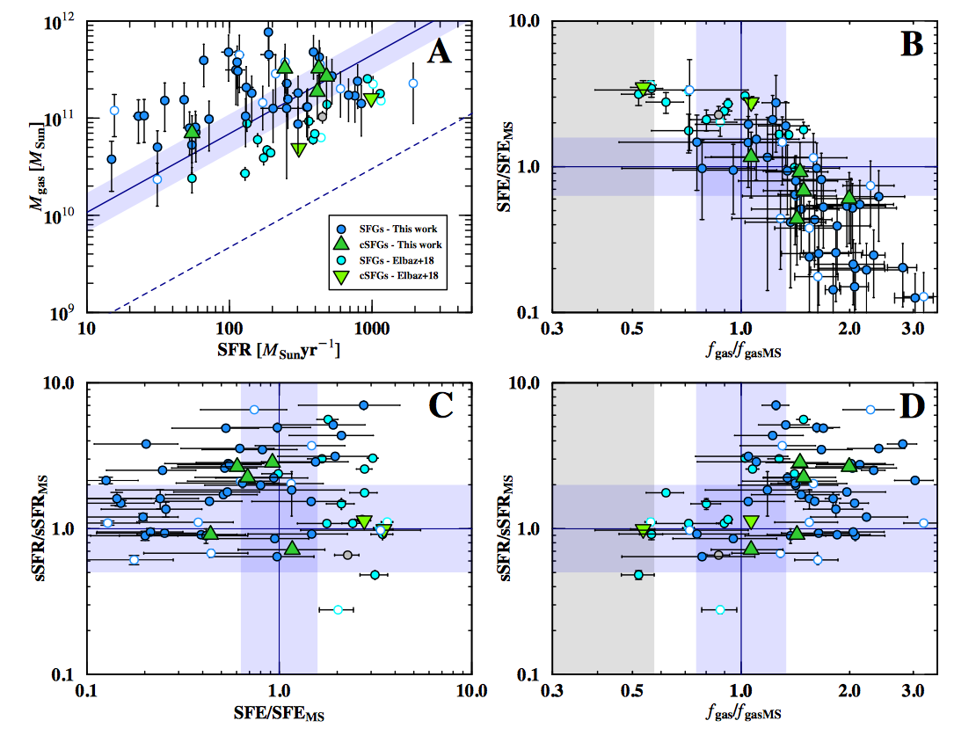
Diagnostic 1: Star Formation Eﬃciency
There is no evidence for a distinct SFE in cSFGs and extended SFGs, suggesting that both secular and rapid evolution processes could generate cSFGs.

Slide 9
Diagnostic 2: Interstellar Medium
This suggest that the growth of a compact stellar core leading to cSFGs could happen secularly. Another explanation could be that if coming from a rapid starburst event, the latent ISM in cSFGs retains similar properties to that of upper-MS normal SFGs.

Slide 10
Diagnostic 3: Radio Emission
There is evidence for a trend in increasing compactness with the expected age evolution of the radio emission in SBs, indicating that cSFGs could be old SBs, while extended SFGs could be a mix of normal SFGs and young SBs.

Slide 11
5. DISCUSSION
two additional behaviours of the general evolutionary trend of the galaxy population.
The apparent contradictory conclusions drawn from the SFE and ISM diagnostics versus the radio emission diagnostic can be reconciled if the SFE and ISM properties do not dominate the entire galaxy in an old SB phase, in agreement with resolved follow-up studies in the literature.
Notes:
1) galaxies start to transition smoothly towards quiescence, as the median sSFR decreases continuously for increasing compactness; 2) at least some of the SFGs galaxies become compact by increasing their sSFR and going above the scatter of the MS,

Slide 12
6. SUMMARY AND CONCLUSIONS
The distribution of galaxies in the ∆MS-∆Σ QGs plane reveal that galaxies transition smoothly towards quiescence with increasing compactness.
The MS is dominated by extended SFGs. However, SFGs with increasing compactness that are transitioning to quiescence contribute to lower the normalization of the MS.
There is no evidence for a distinct SFE in cSFGs and extended SFGs, suggesting that both secular and rapid evolution processes could generate cSFGs.
Extended SFGs located slightly above the MS (upper-MS galaxies) have ISM properties (CO excitation, density of the neutral gas, and strength of the ultraviolet) similar to lower envelope of SBlike ISM properties,
There is evidence for a trend in increasing compactness with the expected age evolution of the radio emission in SBs.

