Slide 1
Galaxy And Mass Assembly (GAMA): The sSFR-M∗ relation part I σ_{sSFR} -M∗ as a function of sample, SFR indicator and environment
L. J. M. Davies et al.
Liu haiyang
2018.11.21

Slide 2
1. INTRODUCTION
star-forming sequence (SFS, or starforming ‘main sequence’):a tight correlation between their star formation rate (SFR) and stellar mass (M∗ )
sit close to the locus of the SFS:star-forming galaxies reside in a self-regulated equilibrium state.
deviate from the SFS:passive cloud, ‘green valley’, star-bursting sources.
high stellar mass regime:ﬂatten. non-star-forming bulge components.
star-formation history (SFH):fundamentally aﬀect its trajectory through the sSFR-M∗ plane.
properties such as environment, morphology and structure, and physical mechanisms which result in galaxies moving through the plane is essential to our parameterisation of the factors driving galaxy evolution.

Slide 3
dispersion along the sSFR-M∗ relation (σ_{sSFR} –M*):One key diagnostic of these physical mechanisms. This dispersion is essentially a metric of the variation in a galaxy’s recent SFH at a given stellar mass.
Previous work:(‘U’-shaped) dispersion--disc-like spirals from Galaxy Zoo.
1,diﬀerent SFR indicators:the physical timescales over which they probe.
2, diﬀerent sample selection methods.
Simulations:(‘U’shaped) σ_{sSFR} -M∗ relation,linearly decreasing σ_{sSFR} -M∗ in EAGLE.
this ﬁrst paper we explore the observed dispersion along the SFS and its variation with sample selection, SFR indicator and group/isolated environment using the Galaxy And Mass Assembly (GAMA) sample.
(‘U’shaped) σ_{sSFR} -M∗ relation:physical or an artefact of their chosen method.

Slide 4
2. DATA AND SAMPLE SELECTIONS
GAMA survey:GAMA II_{Eq}(three equatorial regions G09, G12 and G15.)
Stellar masses: ugriZY JHK photometry, Chabrier IMF (Chabrier 2003).
GalaxyZoo:the Kilo Degree Survey (KiDS)
49,851 galaxies z < 0.15.
z < 0.1:extend to lower stellar masses, largely remove any evolution in the SFS.
isolated (non-group or pair) galaxies:remove any additional environmental quenching eﬀects.
starting sample: 9005 galaxies.

Slide 5
GAMA SFR indicators: i) magphys-derived SFRs ii) combined Ultraviolet and Total Infrared (UV+TIR) SFRs iii) Hα-derived SFRs iv) Wide-ﬁeld Infrared Survey Explorer (WISE) W3-band SFRs v) extinction-corrected u-band SFRs

Slide 6
3. ISOLATING THE TARGET POPULATION
diﬀerent selection methods can signiﬁcantly aﬀect the observed distribution.
No Selection:all 9005 sources
u − r Colour Selection:
sSFR Selection: Log[sSFR]>-11.31
Morphological/Structural Selections:
Galaxy Zoo:
Grootes et al disc Proxy:log₁₀ [M∗]>9.0
Bulge-to-Total Mass:B/T<0.5
Sersic Index:n < 2.5
Galaxy Zoo morphology and single Sersic Index
Galaxy Zoo morphology, single S´ersic Index and B/T

Slide 8
4. A MASS DEPENDENT σ_{SSFR}?
symmetric log-normal distribution
an asymmetric tail extending to low sSFRs indicative of a greenvalley/passive population
a negative skew value, highlighting that the distributions have asymmetric tails extending to low stellar masses.
For both SFRs in all but the lowest stellar mass bin the skew value becomes more negative to higher stellar masses suggesting that the distribution becomes more asymmetric as a function of mass.

Slide 9
‘U’-shaped distribution with minima at σ_{sSFR} ∼ 0.35 − 0.5 dex and log₁₀ [M∗ ]=8.5-9.5
a steep increase in both σ_{sSFR} and interquartile range to higher stellar masses than this minima. The increase to lower stellar masses is much shallower but tentatively observable in both measures of dispersion.
a consistency between the dispersion measured using both σ_{sSFR} and the interquartile range at most stellar masses.
the interquartile range may be a more accurate representation of the dispersion as it does not assume a log-normal distribution.
irrespective of the method for selecting a star-forming/disc-like galaxy population based on colour and morphology, in GAMA we observe a ‘U’-shaped σ sSFR -M ∗ relation which is largely consistent with the previous observations.

Slide 10
4.1 Variation with SFR indicator
a comparison of all SFR indicators by scaling the distributions using the minimum dispersion in each indicator. This removes some of the dependancy on absolute normalisation between SFR indicators and allows a more direct comparison of their shape.

Slide 11
a simple metric based on the slope of σ _{sSFR} -M ∗ in the low- and high-stellar mass regime, divided at log ₁₀ [M ∗]=9.25.
This metric displays, at a glance, that irrespective of sample selection or SFR indicator the σ sSFR -M ∗ relation is U’-shaped with minimum close to log ₁₀ [M ∗]=9.25 and increasing dispersion to low and high stellar masses.

Slide 12
4.2 Comparison To The State-Of-The-Art Semi Analytic Model and Hydrodynamical Simulations
the σ _{sSFR} -M ∗ relation from both simulations are consistent with the GAMA results; showing a ‘U’-shape with minimum at log ₁₀ [M ∗]=9-10 and a steep rise at higher stellar masses.

Slide 13
4.3 The Impact of Group Environment
the pairs of points for each sample selection are closer together indicating that the distribution is less curved.
the points are more negative both at the high (squares) and low (circles) mass end indicating that in most cases the distributions are no longer ‘U’-shaped but have a decreasing σ _{sSFR} with increasing stellar mass.

Slide 14
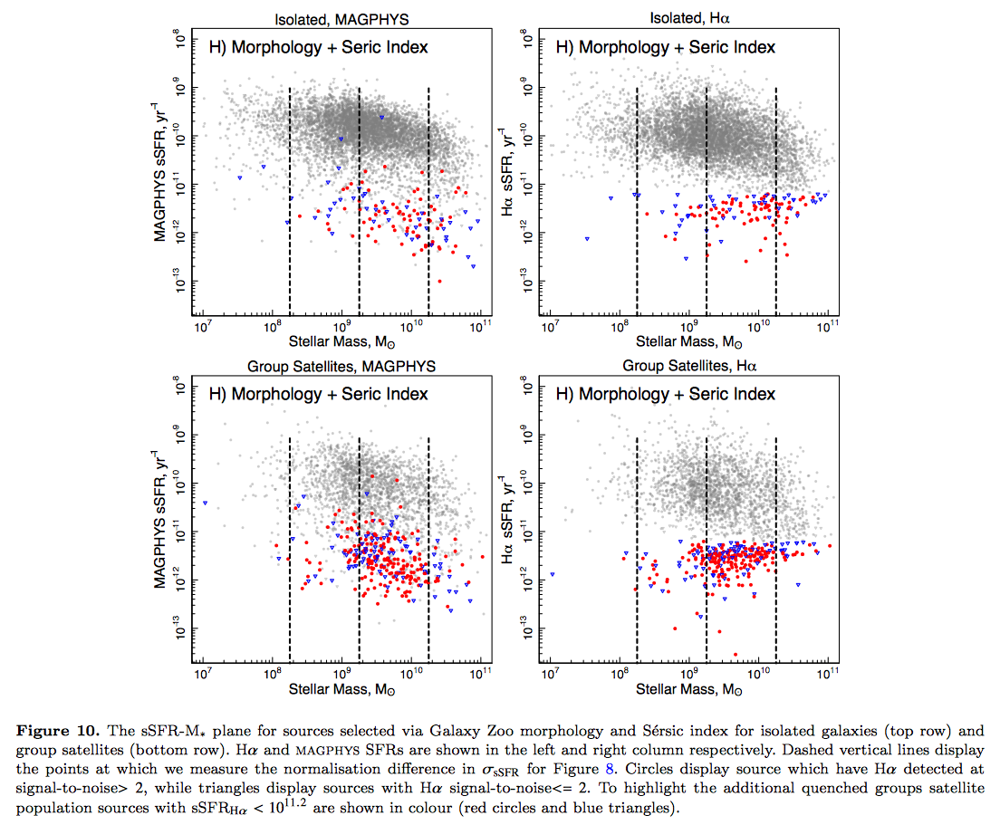
an additional population of quenched group satellite galaxies at log 10 [M*]∼9-10. To highlight this, in Figure 10 we colour all galaxies with sSFR Hα < 10 −11.2 .

Slide 15
5. CONCLUSIONS
Irrespective of selection method of star-forming disc-like systems the σ _{sSFR} -M ∗ relation is parabolic with high dispersion at the low and high stellar mass end and minimum point of σ sSFR ∼ 0.35 − 0.5 dex at log ₁₀ [M*]∼8.75-9.75. This holds true for diﬀerent SFR indicators.
Our results are largely consistent with a number of previous studies and simulation results from EAGLE, Illustris and Shark.
‘U’shape of σ _{sSFR} -M ∗ relation is physical and not an artefact of sample selection or method.
For group satellite galaxies we ﬁnd an increased dispersion at all stellar masses potentially due to more stochastic star formation processes occurring in groups.
We tentatively suggest that this population is produced by group quenching processes and highlight that diﬀerences between Hα- and magphys-derived SFRs for this population may be indicative of short timescale quenching.

