Slide 1
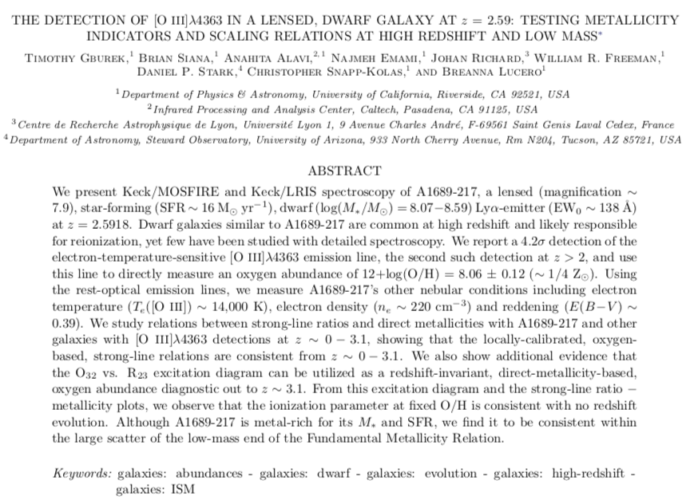

Slide 2
INTRODUCTION
[O III]λ4363 is used for the “direct” method to estimate the electron temperature and density of gas. Combined with oxygen and Balmer lines, it can determine the gas-phase metallicity.
However, it is weak in metal-poor galaxies and even weaker in metal-rich galaxies. This makes [O III]λ4363 difficult to be observed locally, and especially difficult at high redshift.
Only 8 galaxies at z>1 have been detected (most via gravitational lensing) with significant [O III]λ4363, and of those only 1 is at z > 2.
On the other hand, there remains questions whether the strong-line method can be used for metallicity calculation at z>1, because high redshift galaxies may have different ionization environment.
This paper reports a distant draft galaxy at z=2.58 with [O III]λ4363 detection, and discuss the relation between strong-line ratio and metallicity at high redshift.

Slide 3
DATA
For A1689-217
IR and Optical Spectrum: Keck/MOSFIRE and Keck/LRIS
Near-UV,Optical and Near-IR Photometry: HST
Comparison sample
The z ∼ 0 sample of Izotov et al. (2006, I06) ,
The z ∼ 0.8 sample of Jones et al. (2015, J15) ,
The z < 0.9 sample of Ly et al. (2014, Ly14)
And etc.

Slide 4
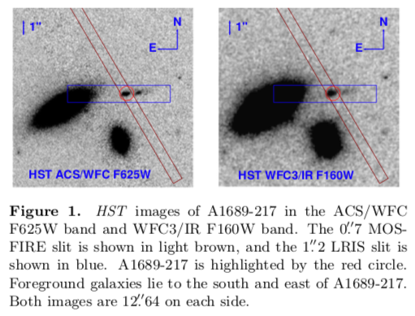
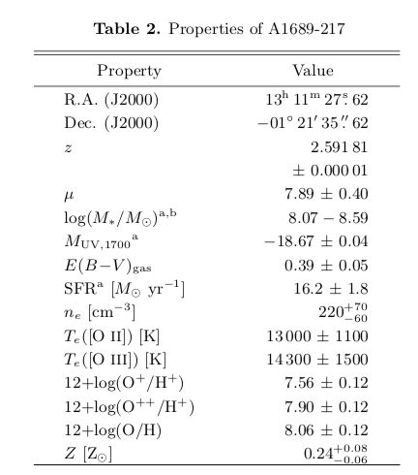

Slide 5
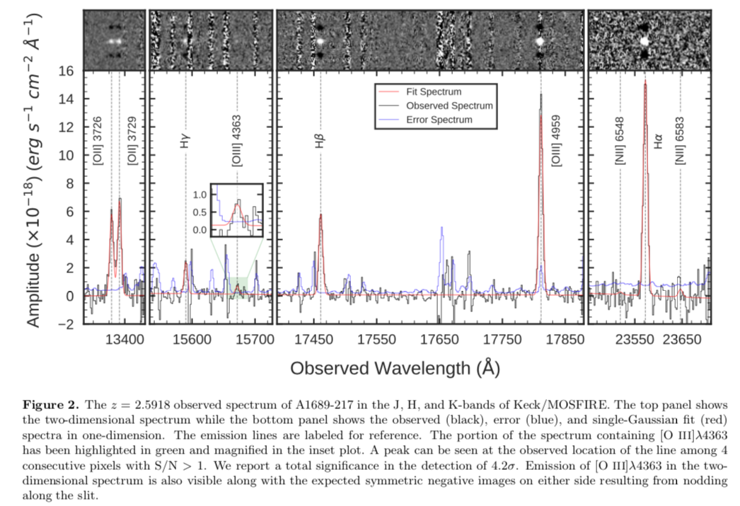

Slide 6
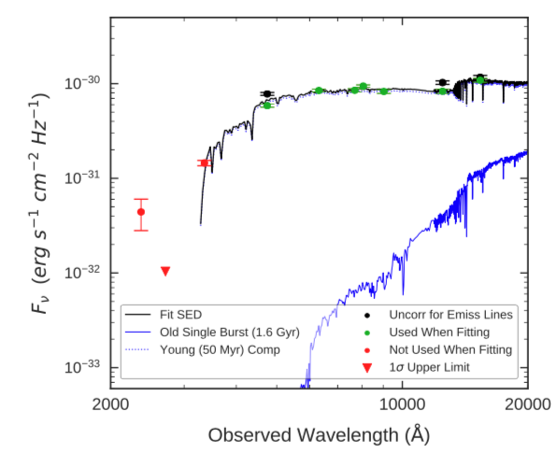
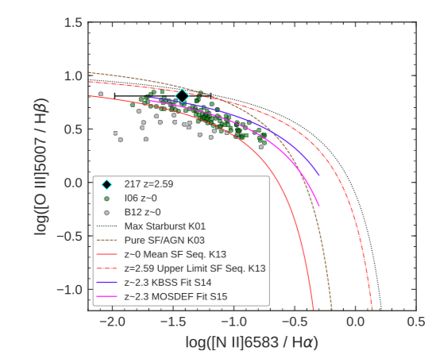

Slide 7
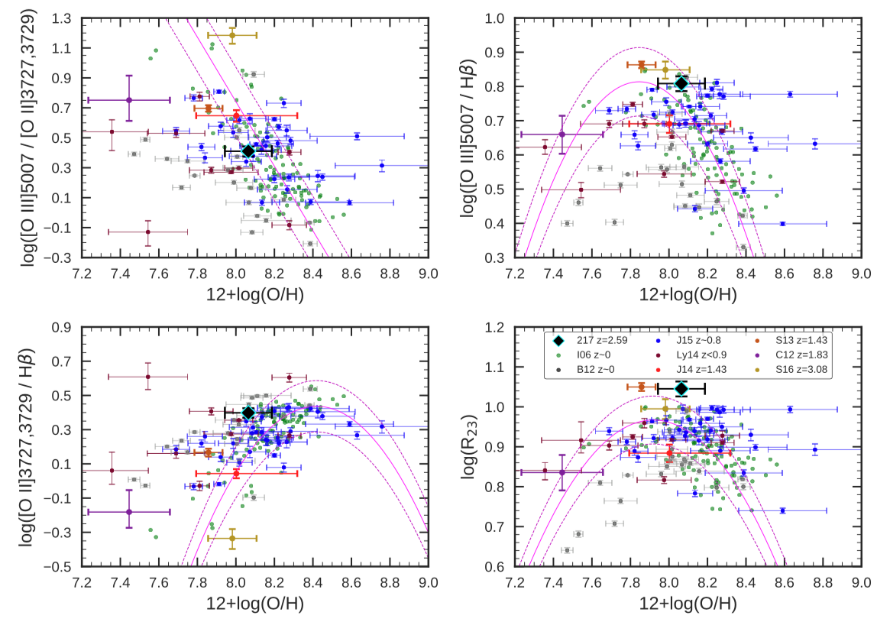

Slide 8
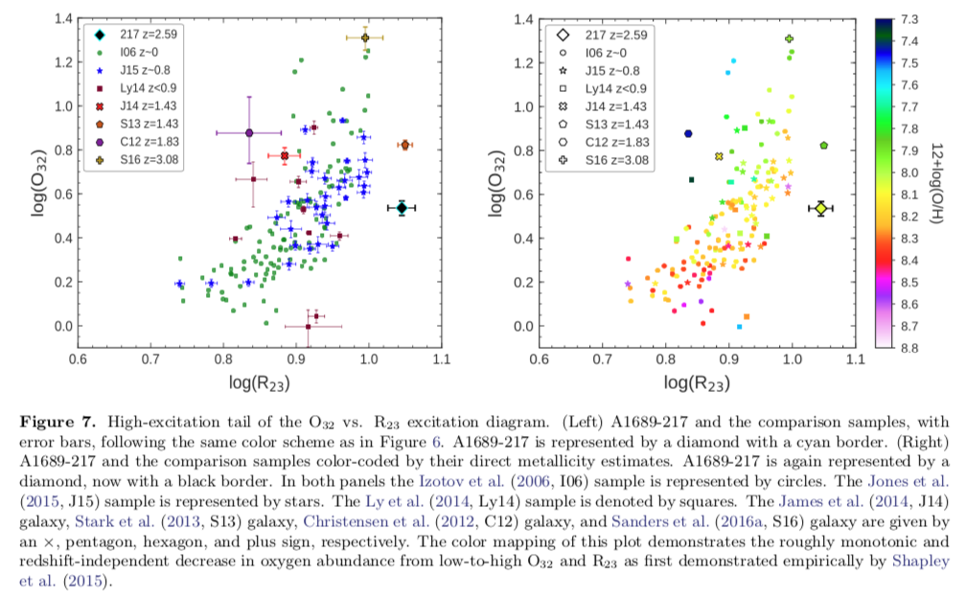

Slide 9
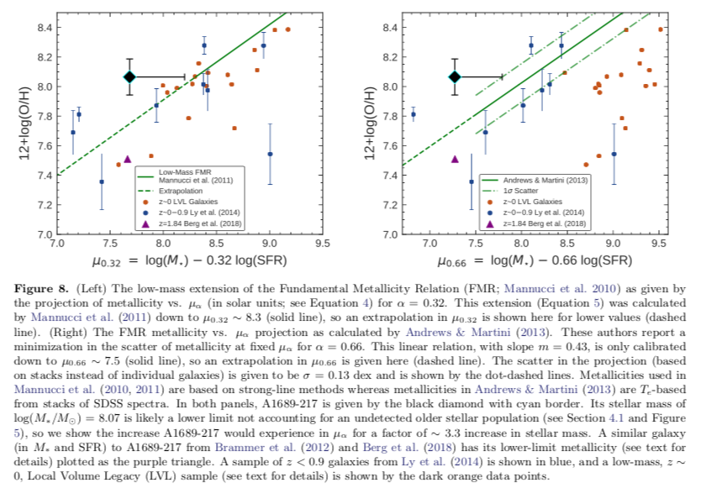

Slide 10
SUMMARY
1.A lensed($μ=7.9$) draft galaxy A1689-217 at z=2.59 was observed to have 4$σ$ [OIII]4363 emission,
it has 12+log(O/H)=$8.06$, log(M/Msun)=$8.07−8.59$ and SFR= $16.2$ Msun/yr.
2.No redshift evolution is found in strong-line ratio—direct metallicity relations from z=0 to z=3.08.
3.No redshift evolution is found in the O32 vs R23 excitation diagram, and there is a nearly mono- tonic decrease in metallicity from low-to-high O32 and R23. Therefore the O32 vd R23 diagram can be used as a redshift-invariant, empirical oxygen abundance indicator.
4.No redshift evolution of ionization parameter is found at fixed O/H, which suggest that the ionization state of high-z, star-forming galaxies is similar to local, metal-poor galaxies.
5.The A1689-217 is consistent with FMRs considering the stellar mass uncertainty due to unseen older stellar population.

