Slide 1
The Circumgalactic Medium of eBOSS Emission Line Galaxies: Signatures of Galactic Outflows in Gas Distribution and Kinematics
Author: Ting-Wen Lan and Houjun Mo.(2018)
Reporter: HuangChi , 2018.12.26

Slide 2
Background
1.What is ISM,IGM and CGM
ISM: InterStellar Medium
IGM: InterGalactic Medium
CGM: CircumGalactic Medium(extended to few hundreds kpc)
2.MgII absorber
MgII 2793,2803 absorption features are common seen in the spectra of quasars. These absorbers originate in cool gas of temperature T~10^4k and N(HI)<=10^18cm^-2 to N(HI)≈10^22cm^-2 .
3.Galaxy-quasar pairs
We can match the MgII absorbers and their nearby galaxies, to probe the distribution of cool circumgalactic gas around the galaxies.

Slide 3
Samples
1.eBOSS Emission Line Galaxies(ELG)(180,000)
z≈0.85, SFR≈8Msun/yr
stellar Mass≈3*10^10Msun, halo mass≈1.5*10^12Msun
2.eBOSS Luminous Red Galaxies(LRG)(760,000)
z≈0,55,
stellar Mass≈10^11.2, halo mass≈10^13.5Msun
3.SDSS DR14 quasar catalog
Combine 1,2 and 3, we select quasar-galaxy pairs that have projected distance smaller than 1.2Mpc and have the quasar redshift higher than galaxy redshift by at least 0.1.This selection yields in total about 70,000 ELG-quasar pairs and 320,000 LRG-quasar pairs.

Slide 4
Parameters
1.Impact parameter rp: the projected distance between the frontground galaxy and the line of sight to its paired background quasar. Used to bin the quasar spectra for stacking.
2.MgII and FeII absorption strengths: Model and remove spectral features in the quasar spectra that are intrinsic to quasars.
3.Star formation rate: roughly indicated by the OII luminosity.
4.Azimuthal angle: the angle between the minor axis of the galaxy and the impact parameter vector of the background quasar.
5.Velocity dispersion of the gas: fit the absorption line profile

Slide 5
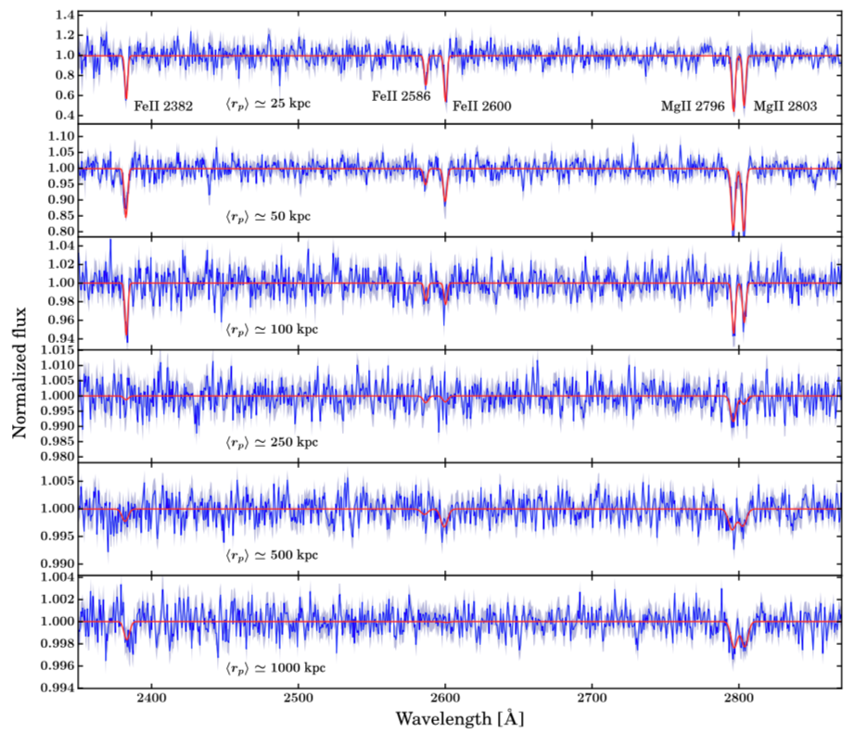

Slide 6
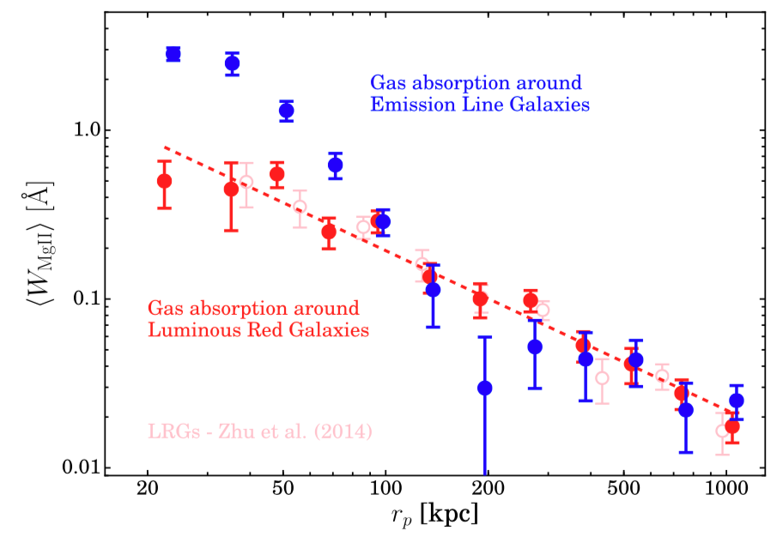
Results
1.MgII rest equivalent width versus impact parameter rp

Slide 7
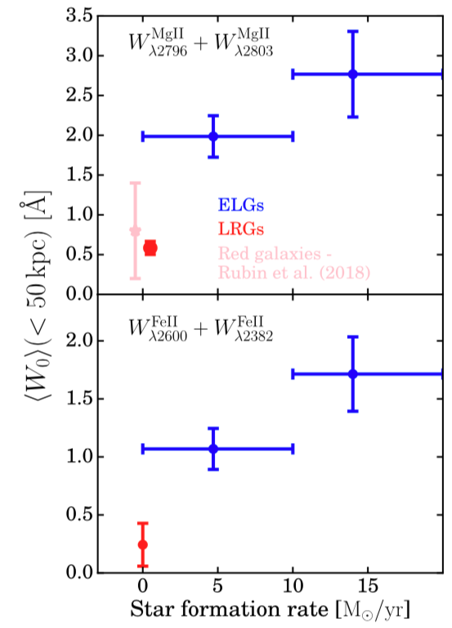
Results
2.Absorption propertities versus SFR

Slide 8
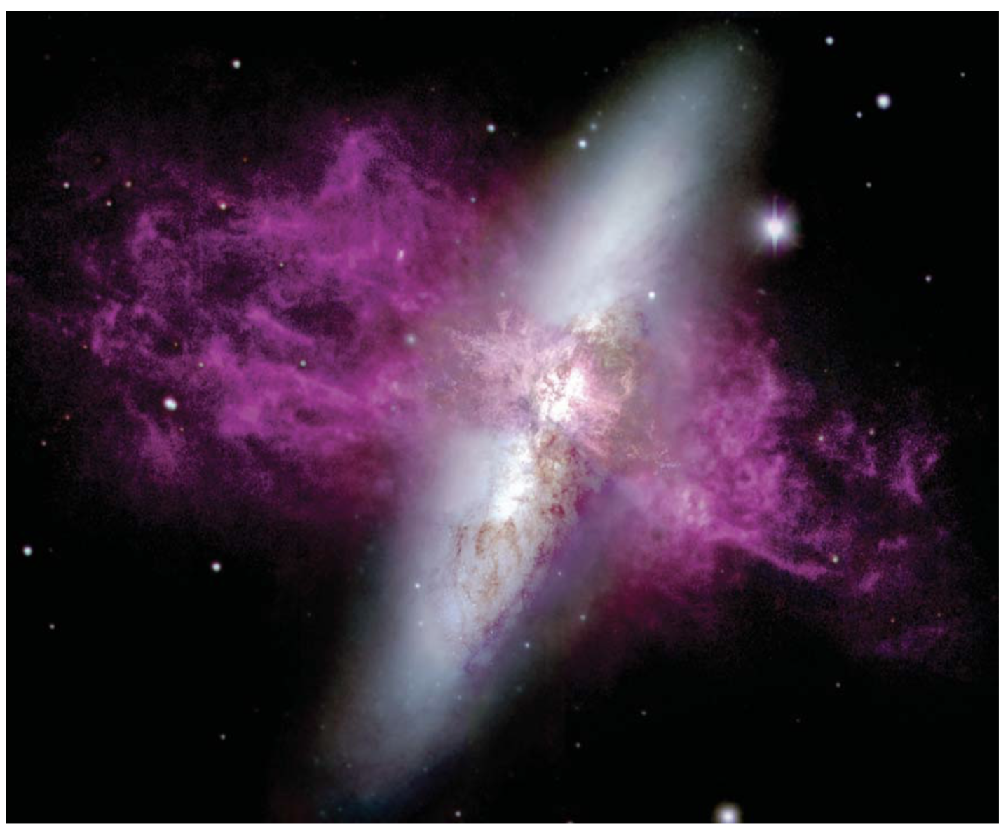

Slide 9
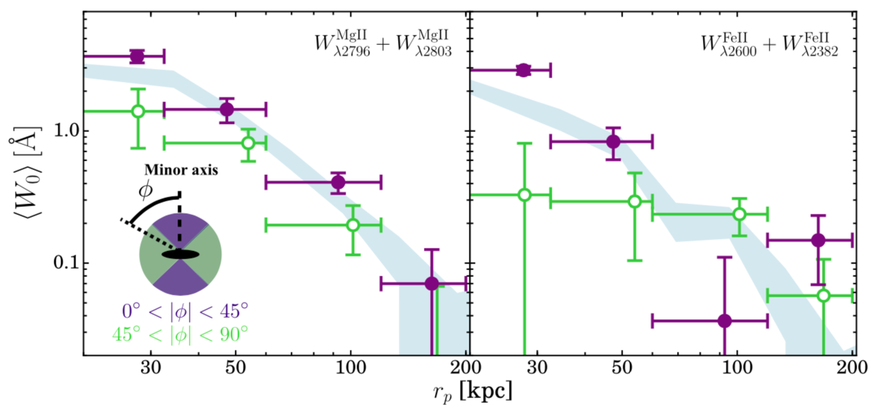
Results
3.ELG’s Dependence of the absorption profile on the azimuthal angle

Slide 10
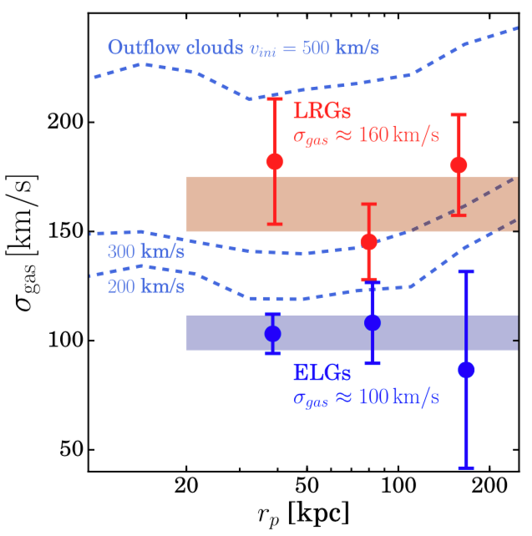
Results
4.Gas velocity
dispersion
versus
rp

Slide 11
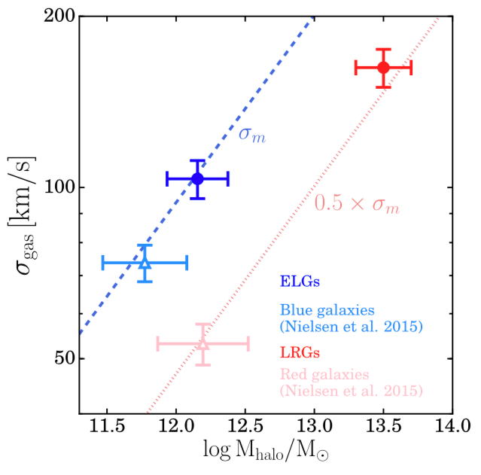
Results
5.Gas velocity
dispersion
versus
Halo mass

Slide 12
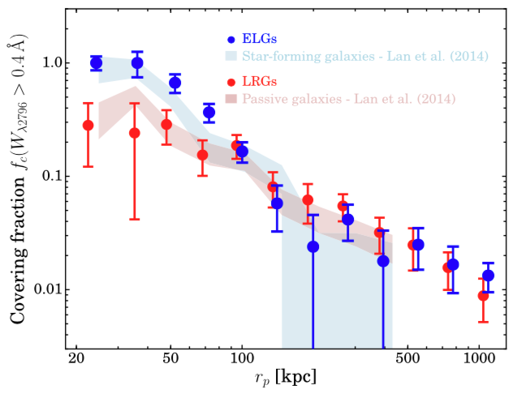
Results
6.MgII covering fraction versus impact parameter rp

Slide 13
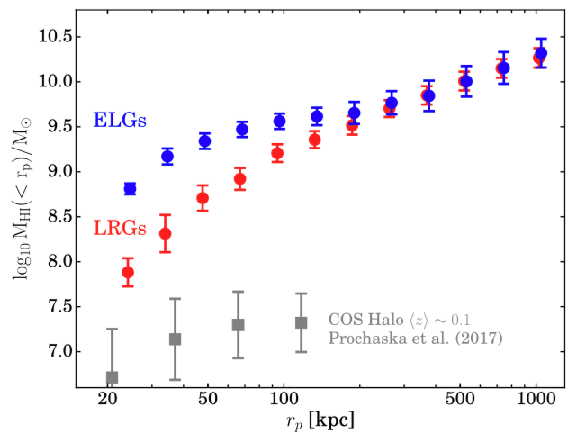
Results
7.Cumulative neutral hydrogen mass versus impact parameter rp

Slide 14
Summary
1.Within 100kpc the ELGs appear to be surrounded by more cool gas. The MgII and FeII absorption around ELGs is about 5-10 times stronger than around LRGs, and is stronger around ELGs with higher SFR. But at larger scales, the absorption around ELGs and LRGs decrease together with rp^-1.
2.For rp<100kpc, the metal absorption along the minor axes of ELGs is averagely 2 times stronger than that along the major axis, which indicates that 2/3 of the absorbing gas is generated by outflows from the galaxies.
3.The gas moves differently around ELGs and LRGs.
4.Within 100kpc, the neutral hydrogen mass around ELGs is about 2*10^9 Msun, about a factor of 3 more than that around LRGs. We constrain the minimum outflow loading factor to be about 0.5.

