Slide 1
The GALEX Ultraviolet Virgo Cluster Survey (GUViCS) IV. The role of the cluster environment on galaxy evolution
Speaker: Xinkai Chen

Slide 2
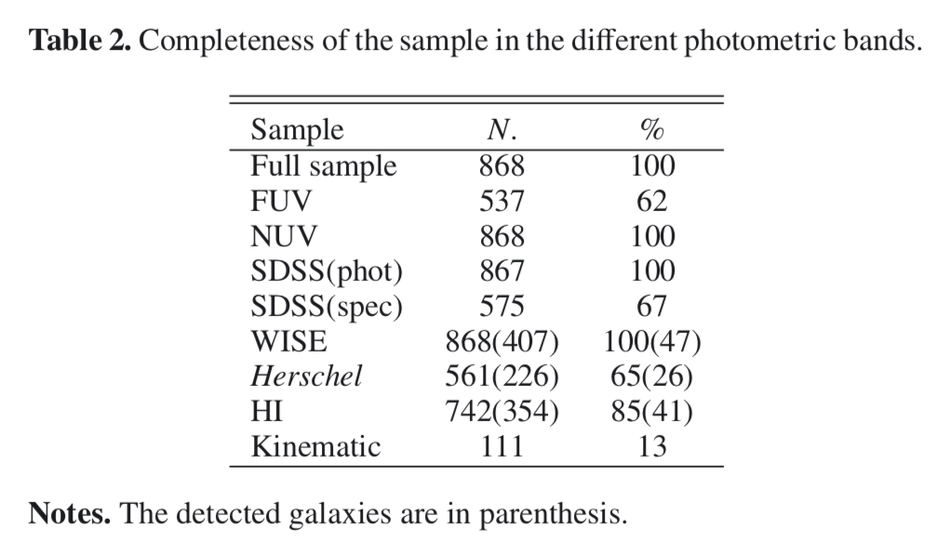
Sample
Sample:
Extended Source Catalogue of Voyer+14
recessional velocity < 3500kms-1, Virgo cluster region
868 object, down to NUV 22 AB mag
the detection of faint star-forming galaxies down to stellar masses 10^6.5, Early-type galaxies to 10^7, in the periphery of the cluster to 10^8-8.5
Multifrequency data
HI: ALFALFA and GOLDMine
Kinematic: ATLAS 3D
X-ray: ROSAT

Slide 3
The derived parameters
estimate stellar masses: i-band luminosity combined with the g − i colour index (Corrected for dust attenuation)
HI-deficiency parameter: the difference between the expected and the observed HI gas mass of each single galaxy on logarithmic scale
Late-type galaxies with HI-def<0.4 -> unperturbed objects
Kinematic data: differentiate rotationally-supported from pressure-supported system Spin parameter: $λ_{e}>0.31\sqrt{ε}$ -> fast rotators, $ε$: ellipticity

Slide 4
Galaxy evolution Model
Multizone chemical and spectrophotometric models of starvation and ram pressure stripping models:
spin parameter λ = 0.05 (normal late-type galaxies)
rotational velocities of 40, 55, 70, 100, 130, and 220 $kms^{−1}$ to reproduce galaxies spanning a wide range in total mass.
stripping efficiency $ε_{0}=1.2M_{⊙} kpc^{−2}yr^{−1}$

Slide 5
The color-stellar mass relation
NUV-i color: sensitive to the relative weight of young stars emitting in the UV bands and the bulk of the stellar population dominated by evolved stars in the i-band. A direct tracer of the mean age.
gas-poor late-type galaxies have redder NUV − i colours than unperturbed galaxies of similar stellar mass on average.
Notes:
Fig. 2. Left: extinction corrected NUV − i (AB system) vs. Mstar relation for all galaxies of the sample. Red symbols are for early-type systems (dE-E-S0a); dark and light blue symbols are for gas normal (HI − de f ≤ 0.4) and gas-deficient (HI − de f > 0.4) late-type galaxies (Sa-Im-BCD). The solid black line shows the typical NUV − i vs. Mstar relation for model unperturbed late-type galaxies. The black dotted vertical line shows the limit of the GUViCS survey, which is more efficient at detecting blue star-forming systems than red objects. The vertical dashed lines show the interval in stellar mass used to define massive, intermediate, and low-mass objects within the sample. The red and blue dotted lines indicate the limit used to define the red sequence and the blue cloud. Centre: distribution of the colour difference (NUV − i) − (NUV − i)Mod (distance from the blue cloud BC) for the whole sample (black), for early-type galaxies (red), and for HI-normal (HI − de f ≤ 0.4; dark blue) and gas-deficient (HI − de f > 0.4; light blue) late-type galaxies. The vertical red and blue dotted lines indicate the limits used to identify the red sequence and the blue cloud. Right: NUV − i vs. Mstar relation where galaxies are coded according to their belonging to the red sequence (red), green valley (green), and blue cloud (blue). The unpeturbed model galaxies are indicated by orange filled squares. Lines are as in the left panel.

Slide 6
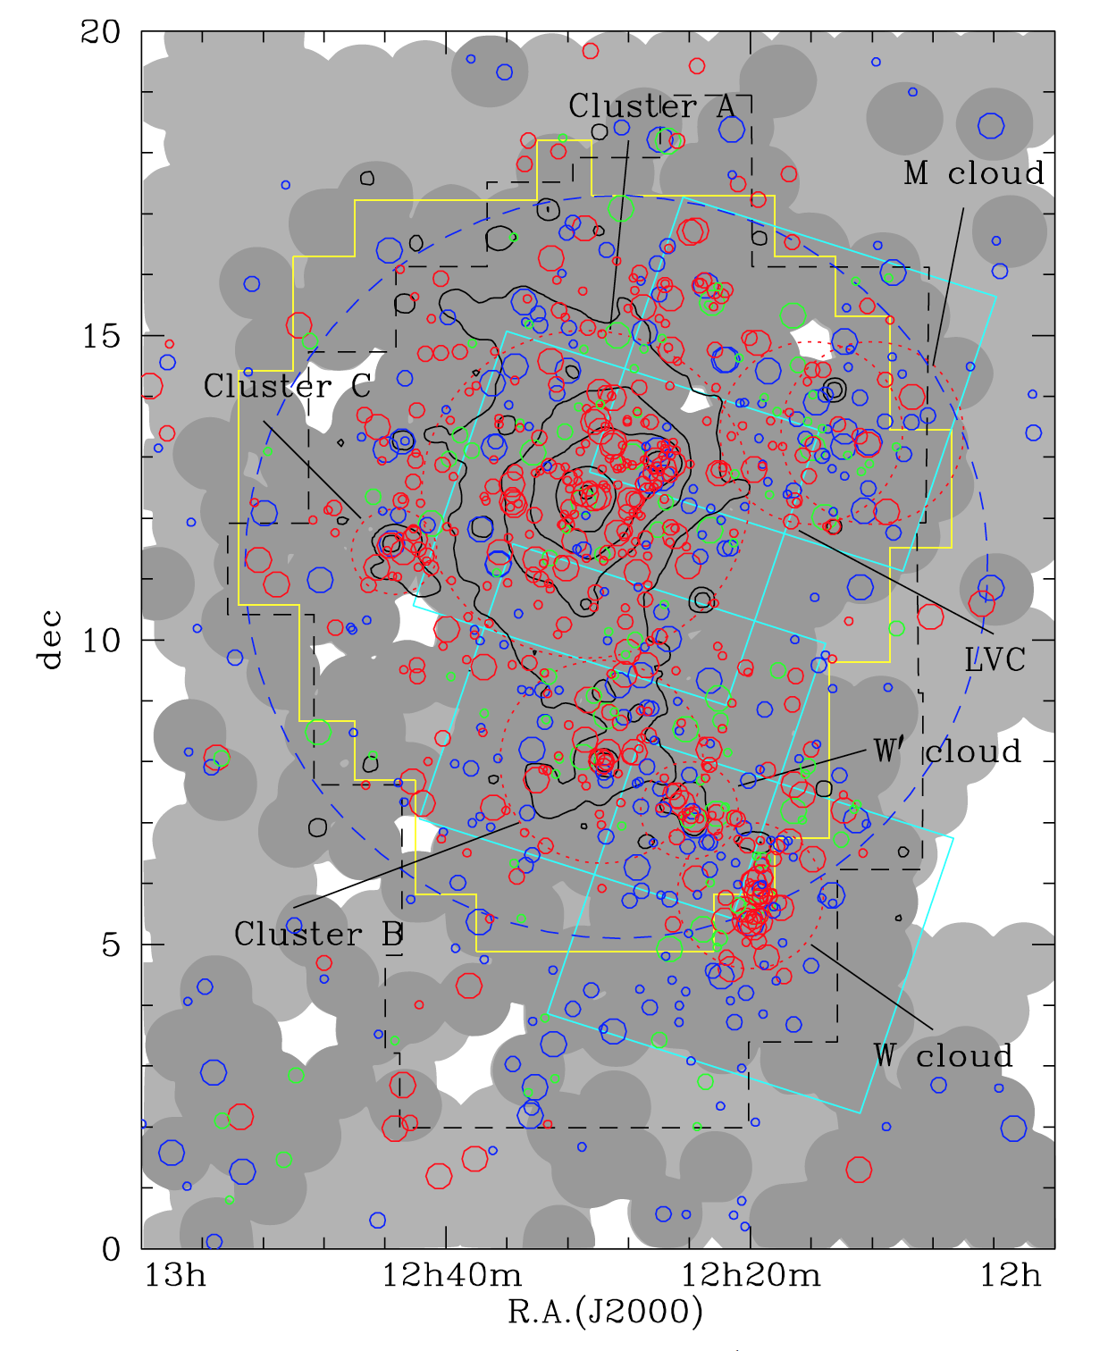
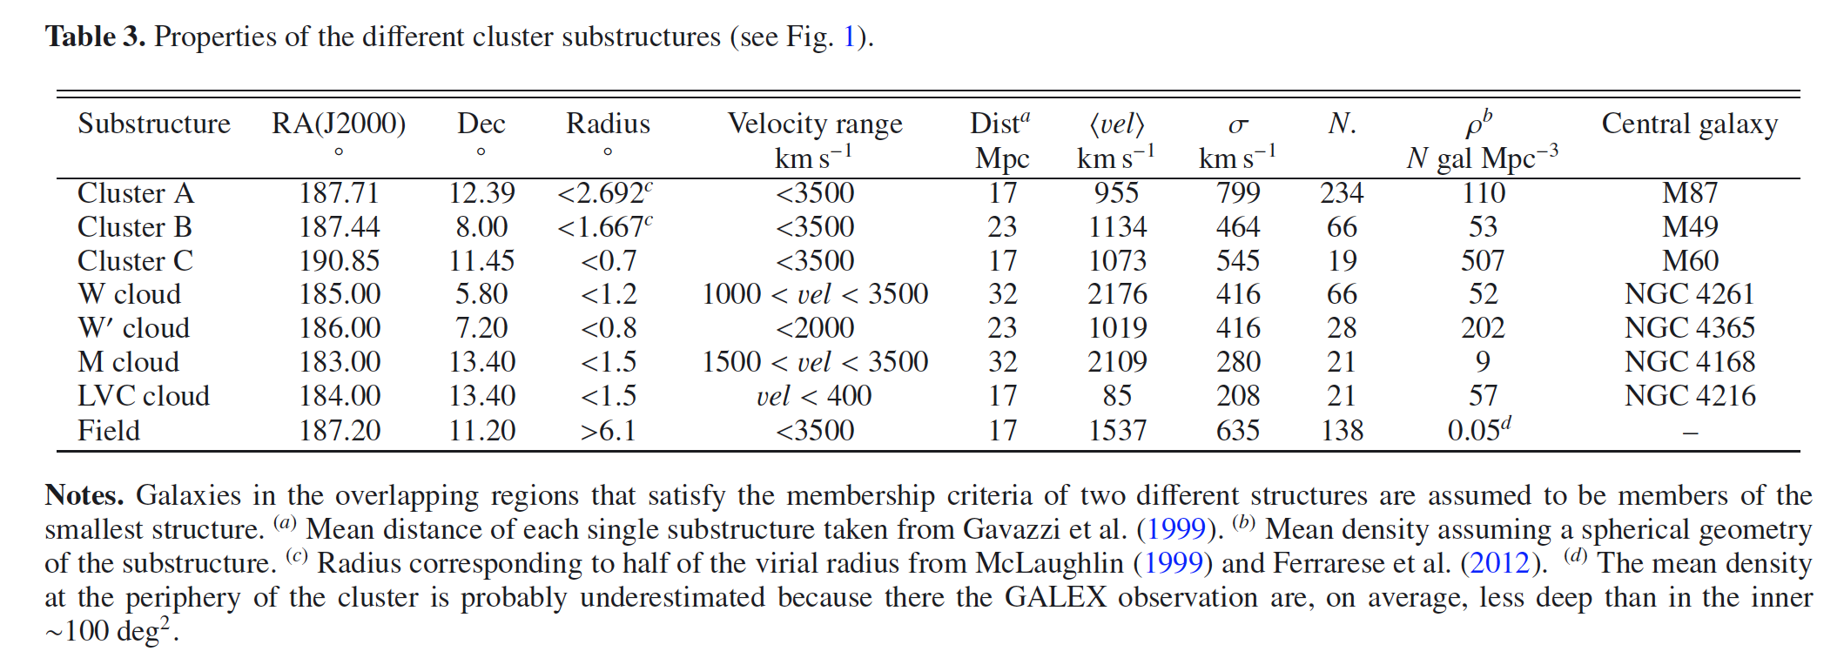
The galaxy distribution within the cluster
Identification of the substructures on the plane of the sky
cut the Virgo cluster region in the velocity space to separate galaxies belonging to the different substructures
counting the number of galaxies within a cylinder of radius 0.2 Mpc and with a depth corresponding to the velocity range
Voronoi tessellation method: define the Voronoi cells as the polygonal cells centred on the galaxy and enclosing all the surrounding empty space closest to that point
Notes:
Fig.1. Sky distribution of the GUViCS galaxies with a recessional velocity vel ≤ 3500 kms−1. Red, green, and blue symbols are for galaxies located in the red sequence, green valley, and blue cloud, respectively (see Sect. 5). The size of the symbols is proportional to the stellar mass of the galaxies: big symbols are for galaxies with Mstar > 109.5 M⊙, medium symbols for objects with 108.5 < Mstar ≤ 109.5 M⊙, and small symbols for Mstar ≤ 108.5 M⊙. The red and blue dashed circles show the identified substructures used in the following analysis. The field is defined as composed by all the galaxies located outside the blue dashed circle and not belonging to any other structure. Light grey indicate shallow (exposure time <800 s) NUV GALEX fields; dark grey are deep fields (exposure time >800 s). The footprint of the VCC is shown by the black dashed line, NGVS by the yellow solid line, and HeViCS by the cyan solid line. The black contours indicate the X-ray diffuse emission of the cluster from Böhringer et al. (1994).

Slide 7
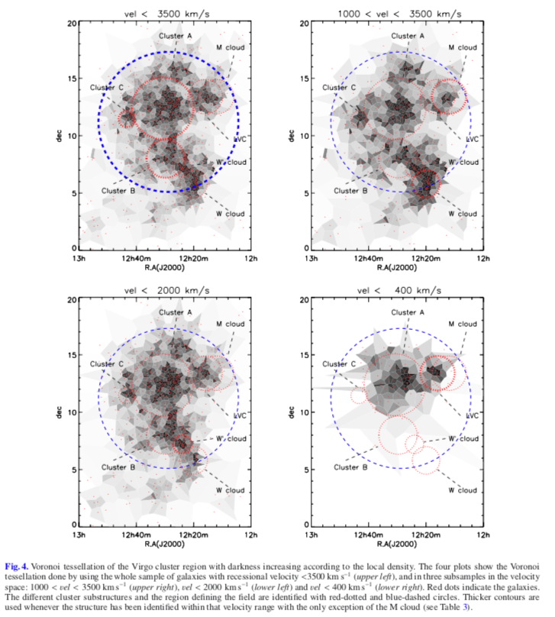
Voronoi density
decided to use the Voronoi density contrast in the following analysis to have the largest possible range in the parameter space.

Slide 8
The 2D distribution of galaxies within the cluster
galaxies belonging to the red sequence are preferentially located in the high density regions.
red sequence, green valley, and blue cloud objects are well mixed for M and LVC

Slide 9
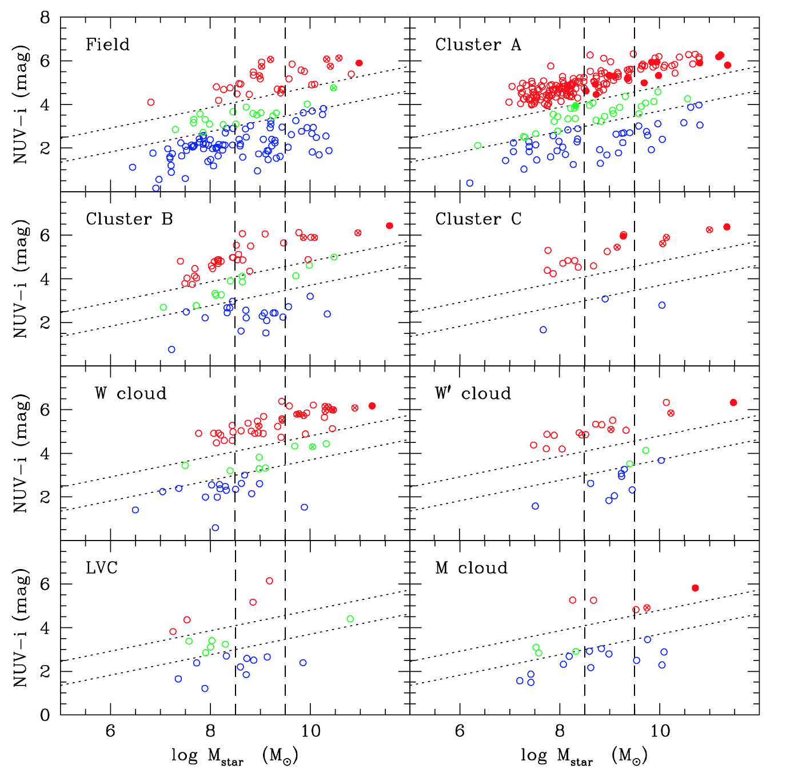
The color-stellar mass relation within the substructures
Cluster A, B, C, W, and W’ are dominated by red galaxies.
Galaxies at the periphery of the cluster are mainly late-type system.
Most massive galaxies are the dominant galaxies in all the substructures.
Massive galaxies are are lacking in the field.
For <10^8, the core of the cluster is dominated by red quiescent dwarf ellipticals these objects in the field are totally lacking

Slide 10
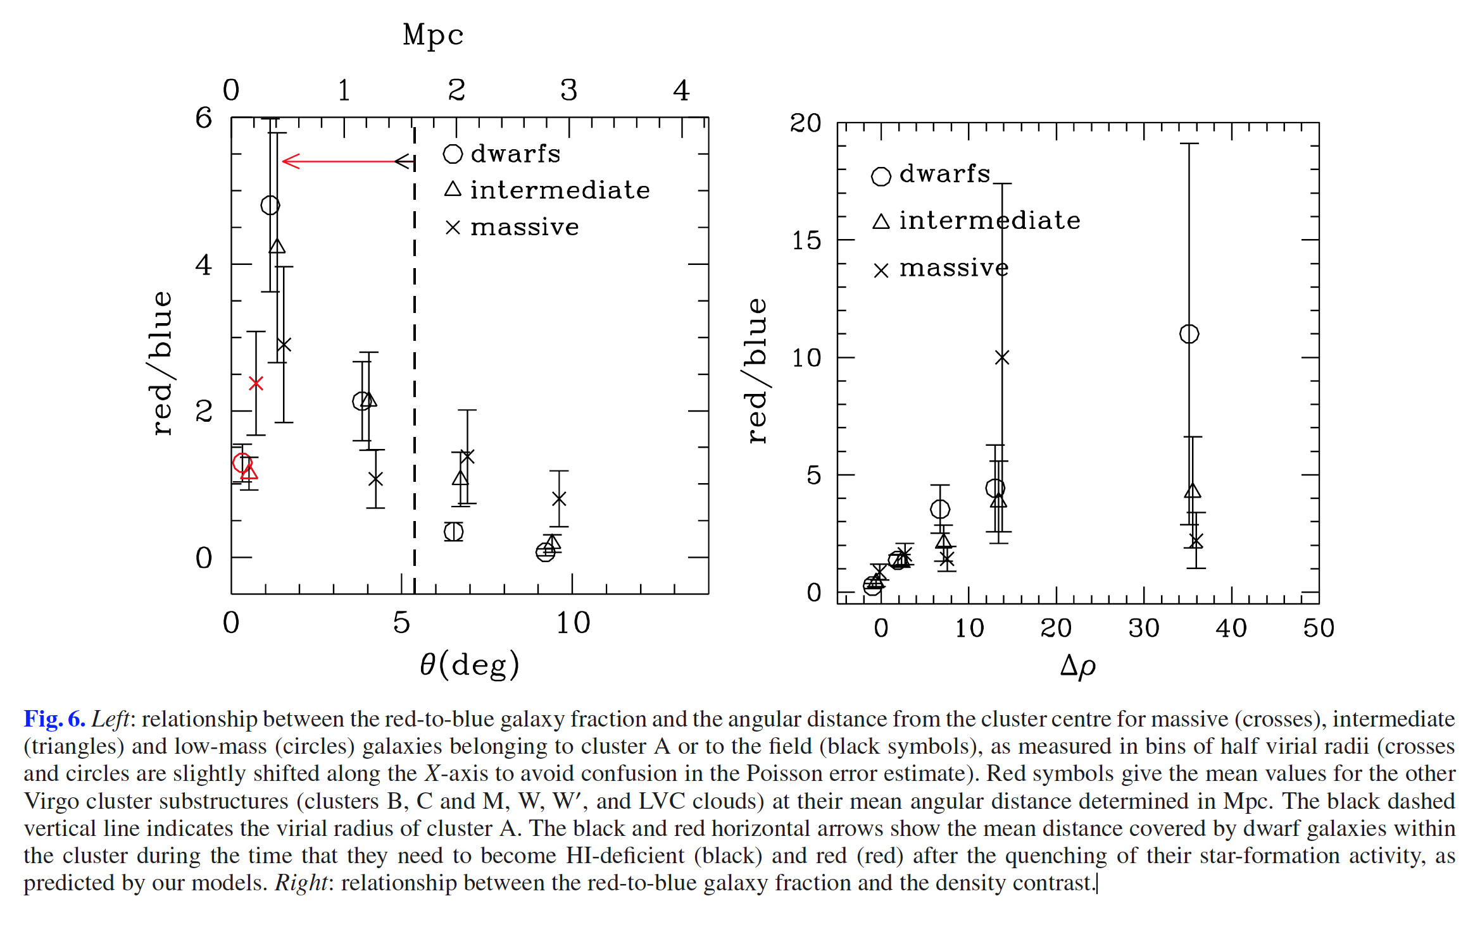
the radial variation of the red-to-blue galaxy ratio from the core of cluster A to ∼ 2 virial radii is small in massive systems (a factor of ∼ 3), while it is important in intermediate mass and in dwarf galaxies (>20).

Slide 11
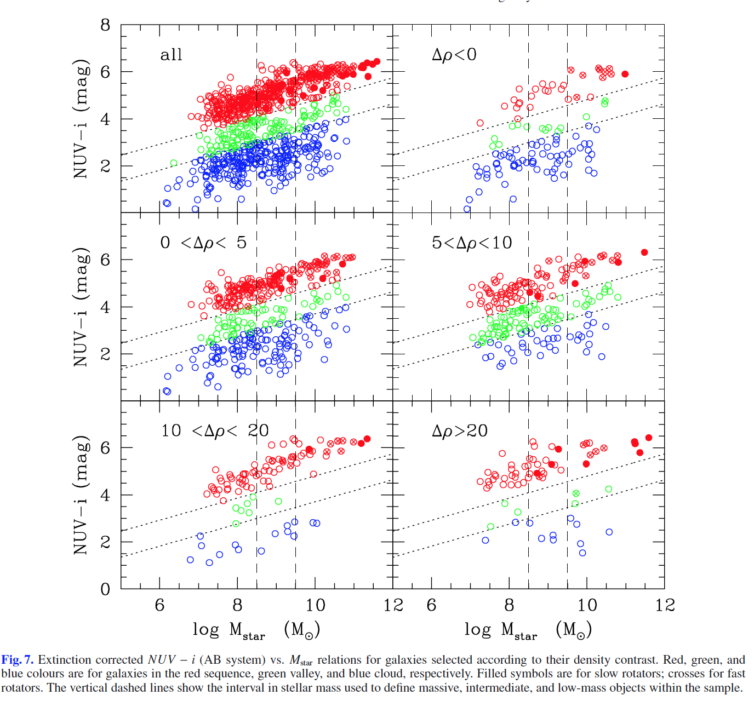
The color-stellar mass relation as a function of the density contrast
density contrast
$ρ_{field}=\frac{N_{field}}{Area_{field}}$
$Δρ=\frac{ρ}{ρ_{field}}−1$
galaxies gradually populate the blue cloud, the green valley, and, finally, the red sequence with increasing density contrast.
This effect is more pronounced in low-mass galaxies than in massive systems.

Slide 12
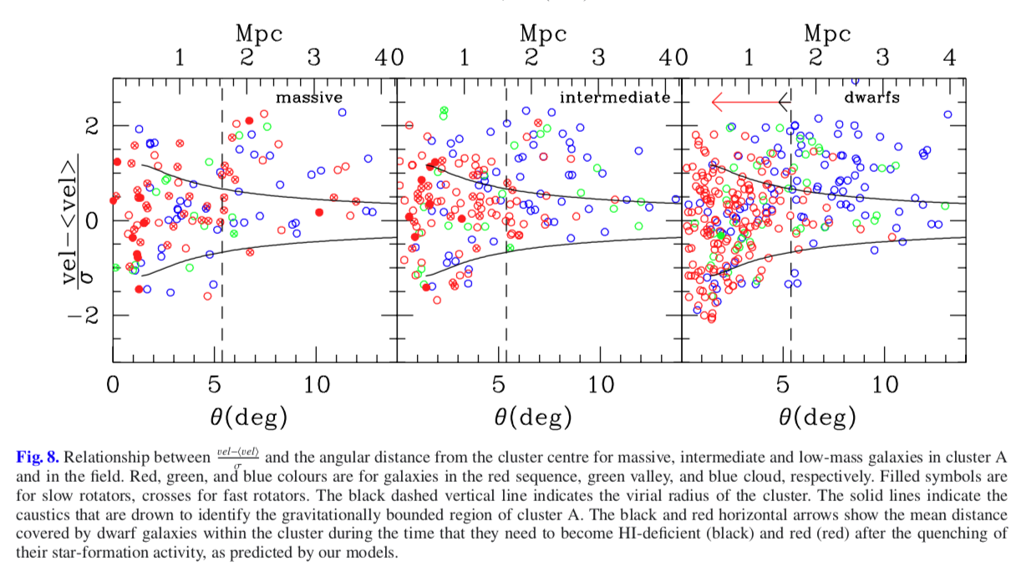
The color-stellar mass relation in the velocity space
The caustic is
a useful tool to separate the infalling regions from the virialised part of the cluster.
Inner region: devoid of unperturbed galaxies in BC and GV
Within the central half virial radius (∼0.8 Mpc), the galaxies with the highest peculiar velocities with respect to the mean velocity of the cluster are red, quiescent dwarf systems. These are, thus, early-type dwarfs which recently entered the cluster.
The majority of the massive and intermediate slow rotators are located in the inner half virial radius and within the caustics, indicating that they are cluster members since the early formation of Virgo.

Slide 13
Environmental Effects
Gravitational:
Tidal interaction (galaxy-galaxy, galaxy-cluster, harassment)
Hydrodynamic interaction (galaxy’s ISM and hot intergalactic medium)
Ram pressure, viscous stripping, thermal evaporation
Hybrid process:
Starvation (removal of the gas feeding the star formation)
preprocessing (taking place in groups of galaxies falling into clusters)

Slide 14
Ram Pressure stripping
ISM could be removed from galaxies moving at ∼1000 $kms^{−1}$ through the hot ($∼{10}^{7}−{10}^{8}$ K) and dense ($∼{10}^{−3}−{10}^{−4}$atoms $cm^{−3}$) intergalactic medium by means of a ram pressure mechanism
Ram pressure can effectively remove the ISM if it overcomes the gravitational pressure anchoring the gas to the disk:
$ρ_{IGM}V_{gal}^{2}≥2πGΣ_{star}Σ_{gas}$
where $ρ_{IGM}$ is the density of the IGM, $V_{gal}$ is the galaxy velocity inside the cluster, $Σ_{star}$is the star surface density, and $Σ_{gas}$is the gas surface density.

Slide 15
Starvation
In normal galaxies the gas that feeds the star formation (on timescales as long as a Hubble time) comes from infall of an extended gas reservoir, the effect of removing the outer galaxy halo would be to prevent further infall of gas into the disk. On timescales of a few Gyr, the star formation would thus exhaust the available gas, quenching further star formation activity.

Slide 16
Preprocessing
According to the hierarchical scenario for the formation of large-scale structures, groups of galaxies falling into clusters of galaxies represent the building blocks of today’s rich clusters of galaxies.
Galaxy groups may represent natural sites for a preprocessing stage in the evolution of cluster galaxies through tidal interactions, meanwhile ram pressure, starvation, and evaporation might already be effective in these groups at z~0.5.

Slide 17
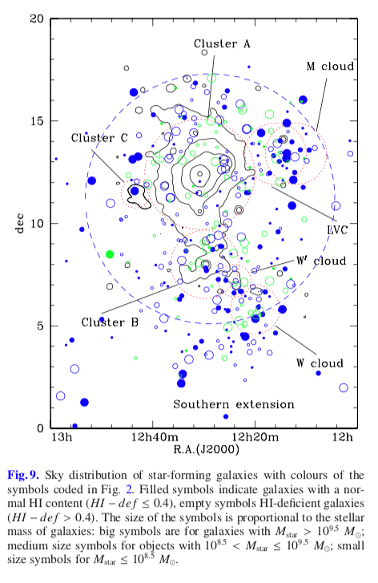
Discussion: Massive galaxies
gas-rich, massive galaxies are not present in the high-density regions
Ram-pressure stripping

Slide 18
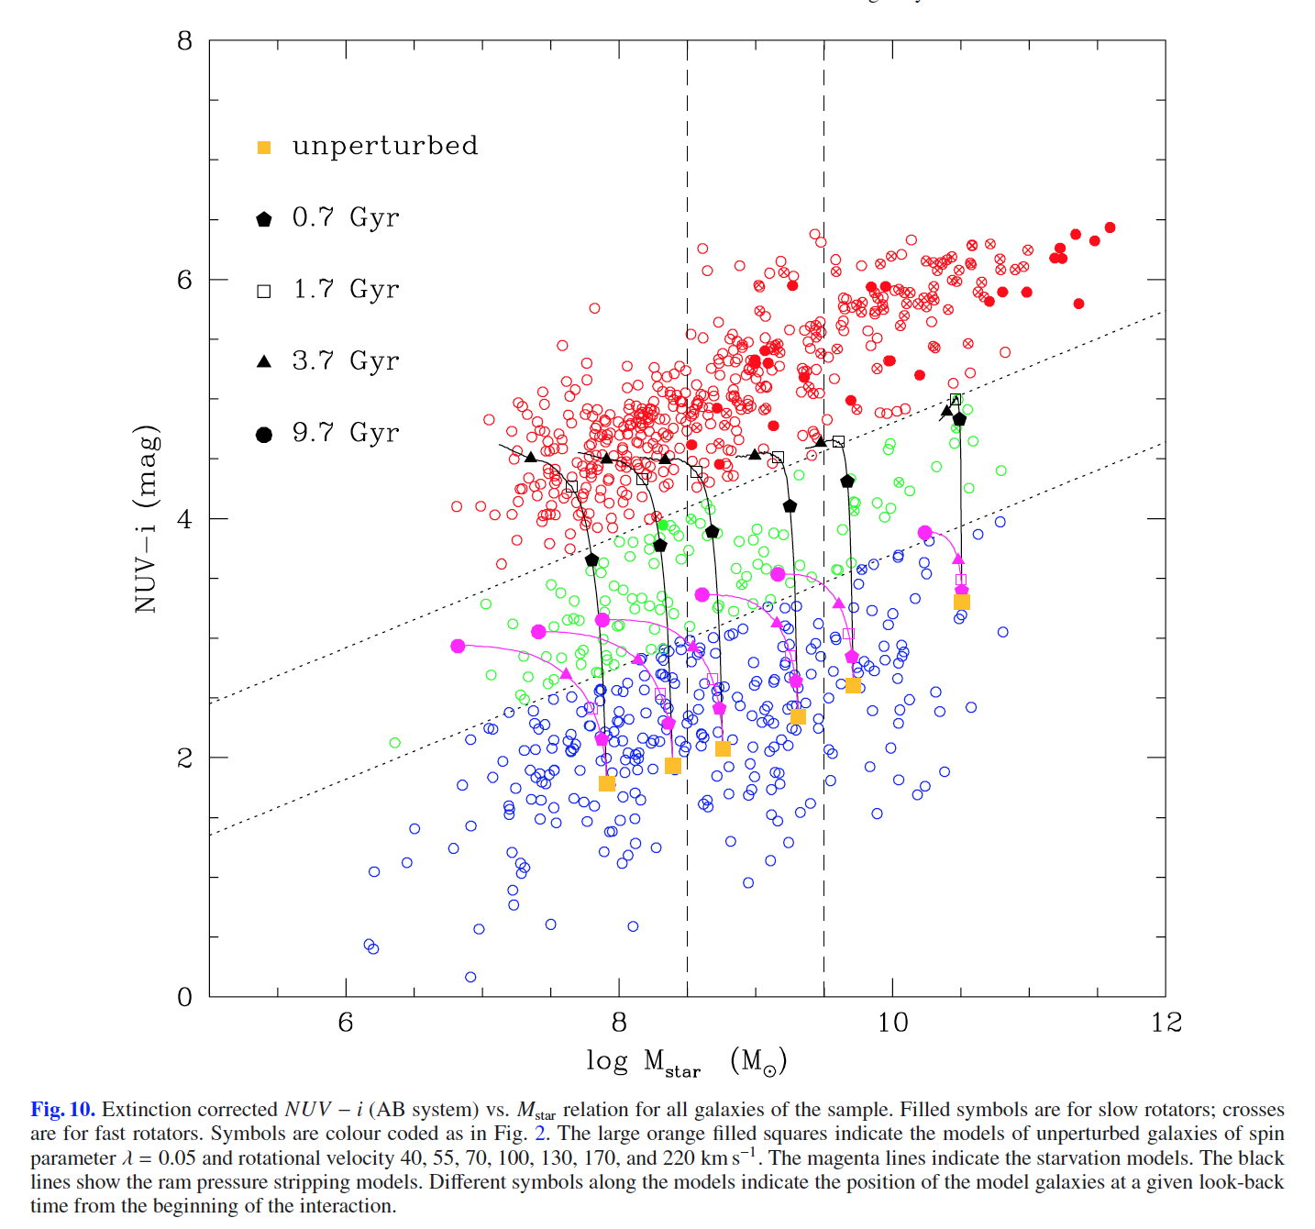
ram pressure gas stripping due to a single crossing of the cluster is not sufficient to fully stop the activity of star formation of infalling massive late-type galaxies
Total gal removal via ram pressure stripping: 1.5Gyr + delay in the quenching 0.8Gyr -> 2.3Gry, gas-poor, freshly infalling star-forming massive galaxies are located all over the cluster,
galaxy starvation is not able to create the red sequence just by quenching the star-formation activity through gas consumption once the infall of pristine gas is stopped.
In galaxies recently stripped of their gas, the timescale for gas consumption, which is determined considering the atomic and molecular gas phase plus the recycled phase produced by stars during their evolution ($τ_{gas,R}$≃ 3.0−3.3 Gyr), is also significantly longer than the timescale for complete gas stripping via ram pressure, making starvation an improbable mechanism for quenching the activity of star formation in massive galaxies in clusters.

Slide 19
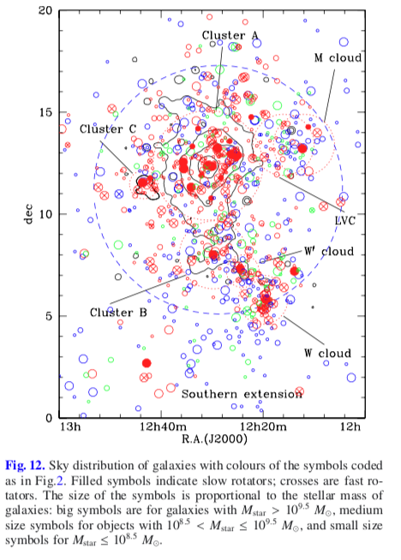
the most massive red galaxies with $M_{star}≥{10}^{10.7}M_{⊙}$ do not have similar counterparts in the blue cloud nor in the green valley.
Most are slow rotators -> major merge.
these slow-rotating massive early-type galaxies are the most massive objects of each single substructure within the cluster.
Slow rotators of lower stellar mass (${10}^{8.5}−{10}^{11}$)
Slow rotators are mainly located inside the inner half virial radius and are preferentially virialised within the cluster potential. They have been formed by a merging event early in the past, when galaxies and groups were smaller than at the present epoch.
gravitational interactions, which are efficient at early epochs when galaxies were accreted in infalling groups (pre-processing), rather than a simple ram pressure stripping event, is at the origin of this population

Slide 20
Dwarf galaxies
the infalling galaxies stop their activity of star formation, and become red systems in ≃1 Gyr.
Ram-pressure stripping process is so efficient to transform star- forming galaxies in quiescent systems as red as those populating the red sequence.
most of them are fully transformed before they reach the cluster core
Can explain the observed variation of the red-to-blue fraction with the angular distance or the trend with local density, and the presence of red dwarf galaxies within the inner region of cluster A but outside the caustic

Slide 21
Conclusion
Identify the different substructure composing the cluster: Virgo cluster A,B and C, the W, W’, M and the LVC.
Identify galaxies belonging to red sequence, green valley, blue cloud using dust attenuation corrected NUV-i color.
Color-segregation effect:
Red galaxies located principally in high density region.
Blue SF systems mainly in the periphery of the cluster
Most massive galaxies are all early-type galaxies dominating the different substructures, they are pressure supported systems (slow rotators), probably formed by a major merging event at early epochs.

Slide 22
Conclusion
Slow rotators of lower stellar mass are also preferentially located within the different high-density substructures of the cluster. They are virialised within the cluster, are Virgo members since its formation. They have been shaped by gravitational perturbations occurring within the infalling groups that later form the cluster (pre-processing).
low-mass star-forming systems are extremely rare in the inner regions of the Virgo cluster A. They can be rapidly deprived of their ISM during their interaction with the IGM. The lack of gas quenches their star-formation activity transforming them into quiescent dwarf ellipticals (ram-pressure stripping)
Starvation has much smaller effects even in the assumption that the process has started ∼ 10 Gyr ago.

Slide 23
Result:
1. massive galaxy: (M>10^11):
Slow rotators
Dominant galaxy of different substructure
Associated with a diffuse X-ray emission
Major merging events occurred at early epochs
Old stellar population
2. lower stellar mass 10^8.5—10^11
located within the different high-density substructures of the cluster.
virialised within the cluster, they are Virgo members since its formation.
shaped by gravitational perturbations occurring within the infalling groups that later form the cluster (pre-processing)

Slide 24
low-mass star-forming systems
extremely rare in the inner regions of the Virgo cluster A
these star-forming systems can be rapidly deprived of their interstellar medium during their interaction with the intergalactic medium.
the lack of gas quenches their star-formation activity transforming them into quiescent dwarf ellipticals.
this mild transformation does not perturb the kinematic properties of these galaxies, which still have rotation curves typical of star-forming systems.

