Slide 1
A simple guide for astrophysical research
Xinkai Chen
2020.9.16

Slide 2
Search engine
ADS
Astrophysics data system
arXiv
an open-access repository of electronic preprints
Google scholar

Slide 3
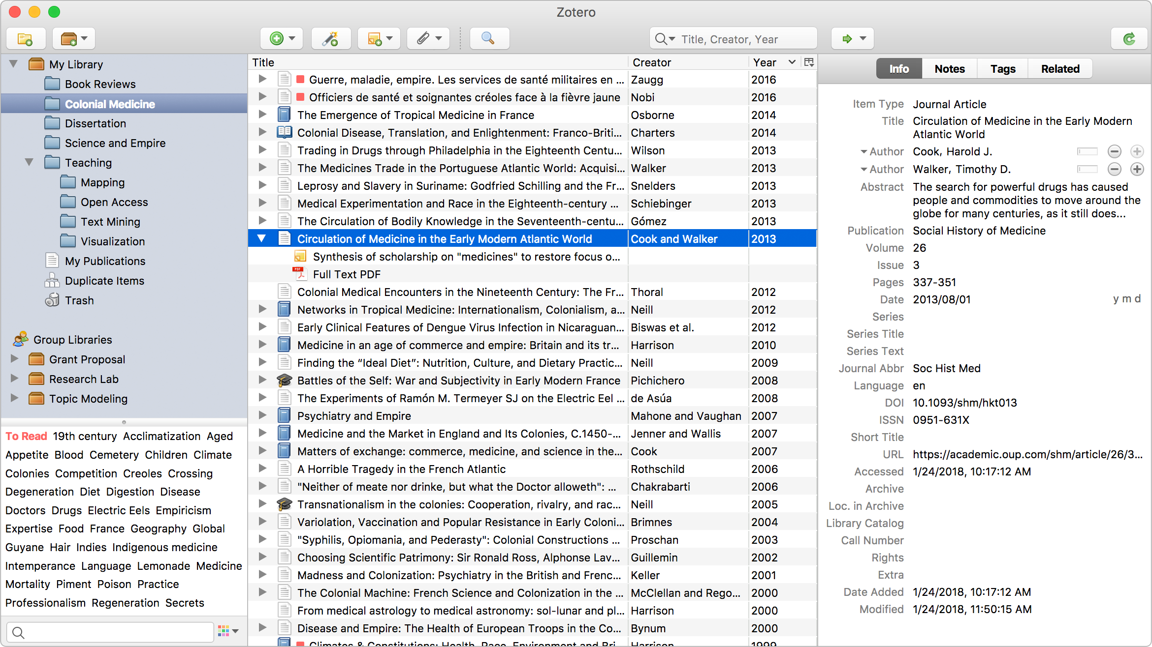
Reference Managemet Software
Zotero
automatically senses research on the web
organize your way
cite in style
stay in sync

Slide 4
Basic Astronomy Database
SIMBAD Astronomical Database - CDS
The SIMBAD astronomical database provides basic data, cross-identifications, bibliography and measurements for astronomical objects outside the solar system.
NASA/IPAC Extragalactic Database
NED is a comprehensive database of multiwavelength data for extragalactic objects, providing a systematic, ongoing fusion of information integrated from hundreds of large sky surveys and tens of thousands of research publications.

Slide 5
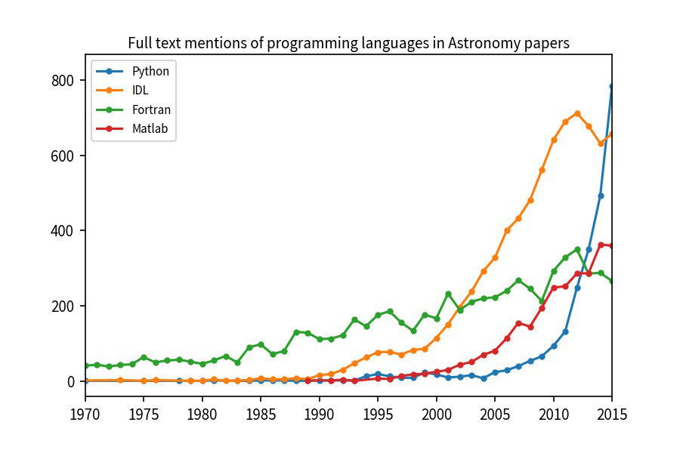
Programming and Developing Software
Python
Python is an interpreted, high-level and general-purpose programming language.
tutorial
Hitchhiker's Guide to Python
廖雪峰python教程

Slide 6
Install python
Anaconda is a free and open-source distribution of the Python and R programming languages for scientific computing, that aims to simplify package management and deployment.
IDE (Integrated Development Environment)
Spyder
jupyter notebook (jupyter lab)

Slide 7
Package
Numpy - Base N-dimensional array package
SciPy - Fundamental library for scientific computing
pandas - Python Data Analysis Library
matplotlib - Comprehensive 2D Plotting
scikit-learn - Machine learning in Python
astropy - Community Python library for astronomer
photutils - An Astropy Package for Photometry
Numpy - Base N-dimensional array package
SciPy - Fundamental library for scientific computing
pandas - Python Data Analysis Library
matplotlib - Comprehensive 2D Plotting
scikit-learn - Machine learning in Python
astropy - Community Python library for astronomer
photutils - An Astropy Package for Photometry

Slide 8
Fits
Flexible Image Transport System
DS9 - An image display and visualization tool for astronomical data
Topcat - Tool for OPerations on Catalogues And Tables

