Slide 1
4. STAR-FORMATION RATES, HISTORIES, AND STELLAR AGES 4.1. Measuring Star-Formation Rates
SFR: UV, H$α$, P$α$, 24-$μ$m luminosity, total IR luminosity, radio continuum luminosity, and X-ray flux.
SFR timescale:
ionizing radiation: ~10^6 year
UV and IR: 10^8 year
Redder is better: dust attenuation will be less
P$α$ > H$α$ (Lyman, Balmer, Paschen)
Mixed SFR indicator:
UV+IR or H$α$+IR
SED fitting:
Age-dust-metallicity degeneracy
Priors on the dust model and SFH library

Slide 2
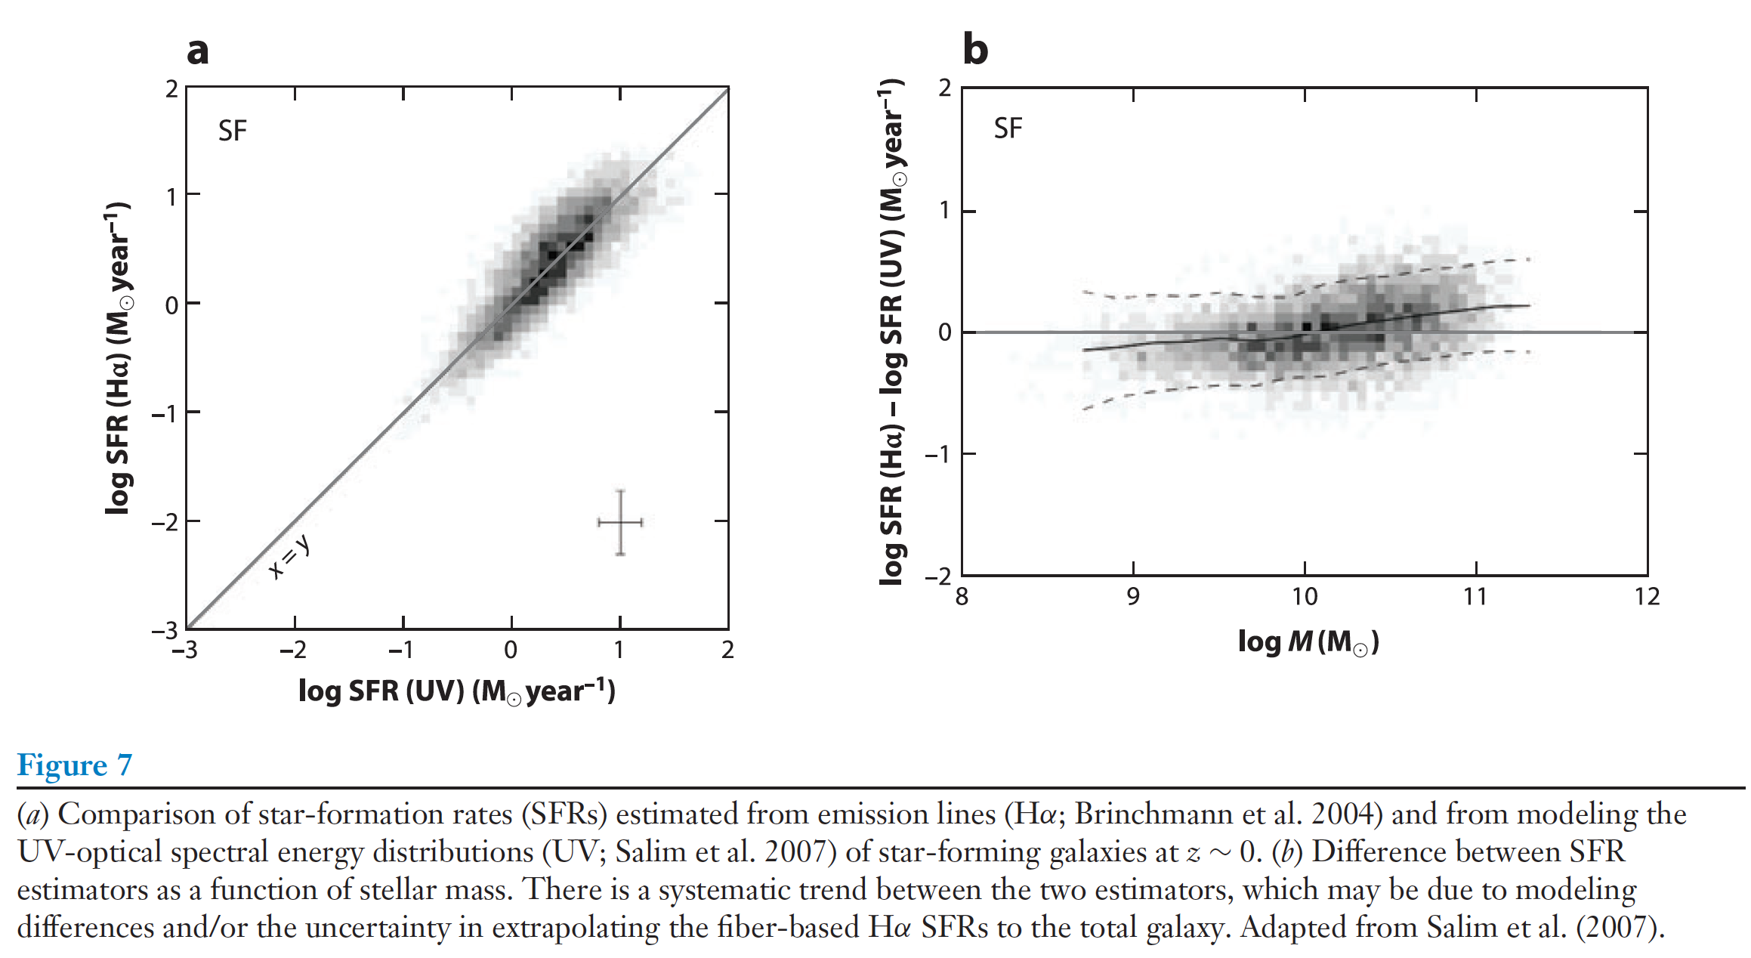
Brinchmann+04, SDSS, by modeling a suit of optical emission lines.
Salim+07, UV(GALEX) + optical, SPS models with a range of SFHs, metallicity, dust attenuation
$≤$0.3 dex level.
Wuyts+11, compare SFRs at z~3, with 3 techniques:
H$α$-based, SED-fitting-based, mixed SFR indicator(UV+IR)
For SFRs$≤$100$M_{⊙}{year}^{−1}$: agreed well
High SFRs, SED-based underpredict compare with mixed.
High redshift: nebular emission line
Notes:
They argued that this was because of their
assumption of a uniform dust screen, and at high column density this becomes an increasingly
poor representation of reality.
nebular emission line
a) specific SFRs are higher, (b)metallicities
are lower, and (c) the redshifting of the spectrum implies that a line of givenEWcomprises a larger
fraction of the flux through a filter.

Slide 3
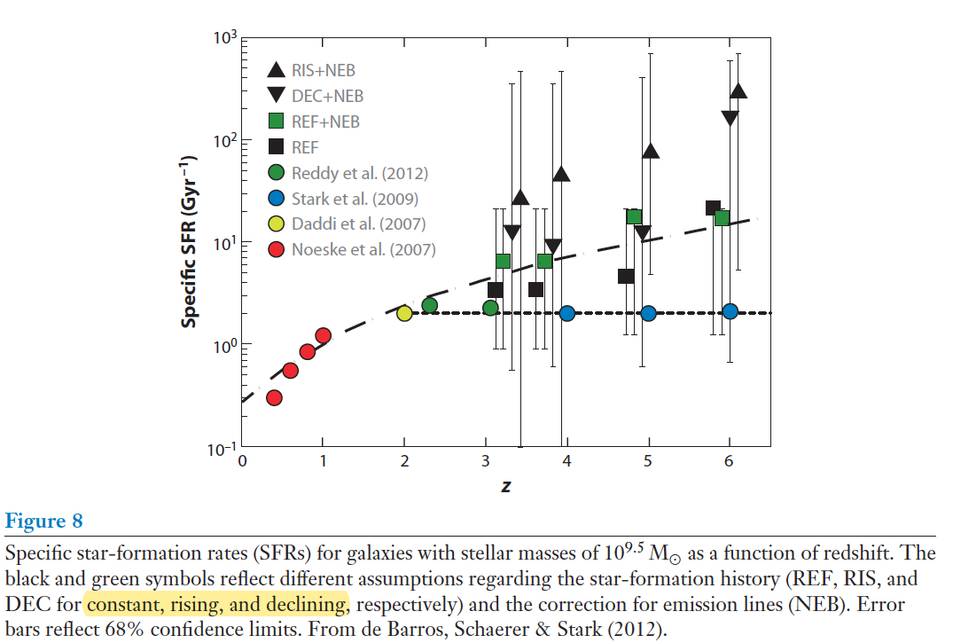
1

Slide 4
4.2. Light-Weighted Mean Ages
Mass-weighted ages offer a direct probe of the integrated SFH, whereas light-weighted ages are more directly measurable from SEDs
Mass-weight larger: young stars outshine older stars
Dn4000, Lick indices
SSP-equivalent ages: fit single-age SSPs to the Lick indices in order to estimate ages (Balmer lines, A-type stars, ${10}^{8}−{10}^{9}$year)
Younger, sensitivity of the Balmer lines to ∼1-Gyr-old stars, measuring residual star formation over ∼1 Gyr timescales.
Notes:
Mass-weighted ages offer a direct probe of the integrated SFH, whereas light-weighted ages are more directly measurable from SEDs.
Mass-weight larger: young stars outshine older stars

Slide 5
H$β$: ideal age indicator, is largely insensitive to metallicity and abundance patterns
Balmer lines are also sensitive to the presence of blue HB stars
Rose1984: CaII is sensitive to the H$ε$, Leonardi1996 CaII and H$δ$can break age-strength degeneracy
Kauffmann03:H$δ$-Dn4000, strong constraints on the burst fraction can be obtained
Percival11: CaII Rose index and the MgII feature could also be used to separate age from blue HB effects.
it is fundamentally very difficult to measure ages for systems older than ∼9 Gyr because evolution in the isochrones is so slow at late times
Notes:
both the Hδ and Dn4000 spectral features in an attempt to
measure two-component SFHs (in particular, a burst of SF and an underlying τ model SFH).
Galaxies with a sizable mass fraction formed in a recent burst of SF are significant outliers in the
Hδ-Dn4000 plane, and so strong constraints on the burst fraction can be obtained in this way
higher-order Balmer are more sensitive to metallicity and abundance ratios than Hβ

Slide 6
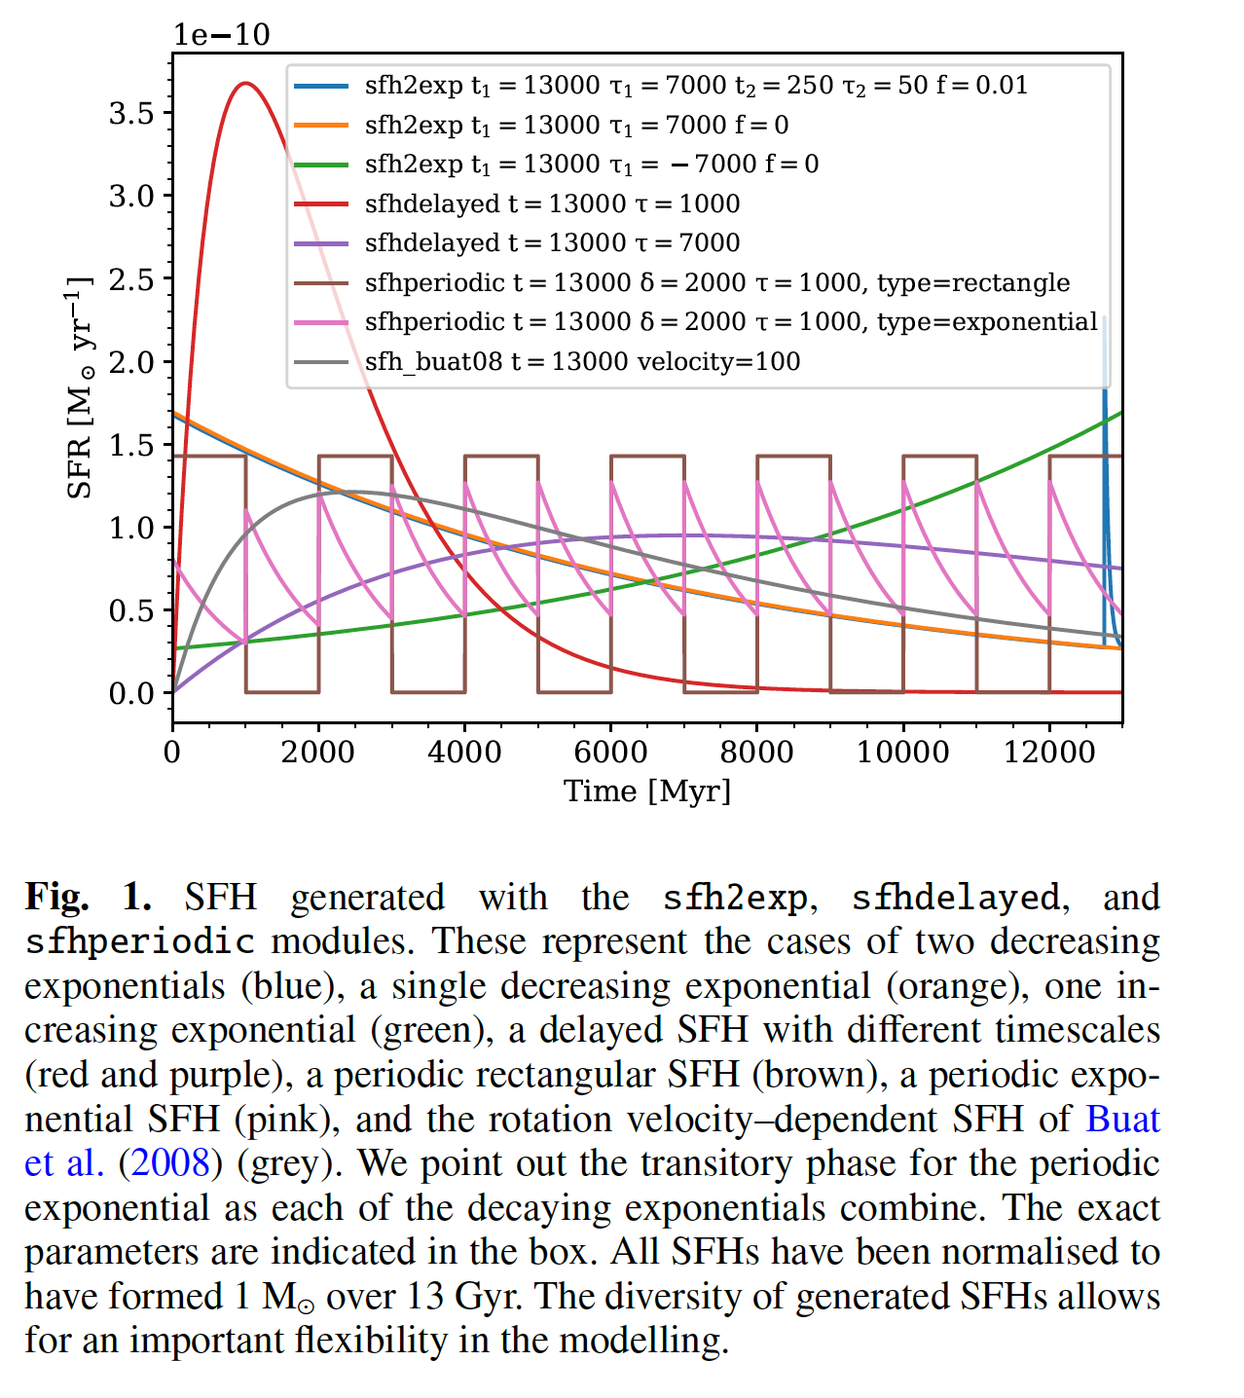
4.3. Which Model Star-Formation Histories to Use?
delayed $τ$:
Outshining effect: the young stars, being so bright, tend to outshine the older, less luminous stars.
Single-component SFH models: underestimated stellar masses
Lee+09, exponentially decreasing SFHs (τ models) resulted in underestimated SFRs and overestimated mean ages
a library of SFHs drawn from semianalytic or hydrodynamic models of galaxy formation.
More likely contain realistic SFHs
be sensitive to the choice of priors

Slide 7
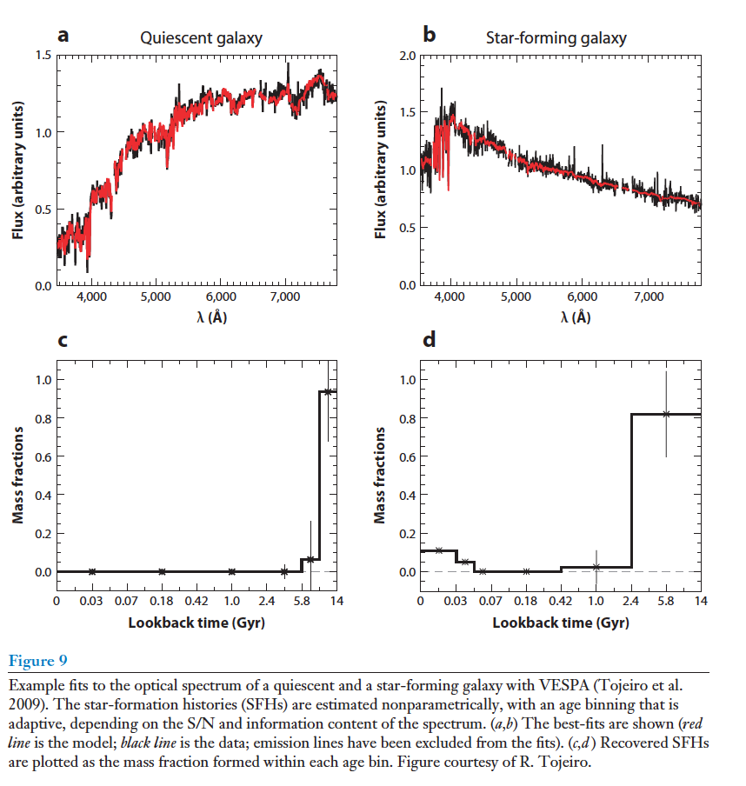
4.4. Nonparametric Star-Formation Histories
specifies a fixed (or adaptive based on SED type and S/N) set of age bins and then fits for the fraction of mass formed within each bin.
seriously underconstrained
High quality data: wide wavelength coverage, high spectral resolution, and high S/N
abundance pattern is fixed

Slide 8
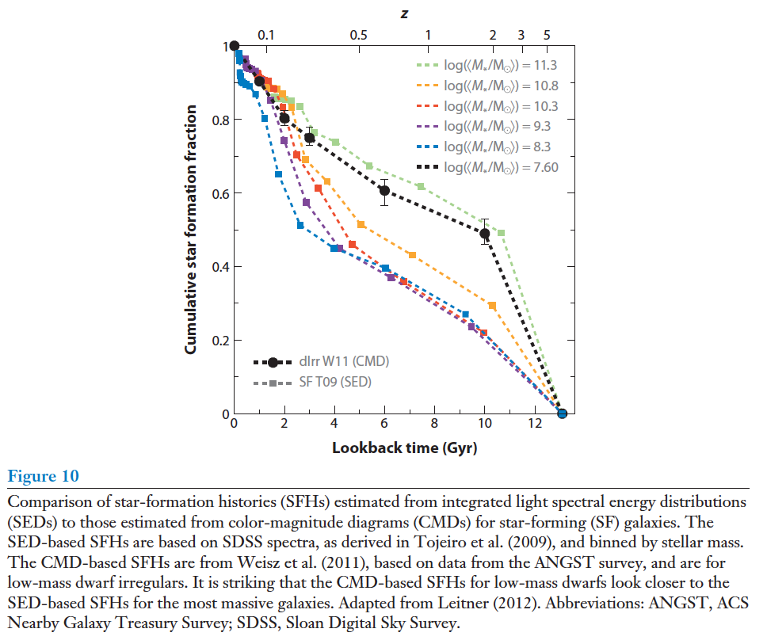
4.4.1. Star-formation histories from color-magnitude diagrams versus star-formation histories from integrated light.
The dwarfs have SFHs comparable to the highest mass bin in the integrated light sample.
Notes:
There are
many complications in making this comparison, not the least of which is the question of whether
or not nearby dwarfs are representative of the cosmological average. Nonetheless, the difference
in the qualitative trend derived from CMD-based and integrated light-based SFHs is striking and
worthy of further study.

Slide 9
4.5. Low-Level Star Formation
low levels of star formation: challenging, become contaminated by other processes.
optical SEDs: ${10}^{−11}year^{−1}$,
UV fluxes: ${10}^{−12}$,
resolved UV photometry: ${10}^{−14}$.
SED-based SFRs are probably accurate at the factor of two level
Notes:
At low luminosities emission lines can be
influenced by low-level AGN activity and they become difficult to measure on top of the strong
absorption features in the continuum; dust emission can be due to heating from old stars (rather
than tracing the formation of new stars); and UV light can be attributed to hot evolved lowmass
stars. The former two indicators have been effectively abandoned as low-level SF indicators,
whereas the third, UV light, still holds some promise.

Slide 10
4.6 Summary
High mass stars are so luminous that they dominate the SEDs
at late times isochrones evolve very little
Effect:
light-weighted ages will always underestimate the true mass-weighted age
Priors on the model SFHs can strongly influence parameters
Nonparametric SFH require data of very high quality
Notes:
Measuring the detailed SFH of a galaxy from its observed SED is one of the holy grails of SPS
modeling. Unfortunately, two unrelated physical effects make this task very difficult in practice:

Slide 11
5. STELLAR METALLICITIES AND ABUNDANCE PATTERNS 5.1 Age-Metallicity Degeneracy
Metallicity:
Lower effective temperatures, cooler main sequence and giant branch
Stronger spectroscopic absorption features and generally redder colors.
Age:
Redden the SED: through the age effect on the isochrones
Worthey94, “3/2 rule”, an increase/decrease in the population age by a factor of three is almost perfectly degenerate with an increase/decrease in metallicity by a factor of two.
The age-metallicity degeneracy can be robustly broken by considering the hydrogen Balmer lines in conjunction with iron features in moderate-resolution optical spectra.
Notes:
Balmer lines, : age metallicity,

Slide 12
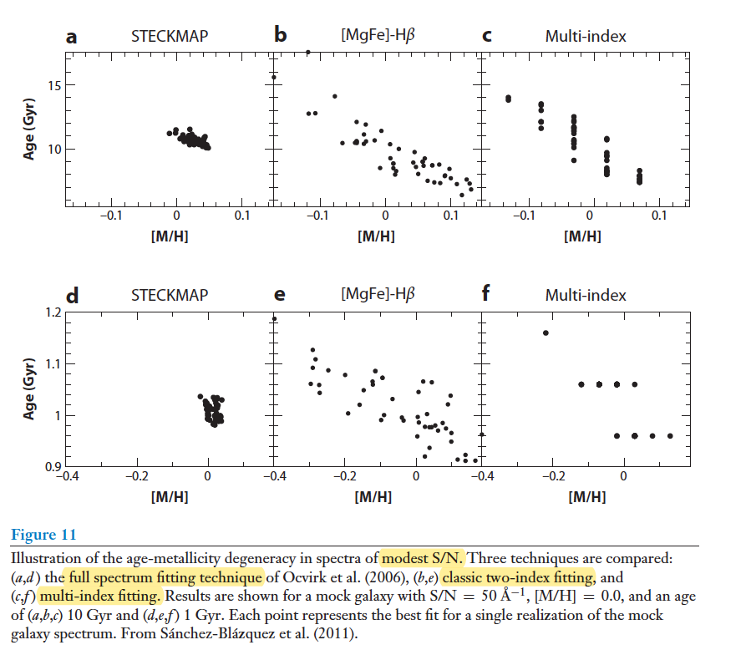
a clean separation of age and metallicity can be achieved with Lick indices only for data of very high S/N
full spectral fitting offers a much more robust separation
Notes:
much more information is available in the full optical spectrum than
can be captured by a limited number of spectral indices.

Slide 13
5.2. Photometric Metallicities
Broadband optical-NIR color (e.g., B−R versus R−H).
age and metallicity can be separately constrained within the context of a particular SPS model, but the derived ages and metallicities will vary from model to model.
NIR light is heavily influenced by AGB stars for populations of moderate age, and so different treatments of this uncertain evolutionary phase cause substantial differences in the age-metallicity grids
Some studies take the even simpler approach of fixing the metallicity to the solar value: will generally affect other parameters
Notes:
were nearly orthogonal
that estimates of stellar metallicities were possible from photometric data
3. emphasized that different SPS models produce very different age-metallicity vectors in color-color space

Slide 14
5.3. Spectroscopic Metallicities
For a fixed population age, the strengths of the absorption features will depend not only on the overall metallicity, Z, but also on the detailed elemental abundance pattern.
Koleva08: investigated the accuracy of full spectrum fitting codes at recovering metallicities, BC03: large uncertainties; Vazdekis/MILES and PEGASE-HR models: ~0.14dex
Notes:
STELIB does not sample a wide enough range inmetallicity

Slide 16
5.4. Elemental Abundance Patterns
Trager2000: [Mg/Fe] exceeds zero and increases with galaxy velocity dispersion
Schiavon2007: [Ca/Fe] values close to zero.
Schiavon2007: [C/Fe] and [N/Fe] increased significantly with increasing luminosity
[Z/H] = [Fe/H]=A[$α$/Fe], A = 0.93,
Notes:
The iron abundance, [Fe/H], is often regarded as a proxy for the total
metallicity, Z, but as discussed above, the correspondence between these two quantities breaks
down for nonsolar abundance patterns.

Slide 17
Summary
The age-metallicity degeneracy can be robustly broken by considering the hydrogen Balmer lines in conjunction with iron features in moderate-resolution optical spectra.
[Mg/Fe], [C/Fe], [N/Fe], and [Ca/Fe] routinely measured from optical spectra.
Spectroscopic metallicities seem to be accurate at the ∼0.2-dex level

