Slide 1
Modeling the Panchromatic Spectral Energy Distributions of Galaxies
Charlie Conroy

Slide 2
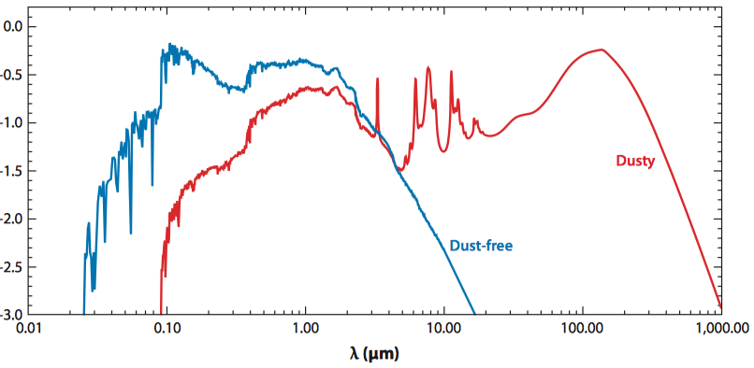
the star-formation history,
metal content,
abundance pattern,
dust mass,
grain size distribution,
stardust geometry
interstellar radiation ﬁeld.
The spectral energy distributions
SED
stellar population synthesis (SPS)

Slide 3
1. INTRODUCTION
star-formation history (SFH), stellar metallicity and abundance pattern, stellar initial mass function (IMF), total mass in stars, and the physical state and quantity of dust and gas.
These properties are encoded in their spectral energy distributions (SEDs).
each provides important clues regarding the formation and evolution of galaxies.
mixtures of stars in ad hoc ways until a match
incorporated physical constraints and automated ﬁtting techniques
relied on stellar evolution theory to constrain the range of possible stellar types at a given age and metallicity
the de facto standard in modeling the SEDs of galaxies
This modeling technique, evolutionary population synthesis, stellar population synthesis (SPS)
The UV and IR spectral windows: dust plays a major role; it absorbs and scatters much of the UV light emitted by stars and reradiates that energy in the IR.
UV:
young stellar populations:hot massive stars
old stellar populations:post–asymptotic giant branch (AGB) and extreme horizontal branch (HB) stars

Slide 4
Several broad questions will serve to focus this review : What have we learned about the physical properties of galaxies from their observed SEDs? How reliable are the quantities thus derived? What can be learned, in principle, from the SEDs of galaxies?
Wavelength: FUV (roughly the Lyman limit) --------------the submillimeter (approximately 1 mm)
Nebular emission lines
active galactic nuclei (AGN)
The technique of ﬁtting models Walcher et al. (2011)
evaluation and comparison of existing SPS models Conroy & Gunn (2010)
science results derived with SPS models Renzini (2006) and Blanton & Moustakas (2009)
Section 2: SPS model construction and application
Section 3: mass-to-light ratios and stellar masses
Section 4: star-formation rates (SFRs), histories, and stellar ages
Section 5: stellar metallicities and abundance patterns
Section 6: dust
Section 7: the IMF

Slide 5
2. OVERVIEW OF STELLAR POPULATION SYNTHESIS
simple stellar population (SSP), which describes the evolution in time of the SED of a single, coeval stellar population at a single metallicity and abundance pattern.
three basic inputs:
stellar evolution theory in the form of isochrones,
stellar spectral libraries,
an IMF.
difﬁcult in practice: incomplete isochrone tables, incomplete empirical stellar libraries, poorly calibrated physics
This approach to constructing SSPs is common but not universal.

Slide 6
Ingredients necessary for constructing simple stellar populations (SSPs)
Ingredients necessary for constructing composite stellar populations (CSPs)
Final CSPs both before and after a dust model is applied

Slide 7
2.1.1. Stellar evolution and isochrones.
An isochrone speciﬁes the location in the HertzsprungRussell (HR) diagram of stars with a common age and metallicity.
hydrogen burning limit (≈0.1 M ⊙ ) to the maximum stellar mass (≈100 M ⊙ ).
discretely sampled
isochrone tables
the Padova and the BaSTI models: The most popular models span a wide range of age (masses) and chemical composition and cover most relevant evolutionary phases.
Geneva models:high-mass stars
Y ² ,Dartmouth and Victoria-Regina models: main sequence, RGB, and HB evolution of low-mass stars
The Lyon : very-low-mass stars and brown dwarfs
Conroy & van Dokkum: low-mass stars
Schoenberner (1983), Vassiliadis & Wood (1994), and Bloecker (1995): the post-AGB evolutionary phase
no single set spans the necessary range of ages, metallicities, and evolutionary phases. It is common to use the Padova isochrones for the bulk of the age and metallicity range and to supplement with the Geneva models at young ages.
Little attention is normally paid to the lowest-mass portion of the isochrones, because low-mass stars contribute only ∼1% of the light of an old stellar population.
MESA will be employed to produce high-quality isochrones over the full age and metallicity range and for all evolutionary phases.

Slide 8
practical difﬁculty of implementing present isochrone libraries:uncertainties relevant to SPS
Convection:The ﬂuid element will likely have a nonzero velocity as it crosses this boundary, and so some amount of overshooting is expected. This will result in a larger convective region. ∼25% increase in the main sequence lifetime compared with models that do not include overshooting.
stellar rotation:rotation increases the main sequence lifetimes (by ∼25%) due to rotation-induced mixing bringing fresh fuel to the convective core.
binary systems:. The interaction of close binary stars via mass transfer and common envelope evolution will affect the evolution of such stars and bring about further changes to their observable properties. s the effects of binary star models without rotation are similar to single star models with rotation.
No popular SPS model includes the effects of binary star evolution.
thermally pulsating (TP-)AGB stars: When the helium shell burns, it does so explosively because of a thin shell instability which gives rise to thermal pulses. controversial topic.
Mass-loss: At M < 8 M ⊙ , massloss determines when a star will end its life as a white dwarf, and how massive the white dwarf will be. At higher masses mass-loss can qualitatively alter the course of advanced evolutionary phases, especially at M > 40 M ⊙ .
2.1.2. Stellar remnants.
The relation between the initial, zero-age main sequence stellar mass and the ﬁnal remnant mass is not well constrained observationally, especially for massive stars.
In SPS models stellar remnants are usually included in the total stellar mass budget, and their contribution can be signiﬁcant.
Notes:
binary systems:Eldridge & Stanway (2012) argued that SPS models that include binary star evolution produced a better ﬁt to UV spectra of star-forming galaxies. Regardless of the details, it is clear that where massive stars matter in galaxy SEDs, the effects of both rotation and binary evolution will play an important role.
the mass-loss prescription is another free parameter in these models, and it is a critical one because it strongly affects the lifetimes of advanced (and luminous) evolutionary phases.

Slide 9
2.1.3. Stellar spectral libraries.
Stellar spectral libraries are required to convert the outputs of stellar evolution calculations—surface gravities, g, and effective temperatures, T _{eff} —as a function of metallicity Z, into observable SEDs.
theoretical or empirical, that covers the entire range of parameter space necessary for constructing SPS models. Stitching together various libraries, often of widely varying quality, is therefore necessary.
Theoretical libraries
Theoretical libraries offer the great advantage of densely covering parameter space, including spectral resolution, and of producing spectra that are not subject to observational issues such as ﬂux calibration and atmospheric absorption. The clear disadvantage is that the libraries are only as good as the input atomic and molecular parameters and the approximations made in the computation of the models,
The BaSeL atlas is almost universally used in modern SPS codes, despite the fact that the input theoretical spectra are now almost 20 years old.
This library is comprised of a variety of theoretical models, The broadband SEDs of the stars in this library have been modiﬁed to agree with observed UBVRIJHKL color–temperature relations for individual stars.

Slide 10
Empirical libraries
Empirical spectra of course do not suffer from issues with line lists, treatment of convection, etc., but they are plagued by standard observational constraints such as correction for atmospheric absorption, ﬂux calibration, and limited wavelength coverage and spectral resolution. the empirical libraries are woefully incomplete in their coverage of parameter space.
empirical libraries are drawn from samples of stars in the Solar Neighborhood. hot main sequence stars at low metallicity are very rare, as are stars in rapid phases of stellar evolution such as WR and TP-AGB stars.
Later optical/NIR libraries, UV atlas, a TP-AGB library, the Spitzer Space Telescope IR stellar library
The Sloan Digital Sky Survey (SDSS) has obtained spectra of several hundred thousand stars and devoted considerable effort to measuring stellar parameters from the spectra . As yet, there is no ofﬁcial stellar spectral library based on the SDSS stars, but it would clearly provide a great leap forward in terms both of coverage in parameter space and of uniformity in spectral quality.
irregular coverage in the HR diagram. Interpolation within the library, necessary for SPS model construction, can be difﬁcult.
A third problem associated with empirical libraries is the assignment of physical parameters to stars, including log g, T _{eff} , and [Fe/H].

Slide 11
the lower main sequence and RGB are well covered by the empirical library over a wide range in metallicity, hotter stars are rare, especially at lower metallicity. Because the HR diagram is covered so sparsely in this regime, constructing SPS models based on empirical libraries at young ages ("1 Gyr) is clearly challenging.

Slide 12
2.1.3.4. Variable abundance patterns.
To construct models with arbitrary abundance patterns, one would want to create synthetic spectra for each possible abundance pattern. When considering large numbers of elements, such an approach becomes computationally infeasible. Instead, the standard technique is to create arbitrary abundance patterns by treating the effect of each element on the spectrum as being independent of the other
Notes:
elements This is a reasonable assumption for trace elements, but it is less realistic for elements such as C, N, O, Na, Ti, and Fe, which affect the opacity, free electron density, and/or molecular equilibrium. There has been surprisingly little work in the literature testing this assumption.

Slide 13
2.1.4. The initial mass function.
The initial distribution of stellar masses along the main sequence, known as the stellar IMF.
there is no compelling evidence for variation in the IMF from direct probes, e.g., star counts.
the IMF (a) determines the overall normalization of the stellar mass-to-light ratio, M/L; (b) determines the rate of luminosity evolution for a passively evolving population; (c) affects the SED of CSPs; and (d ) has a small effect on the shape of the SED of single stellar populations.
the ﬁgure demonstrates quantitatively that low-mass stars dominate both the stellar mass and the number of stars in a galaxy but contribute only a few percent to the bolometric light of an old stellar population.

Slide 14
2.2. Dust
Interstellar dust is a component of nearly all galaxies, especially those that are actively star-forming. Dust plays a dual role in SPS, both as an obscurer of light in the UV through NIR and as an emitter of light in the IR.
Attenuation.
Dust grains obscure light by both absorbing and scattering starlight.
In the MW and LMC the only striking feature in the extinction curve is the broad absorption at 2,175 A. This feature is absent in three out of four sightlines to the SMC, and it is weaker in the LMC than in the MW.
The grain population responsible for this feature is not known, but polycyclic aromatic hydrocarbons (PAHs) are a leading candidate . In general, dust extinction is a consequence of the optical properties of the grains and the grain size and shape distribution
the relevant concept is dust attenuation, which differs from extinction in two important respects: (a) light can be scattered both out of and into a given and (b) the geometrical distribution of dust with respect to the stars strongly affects the resulting SED
The simplest dust geometry, that of a homogenous foreground screen

Slide 15
2.2.2. Emission
Beyond λ ∼ 10 µm, the SEDs of normal galaxies are dominated by emission from dust grains.
A variety of models exist that combine grain size distributions and grain optical properties with models for starlight (or simply the radiation ﬁeld) to predict IR emission.
2.2.3. Dust around asymptotic giant branch stars.
Stars experience very high mass-loss rates as they climb up the AGB The mass lost is observed to be dust-rich. These stars are often heavily dust obscured in the optical and emit copiously in the IR.
It will diminish the importance of AGB light in the optical and NIR, and it will contribute additional ﬂux in the mid-IR beyond what would be expected from standard dust models.

Slide 16
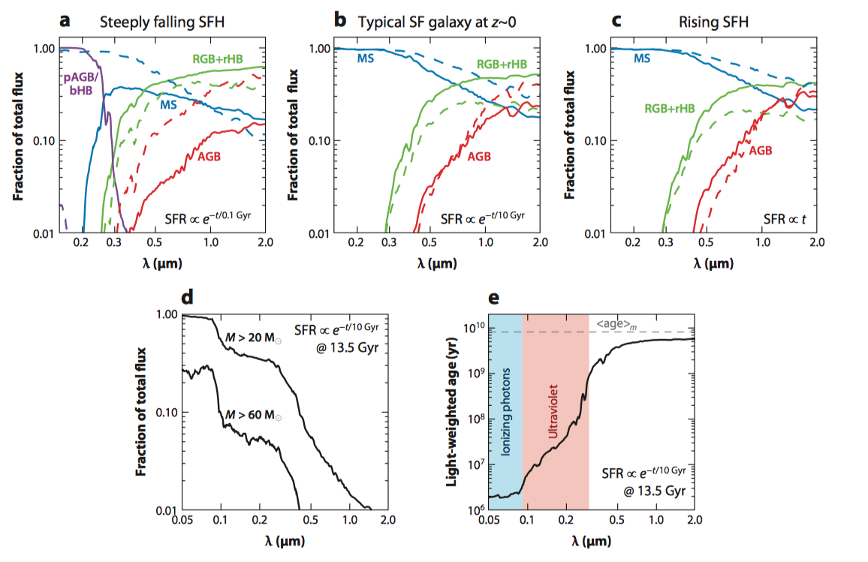
2.3. Composite Stellar Populations
Notes:
At late times the RGB and red HB dominate the red and NIR ﬂux of τ-model SFHs, as is well known. However, at young ages and/or for rising SFHs, the red and NIR are also inﬂuenced strongly by AGB stars, suggesting that the NIR can be susceptible to large uncertainties (due to uncertainties in the modeling of the AGB,
Already by 0.5 µm (approximately the V-band), the light-weighted age reaches its maximal value, again suggesting that going to redder restframe wavelengths is not providing substantial new information on the SFH.

Slide 17
3. MASS-TO-LIGHT RATIOS AND STELLAR MASSES
3.1.1. Color-based M/L ratios
SPS model to chart out the relation between M/L and color as a function of metallicity and SFH.
optical-NIR SEDs of ∼12,000 galaxies with SDSS and 2MASS photometry. They constructed a grid of SPS models with varying SFHs, including bursts, and metallicity. They did not allow for reddening due to dust. They derived best-ﬁt M/L values from SED ﬁtting and created new, observationally constrained color-M/L relations.
TP-AGB evolutionary phase
a large difference in M/L H ratios estimated from i−H colors between the new Charlot & Bruzual models and the previous version with typical offsets of 0.2–0.4 dex. This difference is largely due to the different treatment of the TP-AGB evolutionary phase
In contrast, optical color-M/L relations showed little difference between the two SPS models and also showed slightly less discrepancy with Bell et al. (2003). These researchers argued that optical color-M/L relations should generally be preferred to NIR-based ones owing to the larger impact of the uncertain TP-AGB phase in the NIR.

Slide 18
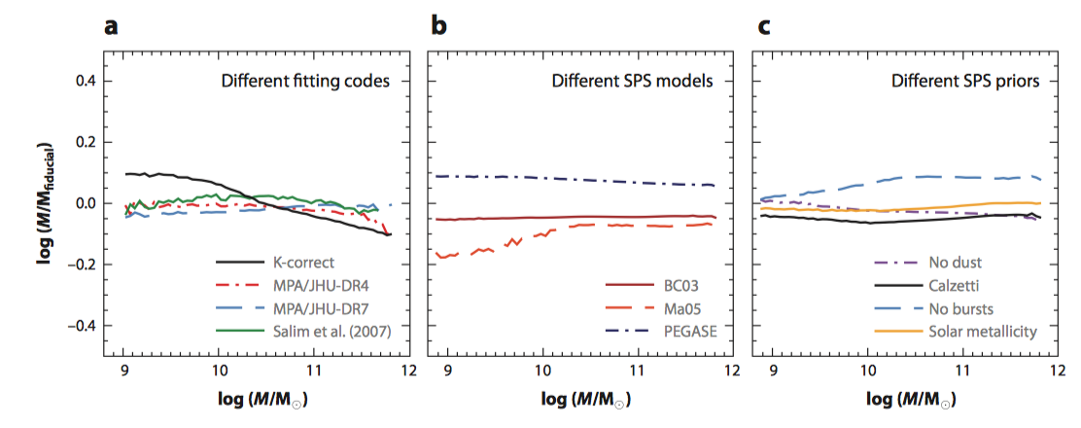
M/L ratios for most galaxies with normal SEDs are probably accurate at the ∼0.3 dex level, for a ﬁxed IMF, with the majority of the uncertainty dominated by systematics (depending on the type of data used).

Slide 19
3.1.2. M/L from broadband and spectral ﬁtting techniques.
when ﬁtting broadband SEDs, one ﬁnds that stellar masses for “normal” galaxies can be recovered at the ≈0.3 dex level (1σ uncertainty).
Stellar masses appear to be the most robust parameter estimated from SED ﬁtting
The reason for this is not fully understood, although it probably is at least partly due to the fact that the dust reddening vector is approximately parallel to SFH and metallicity variations in color-M/L diagrams.
the sensitivity of derived stellar masses to uncertain stellar evolutionary phases, in particular the TP-AGB.
At ages where the TP-AGB phase is most prominent (∼3 × 10 ⁸ − 2 × 10 ⁹ year), Maraston’s model predicts approximately a factor of two more ﬂux at >1 µm compared with earlier work. Maraston et al. (2006) found that her SPS model implied a factor of two smaller stellar mass.
These researchers isolated the importance of the TP-AGB phase and conﬁrmed previous work indicating that the adopted weight given to this phase in the models can have a large modulating effect on the stellar mass.
The contribution of TP-AGB stars to the integrated light peaks at ∼3 × 10 ⁸ − 2 × 10 ⁹ year, depending on metallicity, and so the importance of this phase to modeling SEDs will depend on the SFH of the galaxy. It was for this reason that Maraston et al. (2006) focused their efforts on quiescent galaxies at z ∼ 2; at this epoch even a quiescent galaxy will have a typical stellar age no older than several gigayears.
Notes:
he effect of TP-AGB stars is limited to galaxies of a particular type, in particular those that are dominated by stars with ages in the range ∼3×10 8 −2×10 9 year. Examples include poststarburst galaxies, which are rare at most epochs, or quiescent galaxies at z # 2. For typical galaxies at z ∼ 0, the treatment of this phase seems to be of little relevance for estimating stellar masses, at least on average,

