Slide 1
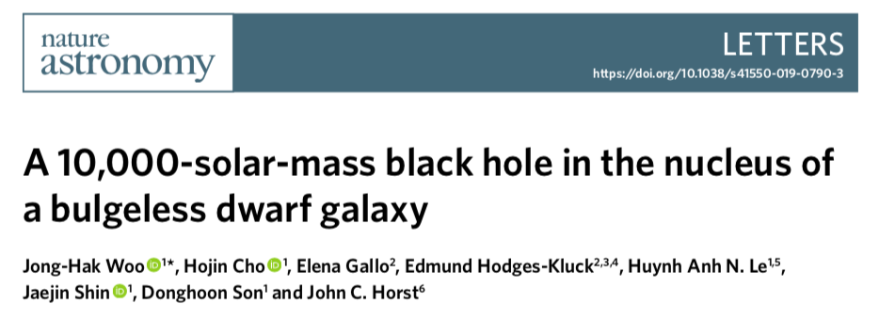
NGC 4395
8×10⁸M⊙ Seyfert I
Least luminous AGN known to date
“containing one of the smallest SMBH (3×10⁵M⊙ )”

Slide 2
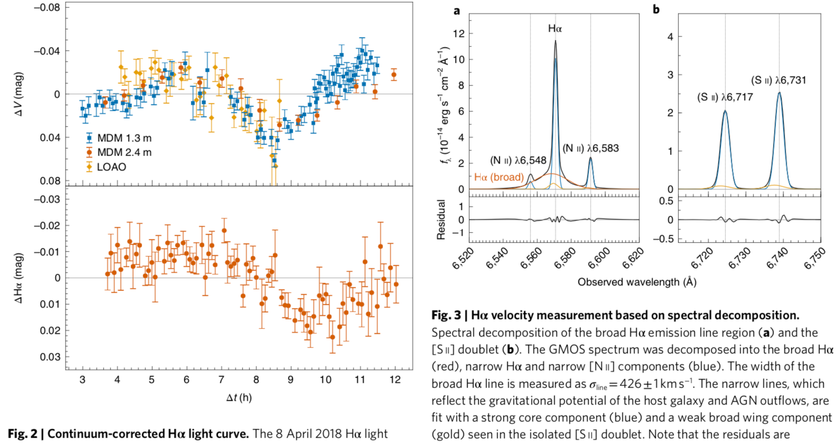
σ_{line}=426±1kms⁻¹
σ★ = 18 ± 1 km s⁻¹
τ = 83 ± 14 min

Slide 3
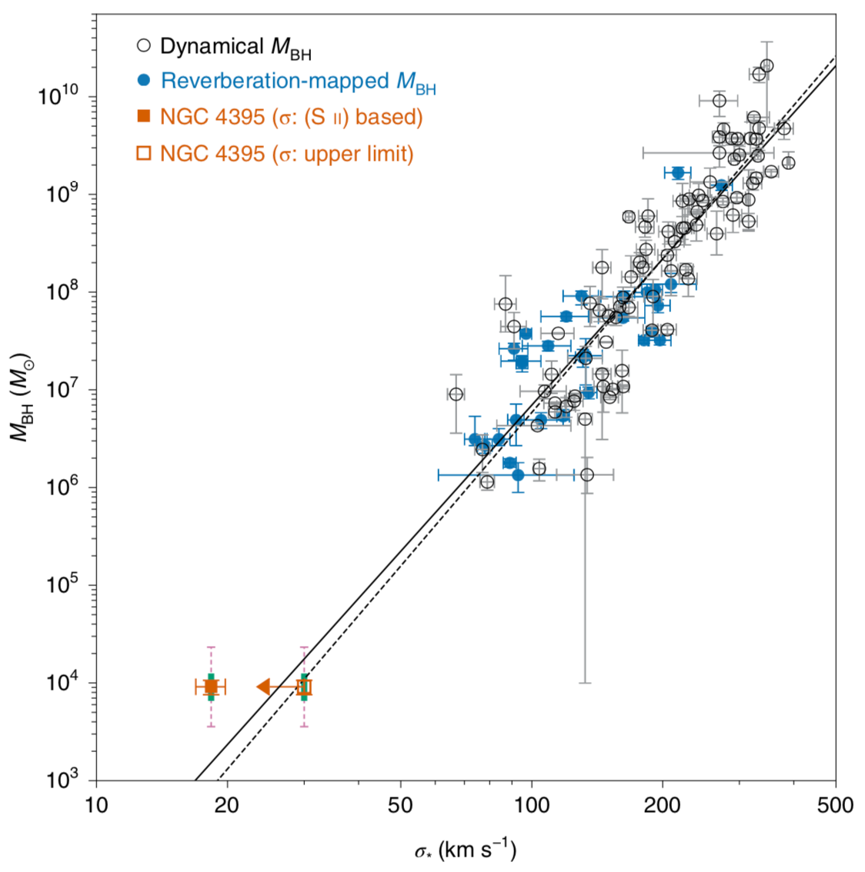
Previous measurements:
Reverberation σ_{CIV} ≈ 2,900 km s⁻¹ ,f=5.5 line profile is far from Gaussian remeasure : σ_{CIV} ≈ 1,500 km s⁻¹ ,f=1.1
Modelling the nuclear molecular disk nuclear star cluster dominates the mass accretion disk is a point source with a similar luminosity
Origion of M_{BH}–σ★ relation:
hierarchical assembly ?
AGN feedback ?
Light seed (10² ~10³ M⊙ )
Heavy seed (10⁴ ~10⁶ M⊙ )

